Slide 1
Cultural values
Created: Sápi Vivien és Ficzek Réka

Slide 2
Easter habits

Slide 3
Sprinkling
This habit looks back at an old rural habit. On Easter Monday, the young leges poured a bucket of water into the girls who reached the age when they able to marry a man.

Slide 4
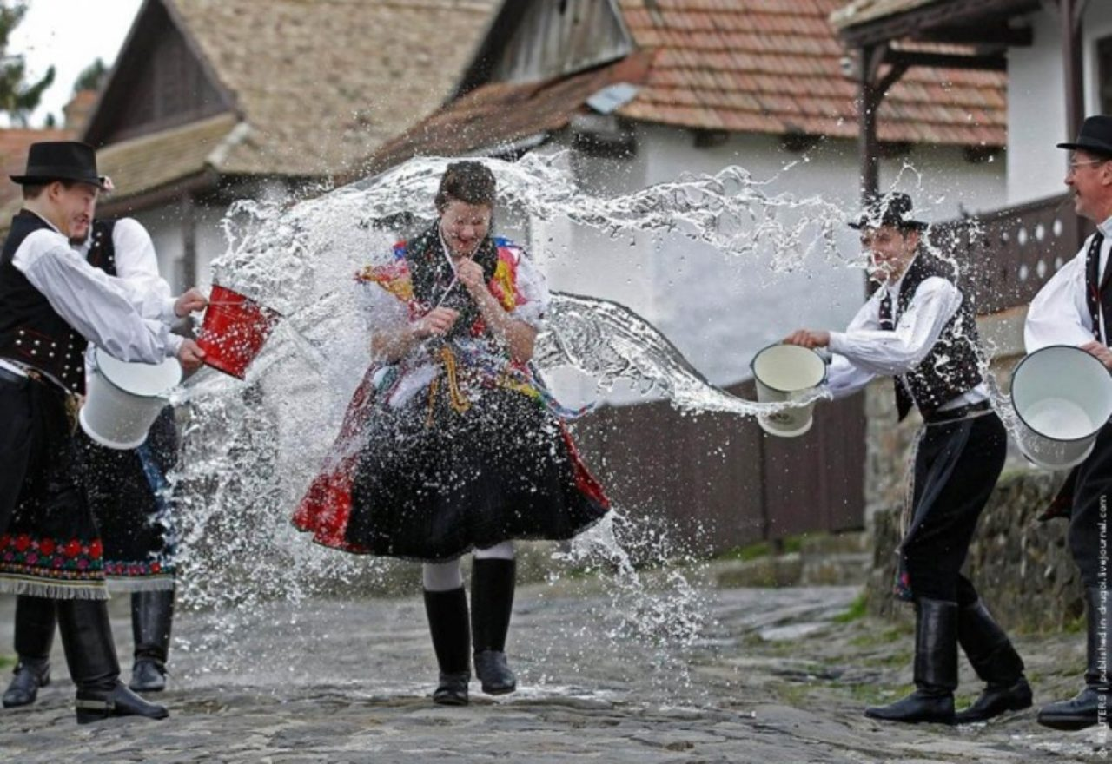
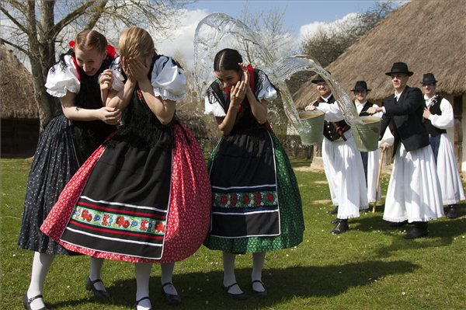

Slide 5
Carnival Habits

Slide 6
Busowalk
This time, people hide behind a sheepskin and a terrific, wooden mask, cling with clicker and other things, and marched along the street and spreading ashes on the powder hoping to keep the bad spirits away. In the end of the carnival the straw puppet symbolizing the "death" of the winter will be burned or threw in a river.

Slide 7
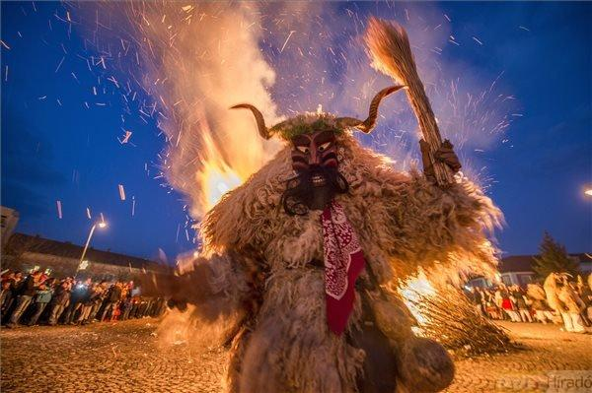
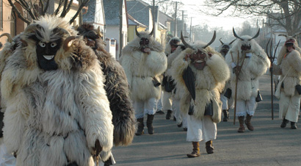

Slide 8
Spa’s
There is a spa in all regions of Hungary. Budapest is the only capital of the world where there is a spa.

Slide 9
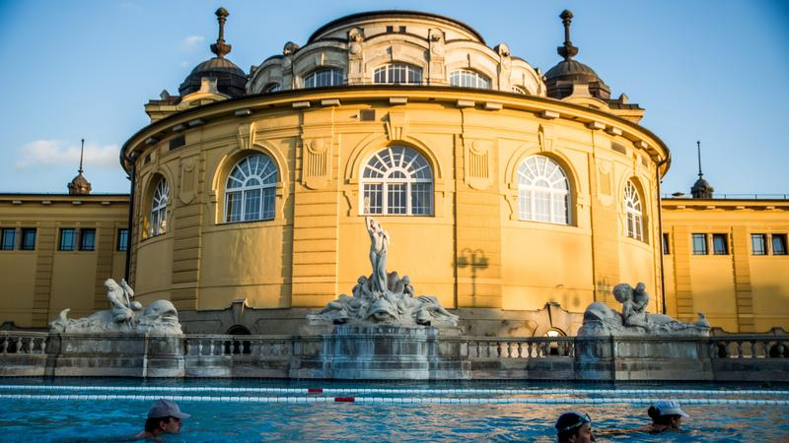
Well-known Spas
Hévíz Healing Zsóry Spa Széchenyi Thermal Baths

Slide 10
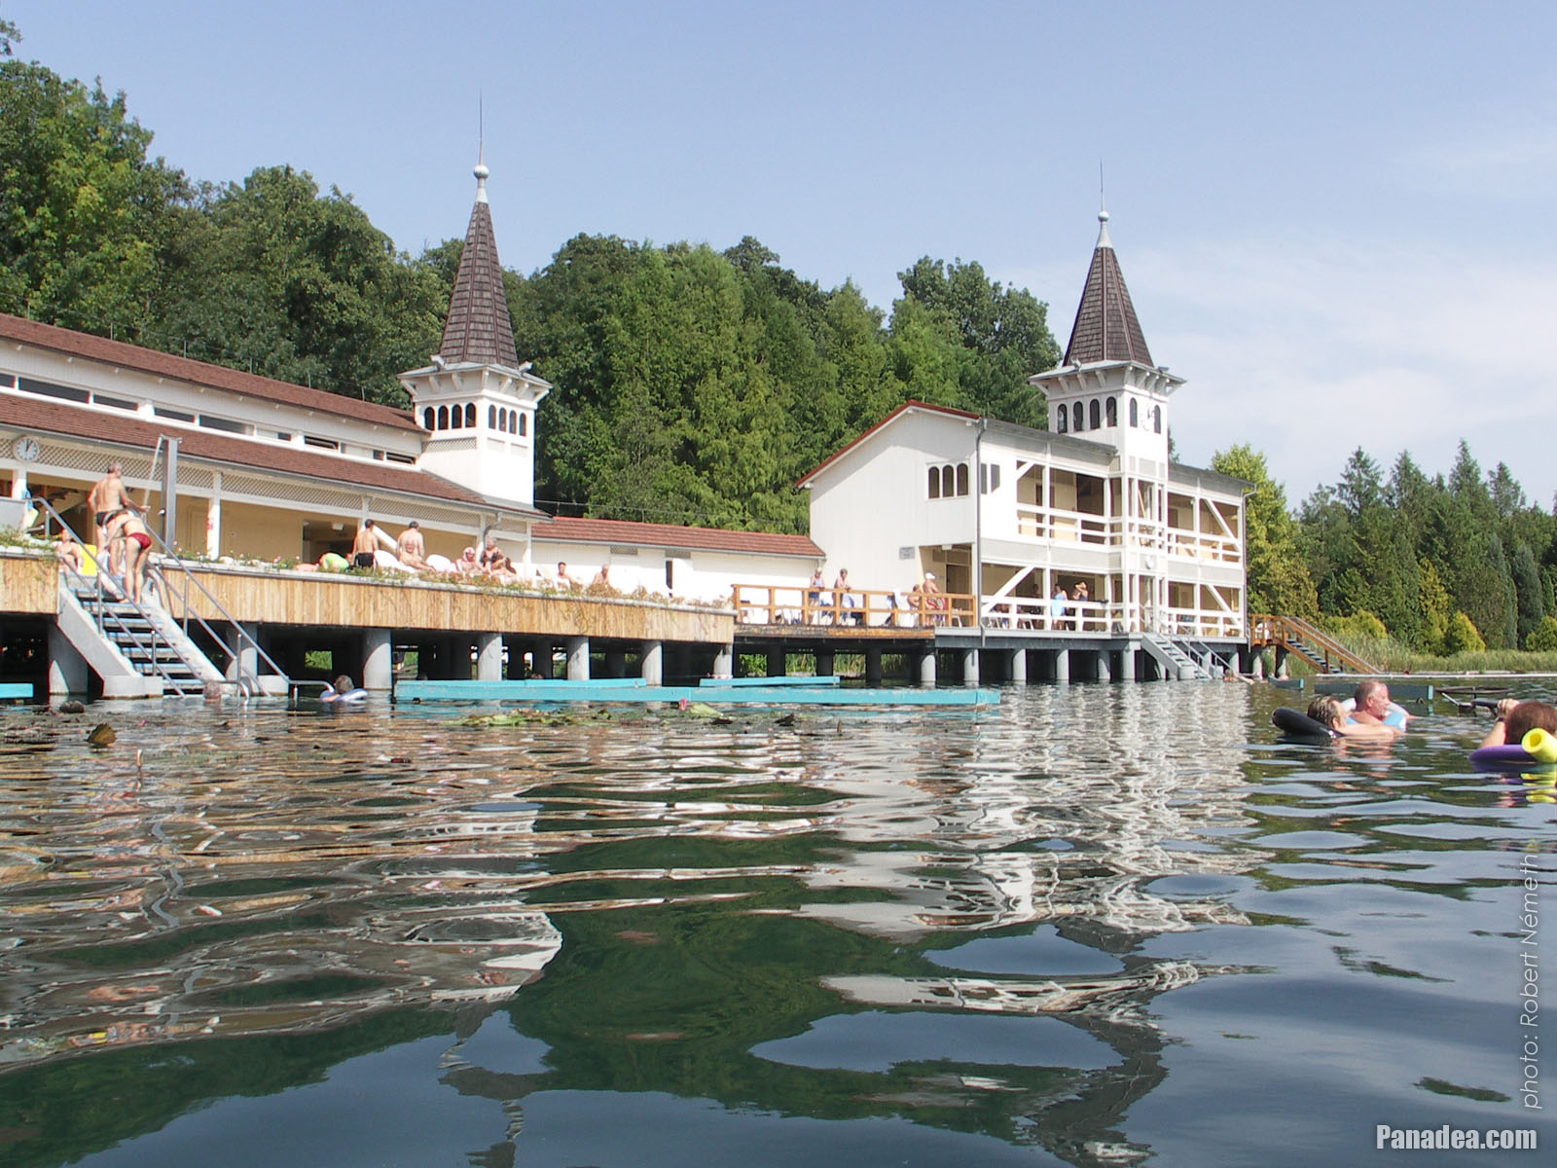
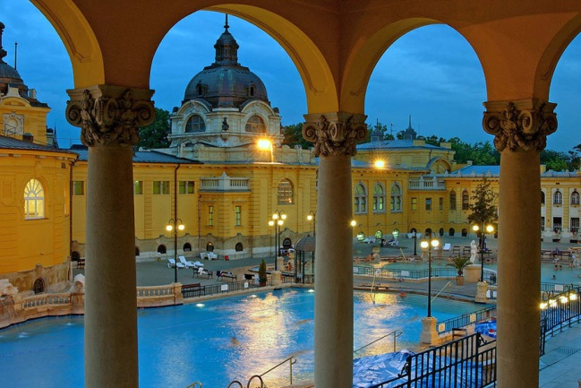

Slide 11
The Hungarian Hussar
For us, the national emblem in whom we see the revival of the ancient Hungarian equestrian warrior in the age of firearms. The Hungarian Hussar is the Hungarian light rider who, in the last half millennia, has been there in the Turkish wars for his family stove, his motherland, for the protection of his national rights in the anti-Habsburg fights, the ruler of dynastic wars Caller's word.

Slide 12
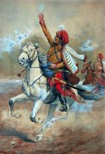
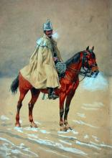

Slide 13
The Hungarian Ranch
The ranch is a uniquely typical rural settlement of the Allanthe Hungarian Ranch, as it is an area inhabited by the outskirts of the region. The old name of the ranch was the accommodation, the scattered, lonely colonies of the Great Plains, which are mostly the management centres.

Slide 14
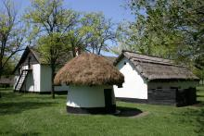
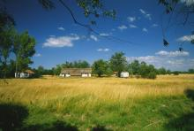

Slide 15
THE MATYÓ FOLK ART
The 19th In the late century, a patchwork of free-form embroidery was developed, which is used in interior textiles as well as canvas and leather wear. Among the countless motifs, matyó style roses are the most characteristic.

Slide 16
THE BENEDICTINE ABBEY AND THE NATURAL ENVIRONMENT OF THE THOUSAND-YEAR-OLD PANNONHALMA
The Benedictine abbey of Pannonhalma has evolved in both its architectural structure and the idem world. Its library of more than 300 thousand volumes today is the world's largest Benedica collection. The Archabbey Archives preserve the founding diploma of the Tihany Abbey.

Slide 17
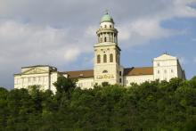
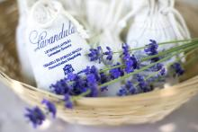

Slide 18
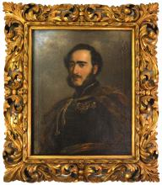
EARL ISTVÁN SZÉCHENYI'S INTELLECTUAL LEGACY
His exemplary patriation, his belief in advancement, his willingness to sacrifice, his willpower, and not least his practical creations have been one of the greatest personalities of Hungarian history.

Slide 19
Halashi Lace
Preparation is very meticulously, time consuming. It requires a hundred percent manual work, which is carried out with a snow-white, with a breath-fine thread and an almost invisible needle.

Slide 20
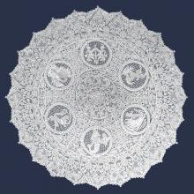
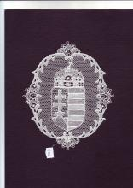

Slide 21
Famous Porcelains
Porcelain of Herend
Porcelain by Hollohaza

Slide 22
Hungarian Culture Day

Slide 23
Task for presentation
https://create.kahoot.it/share/magyar-kulturalis-ertekek/004c36c6-6c11-42ca-865b-33b33074c2e9

Slide 24
Thank you for your attention!

