Slide 1
TURKEY’S
ARCHITECTURE
FEATURES
WORKS KNOWN AS CULTURAL HERITAGE

Slide 2
TURKEY’S GENERAL ARCHITECTURE
Turkey, which has hosted different cultures throughout history with the return of its geographical location, but also undertaking a bridge between Europe and Asia and is therefore quite who incorporates different cultural structures of one of the unique geography. In addition to this, every region of Turkey draws different profiles from each other in terms of both a geographic and climatic conditions and cultural richness that adds to the overall culture of Turkey.

Slide 3
In this geography, which is considered as a cradle where quite different civilizations come together, the richness of the concepts created and developed with culture such as lifestyle, art and architecture cannot be ignored. Especially when it comes to architectural construction of Turkey's possible to meet with the architecture around with different qualities to the fore. Both the periodical as well as possible to examine regional differences in Turkey showing different categories of architecture.

Slide 4
In their homeland in Central Asia, Turks lived in dome-like tents appropriate to their natural surroundings, and they were nomads. These tents later influenced Turkish architecture and ornamental arts. At the time when the Seljuk Turks first came to Iran, they encountered an architecture based on old traditions. Integrating this with elements from their own traditions, the Seljuks produced new types of structures. The most important type of structure they formulated was the" medrese"( Muslim theological schools) .

Slide 5
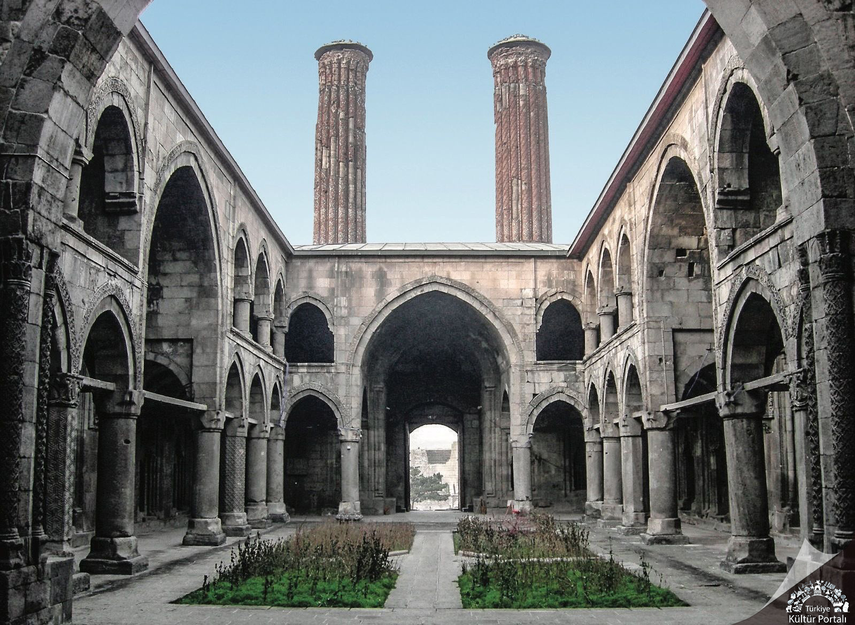

Slide 6
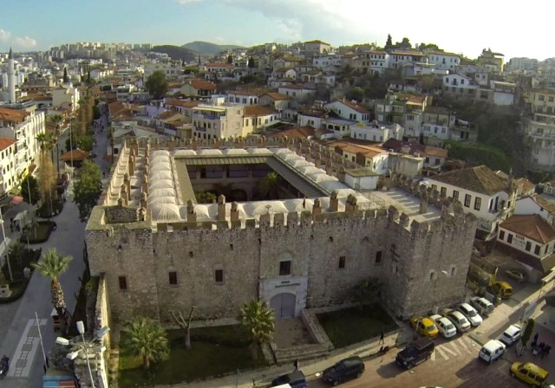
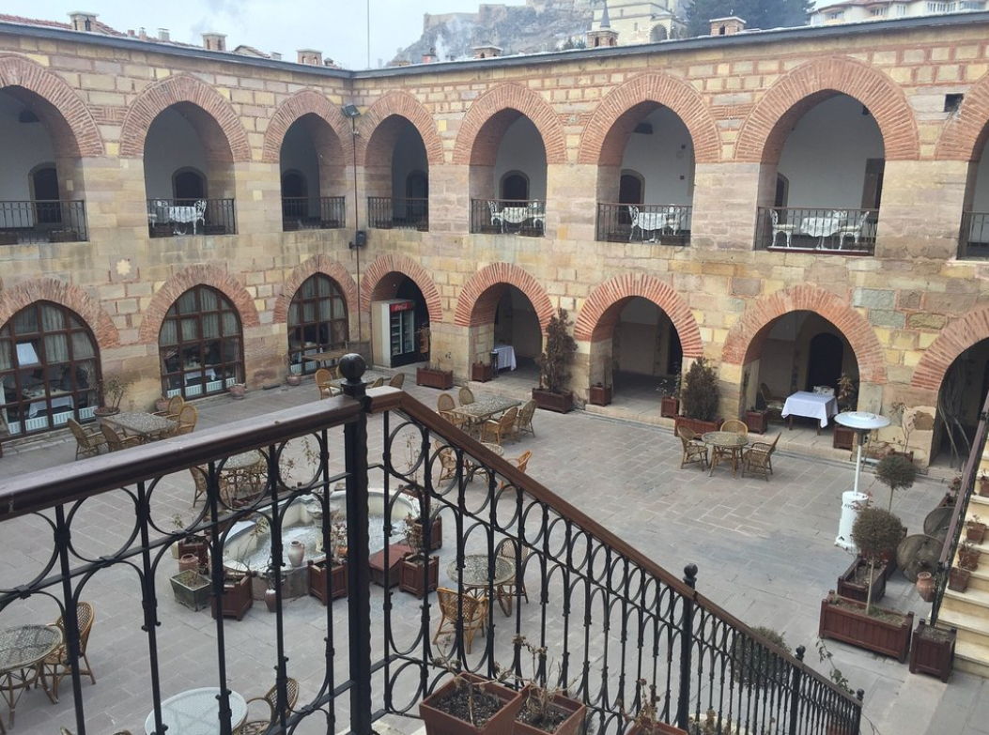
The Ribati- Serif and The Ribati Anasirvan are examples of surviving 12th century Seljuk Caravanserais, where travelers would stop over for the night.

Slide 7
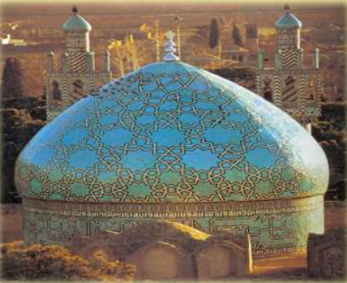
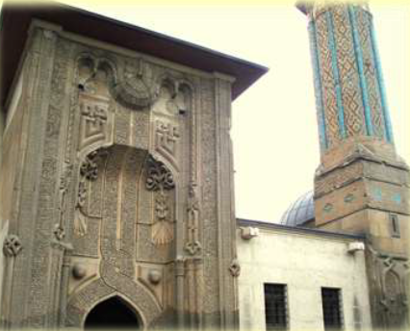
In Seljuk buildings, brick was generally used, while the inner and outer walls were decorated in a material made by mixing marble, powder, lime and plaster.

Slide 8
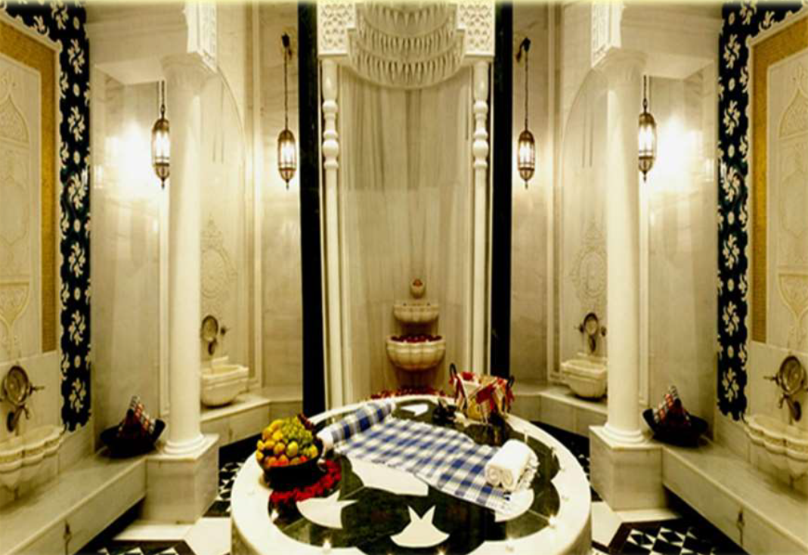
The Ottomans integrated mosques into the community and added soup kitchens, theological schools, hospitals, Turkish baths and tombs.

Slide 9
Turkish Art
Turkish art refers to all works of visual art originating from the geographical area of what is present day Turkey since the arrival of the Turks in the Middle Ages. Turkey also was the home of much significant art produced by earlier cultures, including the Hittites, Ancient Greeks, and Byzantines.
The 16th and 17th centuries are generally recognised as the finest period for art in the Ottoman Empire, much of it associated with the huge Imperial court. Apart from Ottoman architecture and Ottoman illumination of manuscripts the most important media were in the applied or decorative arts rather than figurative work. Pottery, especially İznik pottery,

Slide 10
İznik poteery

Slide 11
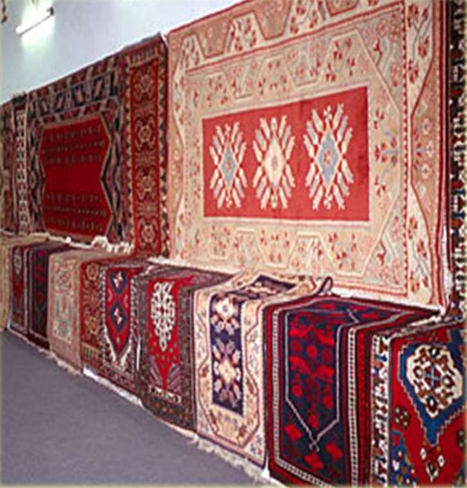
hardstone carvings, Turkish carpets and textiles were all produced to extremely high standards.

Slide 12
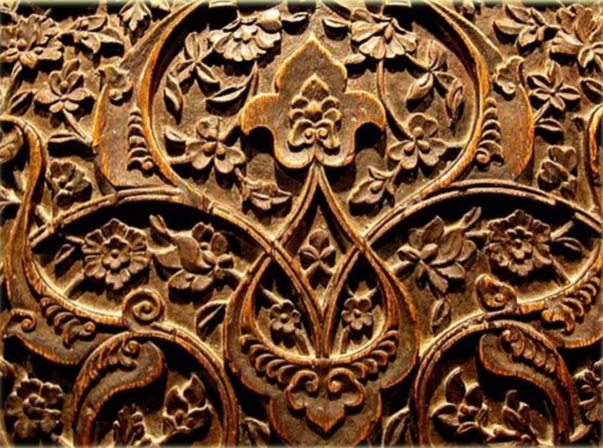
Turkish wood carving art

Slide 13
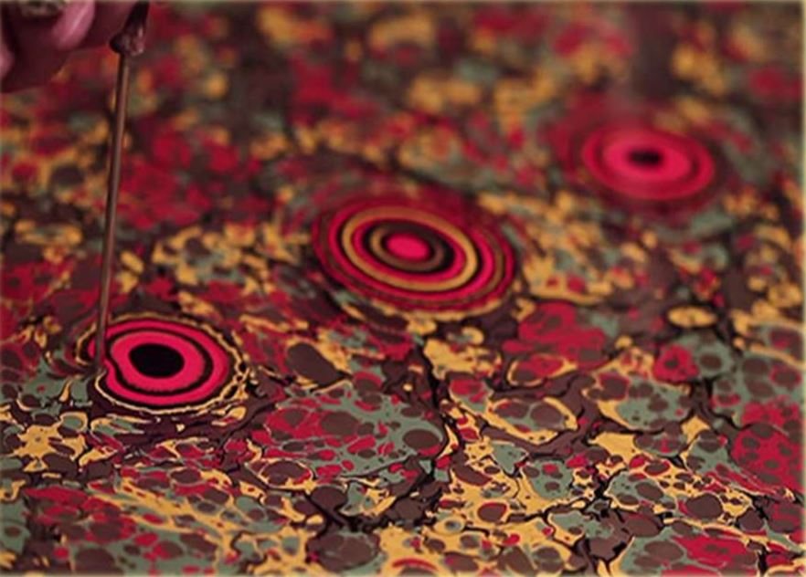
Other Turkish art ranges from traditional Ebru (The art of marbling on paper, or 'ebru' in Turkish, is a traditional decorative form employing special methods) to Western style paintings.

Slide 14
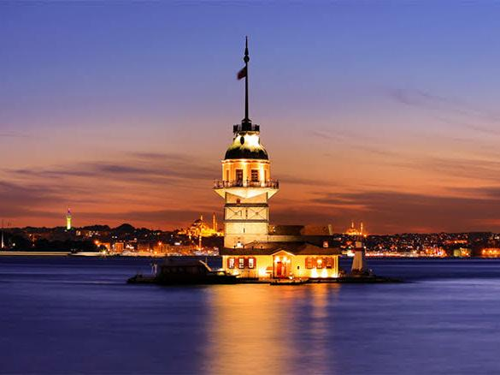
MAIDEN’S TOWER
One of the most iconic images of Istanbul surely has to be the Kız Kulesi Üsküdar, known in English as Maiden’s Tower, Tower of Leandros, Leander’s Tower or Bosphorus Tower. It is found on a small natural islet in the Bosphorus, just off the shore of Asian Istanbul. The first tower here was built by an Athenian commander during the 5th century.

Slide 15
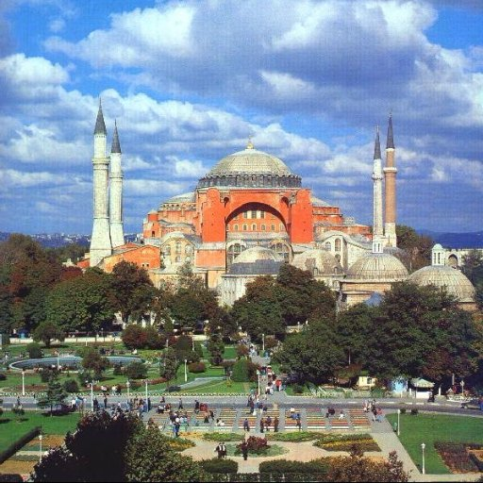
HAGIA SOPHIA
Hagia Sophia is a historical museum in Istanbul. It was built by Byzantine Emperor Justinian I in the old city center on the historical peninsula of Istanbul between 532-537. Since 1935 it has been serving as a museum.

Slide 16
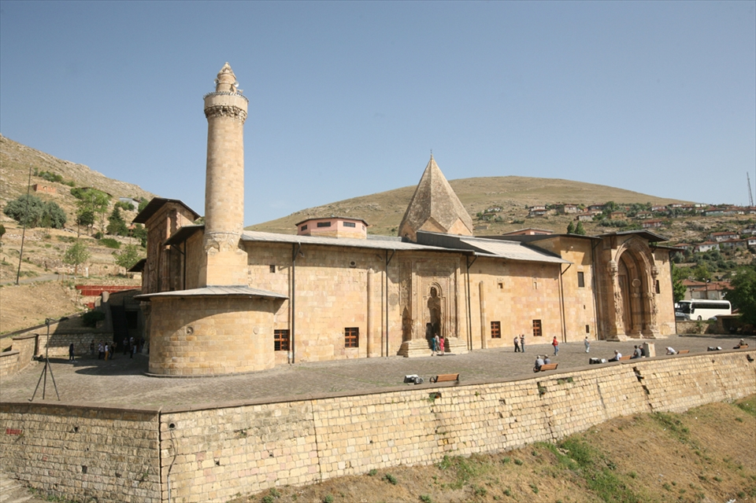
DIVRIGI ULU MOSQUE
Great Mosque and Hospital of Divrigi, historical mosque and hospital in Divrigi district of Sivas. The mosque was built by Mengücekli bey Ahmed Shah in 1228-29; The Great Mosque and Hospital of Divrigi was included in the UNESCO World Heritage List in 1985.

Slide 17
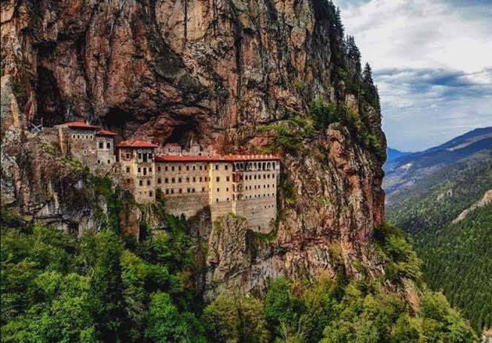
SUMELA MONASTERY
Sümela Monastery is an ancient Greek Orthodox monastery and church complex at the height of 1.150 m above sea level on the hill of Kara (Ancient Greek name: Mela) on the western slopes of the creek (Ancient Greek name: Panagia), which is located within the borders of Altındere valley in Maçka district of Trabzon province.Its name is Panagia Sumela (Παναγία Σουμελά) or Theotokos Sumela.

Slide 18
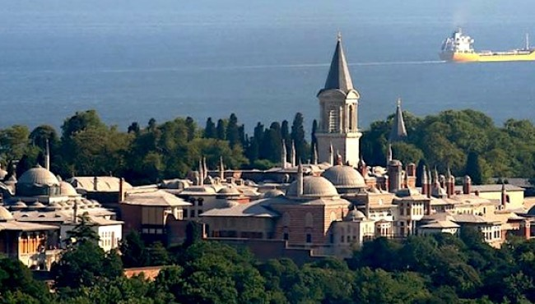
TOPKAPI PALACE
Topkapı Palace is the Ottoman Empire's 600-year history of 400 years, used as the administrative center of the state and the palace of the Ottoman sultans lived in. Nearly 4,000 people lived in a time. Topkapi Palace was built in 1478 by Fatih Sultan Mehmed.

Slide 19
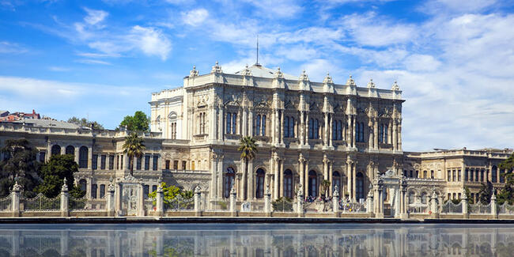
DOLMABAHÇE PALACE
Dolmabahçe Palace is an Ottoman palace in Istanbul, Besiktas, on an area of 250,000 m² between Dolmabahçe Street, which extends from Kabataş to Besiktaş, and the Bosphorus. It is located on the left bank at the entrance to the Bosphorus by sea from the Sea of Marmara, opposite Üsküdar and Salacak. Construction started in 1843 and finished in 1856.

Slide 20
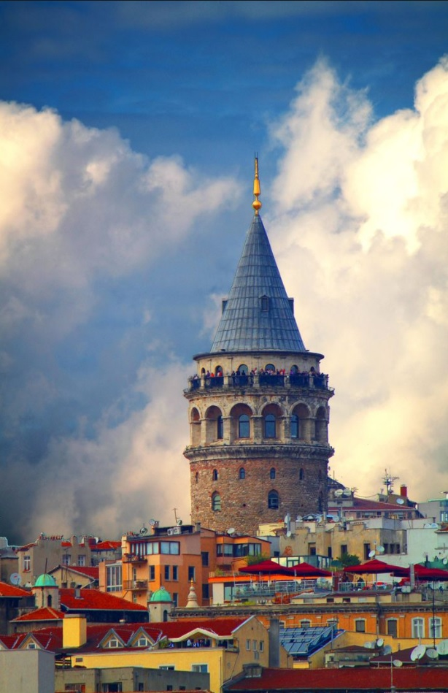
GALATA TOWER
Galata Tower is a tower located in the Galata district of Istanbul. Built in 528, it is one of the most important symbols of the city. The Bosphorus and the Golden Horn can be viewed from the tower. In 1348, it was rebuilt by the Genoese in addition to the walls of Galata by using masonry stones called Isa Tower.

Slide 21
The master architect of the classical period, Mimar Sinan, was born in 1492 in Kayseri and died in Istanbul in the year 1588. Sinan started a new era in the world architecture, creating 334 buildings in various cities. His style was to have a considerable influence on future epochs.

Slide 22
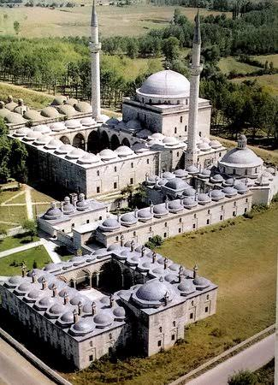
EDIRNE BAYEZID COMPLEX
"Sultan Bayezid II Complex Health Museum", "Edirne Health Museum", Edirne, the Second Beyazit Complex of the Darussifa and Medical madrasah structures, serving within the structure of the University of Trakya Darüssifaa (hospital since 1488) ), 1877-1878 until the Ottoman-Russian War for 400 years incessantly before all kinds of patients; Later, it was a health institution that only served mental and mental patients.

Slide 23
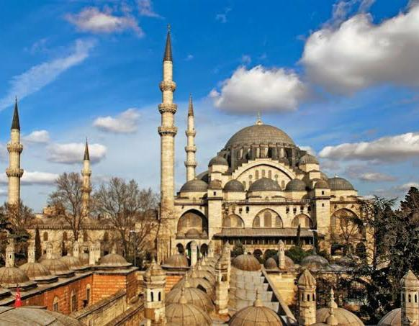
SULEYMANIYE MOSQUE
Süleymaniye Mosque was built by Mimar Sinan in 1551-1557 on behalf of Suleiman the Magnificent. Suleymaniye Mosque, which is described as the work of Mimar Sinan for the journeyman, was built as a part of the Suleymaniye Complex, which consisted of madrasahs, library, hospital, medical school, Turkish bath, imaret, graveyard and shops.

Slide 25
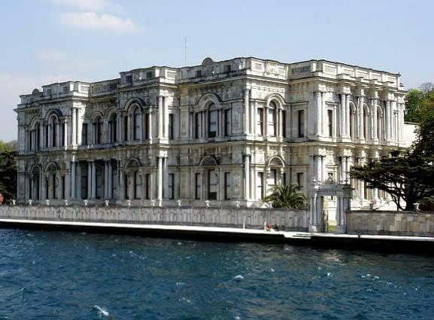
BEYLERBEYI PALACE
Beylerbeyi Palace was built by Sultan Abdulaziz in 1861-1865 by architect Sarkis Balyan in Beylerbeyi district of Uskudar district of Istanbul. Sultan IV. Murad was born in this palace.

Slide 26
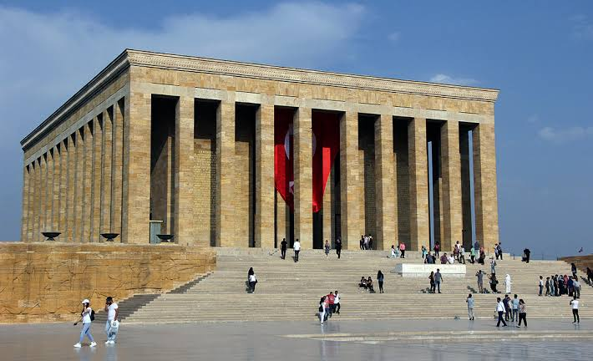
ANITKABIR
Anitkabir, the Turkish Independence War, Revolution and the leader of Turkey's first president, Mustafa Kemal Ataturk, in Ankara Anıttepe (formerly the Rasattepe) is the mausoleum. In addition, the fourth president Cemal Gürsel was buried in the martyrs section of the revolution in 1966.

Slide 27
Mimar Sinan - Kız Kulesi - Topkapı Palace - Hagia Sophia - 1985 - Anıtkabir - Genoese - 1.150 - Dolmabahçe Palace - Edirne Bayezid Complex - Sultan Abdulaziz - Sultan IV. Murad
1-).......... known in English as Maiden's Tower.
2-).......... was built between 532-537.
3-)Divriği Ulu Mosque was included in the UNESCO World Heritage List in .....
4-)Sumela Monastery is at the height of .... above sea level.
5-)Nearly 4.000 people lived in a time in ........ .........
6-).......... .......... on an area of 250.000m².
7-)Galata Tower was rebuilt by ......... in 1348.
8-)After war , ......... ........... ......... was a health institution that only served mental and mental petients.
9-)Süleymaniye Mosque was built by ......... ...........
10-)Beylerbeyi Palace was built by .......... .......... and ......... .... ........ was born in this palace.
11-)Mustafa Kemal Atatürk's grave is in the ...........

Slide 28
Read the sentences and say ‘True’ to the correct ones and ‘False’ to the wrong ones.
1-)Since 1923, Hagia Sophia has been serving as a museum.
2-)DivriGi Ulu Mosque was built by Mengücekli bey Ahmed Shah.
3-) Dolmahabçe’s construction started in 1843 and finished in 1856.
4-) Topkapi Palace was built in 1478 by Sultan IV. Murad.
5-) Galata Tower is one of the most important symbols of the Ankara.
6-) Süleymaniye Mosque was built by Mimar Sinan in 1551-1557 on behalf of Suleiman the Magnificent.

Slide 29
When was Beylerbeyi Palace build?
A) 1923-1935
B) 1861-1865
C) 1551-1557
D) 532-537

Slide 30
Answer : B

Slide 31
Which one was included in the UNESCO World Heritage List in 1985?
A) Edirne Bayezıd Complex
B) Dolmabahçe Palace
C) Divrigi Ulu Mosque
D) Hagia Sophia

Slide 32
Answer : C

