Slide 1
Natural values of hungary
Created by: Vivien Mádi, Viktória Bodnár, Panna Málnás

Slide 2
Aggtelek National Park
Greatist stalactite cave of Hungary.
Several protected animals and plant species can be found here.
The National Park covers an area of 20170 hectares.
There are 280 small and large caves in the national park area.

Slide 3
Aggtelek National Park
The caves are also extremely diverse:
There are active streams among them
Vertical and cavern shafts
caves

Slide 4
Aggtelek National Park
About two-thirds of the internationally recorded basic types of carbonate precipitation can be observed in some caves: suspended and standing stalactites, stalactite columns, stalactite flags.

Slide 5
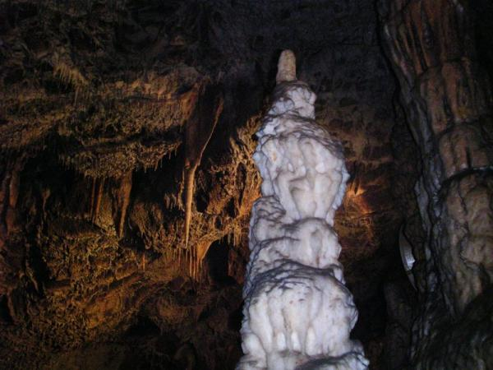
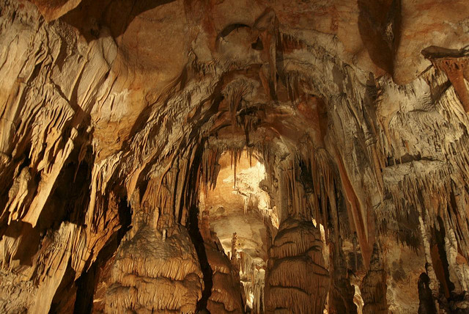
Aggtelek National Park

Slide 6
Duna-Ipoly National Park
It is one of the richest national parks in Hungary.
It was established in 1997, connected to the former Pilis and Börzsöny Landscape Protection Areas of the affected section of Ipoly.
Many species of animals and plants live here in Hungary.
Several programs have been launched to save rare, extinct species.

Slide 7
Duna-Ipoly National Park
Three large landscape units: the meeting point of river valleys, mountains and plains.
The 300- 350 springs of the mountain range feed streams.
The highest elevation, with a height of 757 meters at Pilis, is the highest elevation of the entire Dunazug mountain range.

Slide 8
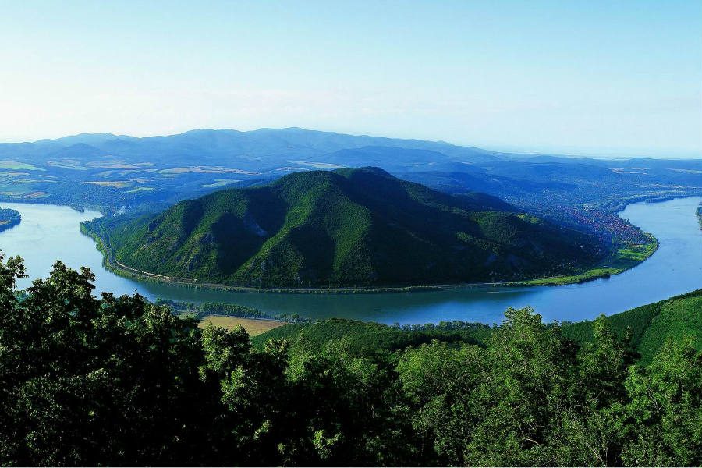
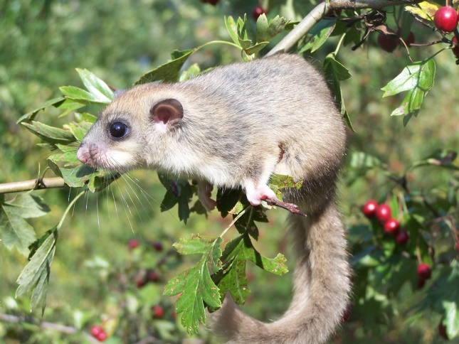
Duna-Ipoly National Park

Slide 9
Lake Hévíz
The most famous attraction of the Hévíz Lake is the Hévíz Lake or the Hévíz Spa Lake.
With its 4.44 hectares and 50 hectares of forests, the lake is Europe's largest medicinal hot water lake.

Slide 10
Lake Hévíz
The unique natural environment of the lake is made especially by the medicinal lake surrounded by the park, the humid layer floating above the water surface and the Indian red water lilies floating on the surface of the lake.
The temperature of the water has a calming effect on bathers and patients, because this temperature value is considered to be indifferent to the temperature of the person.

Slide 11
Lake Hévíz
In summer the water temperature is 33-35 ° C, but on very warm days it can reach 36-38 ° C.
In autumn and winter temperatures are lower, around 24-26.

Slide 12
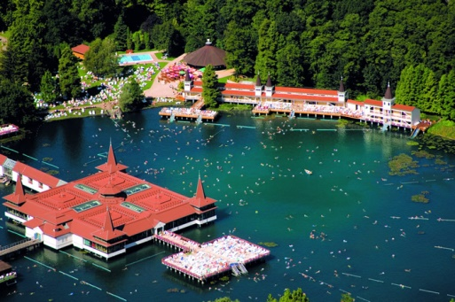
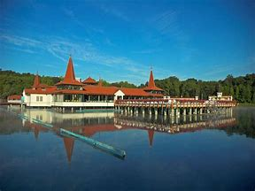
Lake Hévíz

Slide 13
Lake Tisza
It is the second largest lake and the largest artificial lake in Hungary on the Tisza, in the Northern Great Plain.
Its area is 127km, where open water surfaces, islands, backwaters and shallow canals change mosaically.
It has a length of 27km, an average depth of 1.3m, and its lowest point is 17m, with 43km of islands.

Slide 14
Lake Tisza
In 1973, the Kisköre Power Plant was built with the dam to control the Tisza floods and to improve the water supply of the Great Plain.
It was completed in the 1990s.
The lake has developed its ecology by today, and it also has a bird sanctuary.
Since 1999 it has been a UNESCO World Heritage Site as a demonstration area of the Hortobágy National Park.

Slide 15
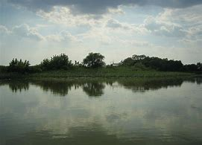
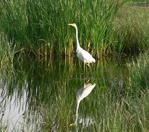
Lake Tisza

Slide 16
Thank you for your attention!

