Slide 1

Hungarikum’s
Created by: Iglai Zsófia
Tóbi Dorina

Slide 2
Foods
Csabai sausage
Winter salami
Egri Bikavér
Unicum
Kalocsai red pepper
Chimney cake

Slide 3
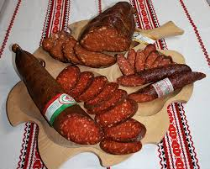
1. Csabai sausage
1809. the use of hot pepper for seasoning
Inheritance of recipe
Spread: Carpathian Basin
Australia
North and South America

Slide 4
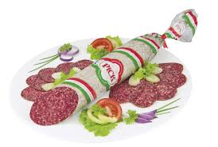
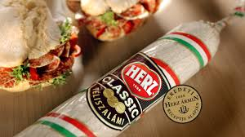
2. Winter salami
Ármin Herz
XIX. Century recipe
premium quality: -beechwood-smoked
-white allspice
-gray-white noble mold

Slide 5
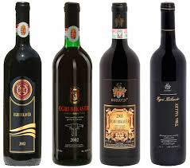
3. Egri Bikavér
First Modern Wine of Protected Origin (1997)
Red wine
Terroir wine: - production areas
-mezoclimate
- choosing the appropriate
wine
- maturation

Slide 6
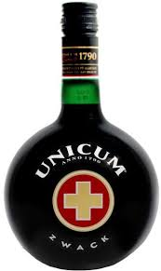
4. Unicum
It was formed in 1790 by Joseph II and one of the ancestors of the Zwack family
According to history, he served it as a medicine to the king
after the first sip the king exclaimed: "Dasistein Unicum"
Popular
  in Italy
  in Germany
  In Austria
  In Hungarian populated areas of the Carpathian Basin

Slide 7
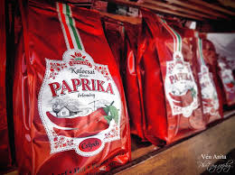
5. Kalocsai red pepper
Kalocsai pepper-producing landscape
Product: deep red with a pleasant aroma

Slide 8
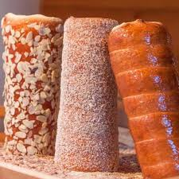
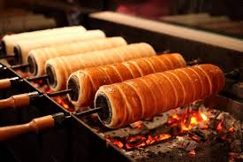
6. Chimney cake
Its shape is reminiscent of smoke extraction chimneys
Mary Mikes 1784

Slide 9
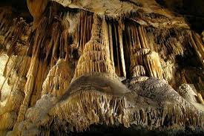
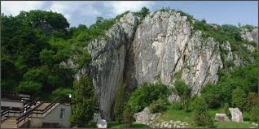
Aggtelek stalactite cave
712 cave
Of these, 273 are Hungarian states
Most famous: Baradla-Domica cave system
Diverse flora and fauna

Slide 10
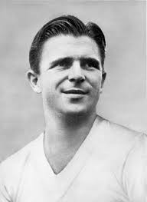
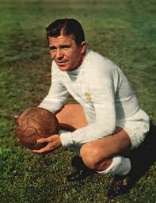
Sport: Ferenc Puskás
Hungarian national team, Olympic champion
Gold team captain
Real Madrid's epic star
His work is unique
Worldwide known

Slide 11
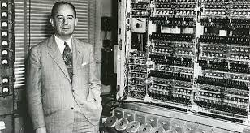
János Neumann: computer
Neumann Principles 1945
Basics of computer operation
All computers, laptops, phones all have the same structure

Slide 12
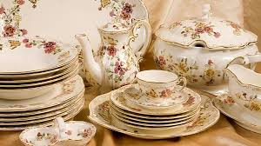
Zsolnay porcelain and ceramic
It is a symbol of constant renewal of artistic value
High quality, unique aesthetics
A true spirit, a culture has developed
The participation of renowned artists :-Ferenc Martyn
-József Rippl-Rónai
-Victor Vasarely

Slide 13
Cultural heritage
Matyó folk art
Herend porcelain
Mohácsi busójárás
Hortobágy

Slide 14
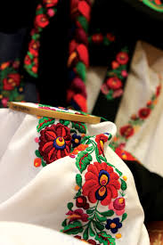
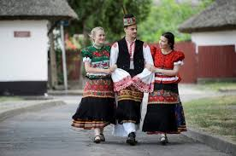
1. Matyó folk art
End of 19th century
Embroidery
Motfs
Matyó traditional costume

Slide 15
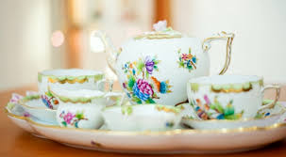
2. Herend porcelain:
1777 porcelain factory
Hollóháza of Borsod-Abauj-Zemplen County
High quality
Tastefully decorated
World famous (ex: Japan, USA, Australia)

Slide 16
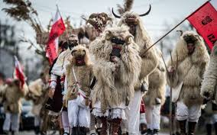
3. Mohácsi búsójárás
It belongs to a seminary, waiting for springtime
Sheepskin Dress, Leatherette, Mourning Mask
Sound-generating devices

Slide 17
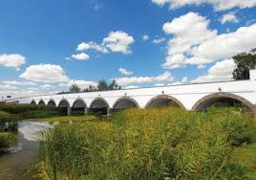
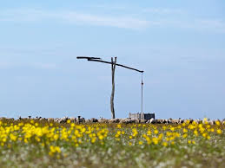
4. Hortobágy
Europe's largest grassland
shepherd Communities
Sheer biodiversity
An outstanding example of the harmonious coexistence of man and nature

