Slide 1
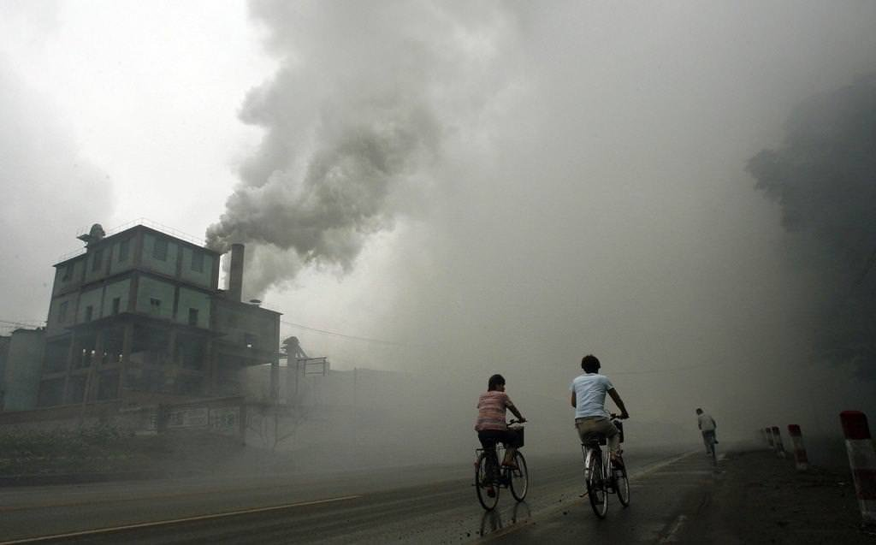
CAUTİONS TO TAKE AGAİNST AİR POLLUTİON

Slide 2
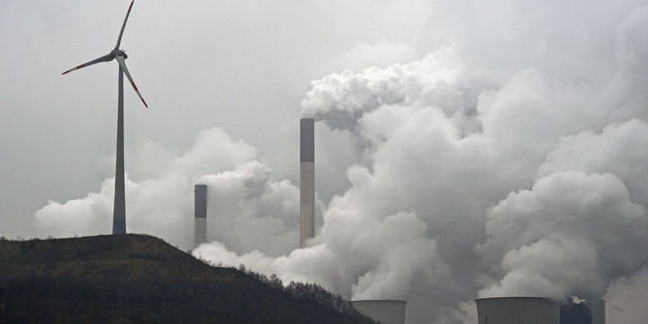
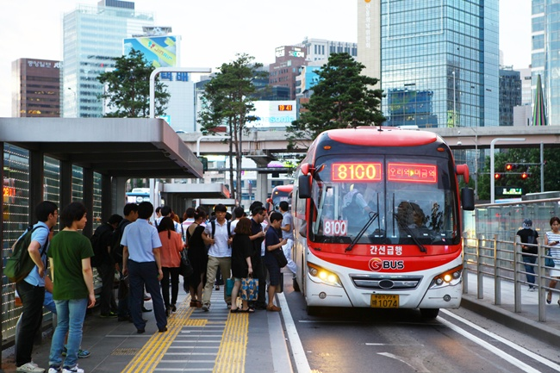
İt needs to be ensured that industrial plants put filters on their flues. They also need to pick their spots wisely.
People should use high calorie coal to warm up their homes. Flues and stove pipes should be cleaned annually. It should be considered important to isolate windows , doors and roofs. Using of natural gas should be generalized and encouraged. Low calorie illegal coal usage should be prevented as that causes for more pollution.
Bailers of heaters and natural gas should be treated periodically. People that are gonna treat the henters must be educated well. Central healting systems should be used at new settlements. Forests should be increared , pollution decreasing , precautions in development plans must be followed.
Public transportations should be generalized. First of all to prevent air pollution we must replace fossil fuels with solar energy wind power and geothermal energy.

Slide 3
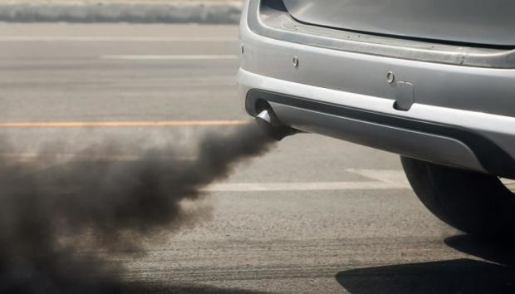
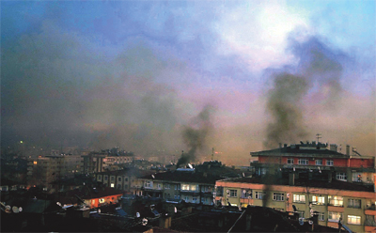
Forest should be increased when building industrial plants. Industrial waste releasing to the air without being filtered should be prevented. İn cities precautions should be taken to lower the pollution that’s caused by car exhausts.
These pollutants make it harder for living creatures to breathin the winter time because they cause ozone to get thinner. People must be encouraged to use public transportation.
The natural gas that’s used as a fuel must be generalized in public transportation. The destruction of forests should be prevented , afforestation action should be accelerated.
Substances like chlorofluorocarbon damage ozone. Chemicals that could replace these substances must be searched.

Slide 4
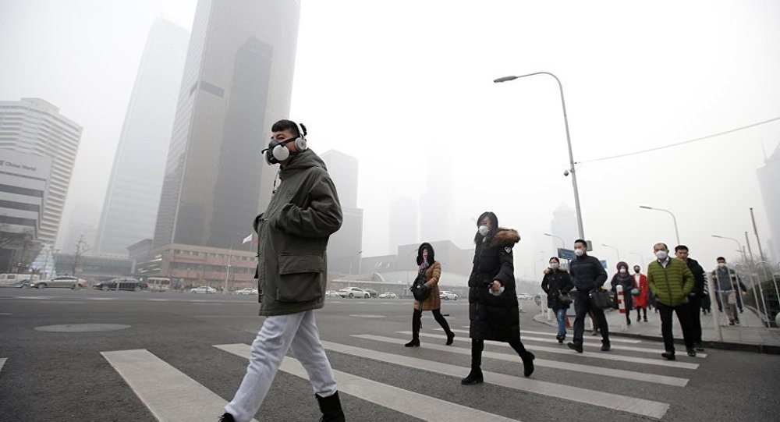
With the help of various banners sensitive people should encourage and help other sensitive people to solve this issue and others many more issues

Slide 5
Questions
Why public transport should be used?
What document should be in the stove to prevent air pollution?
Which substances damage the ozone layer?

Slide 6
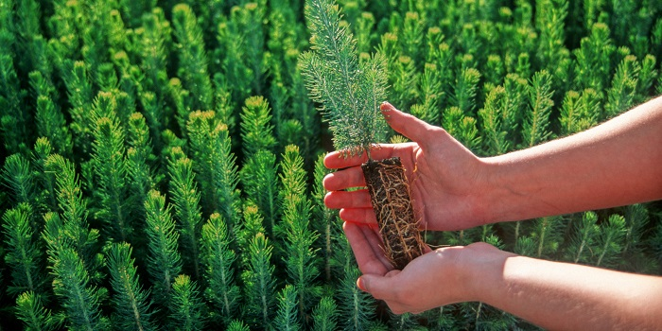
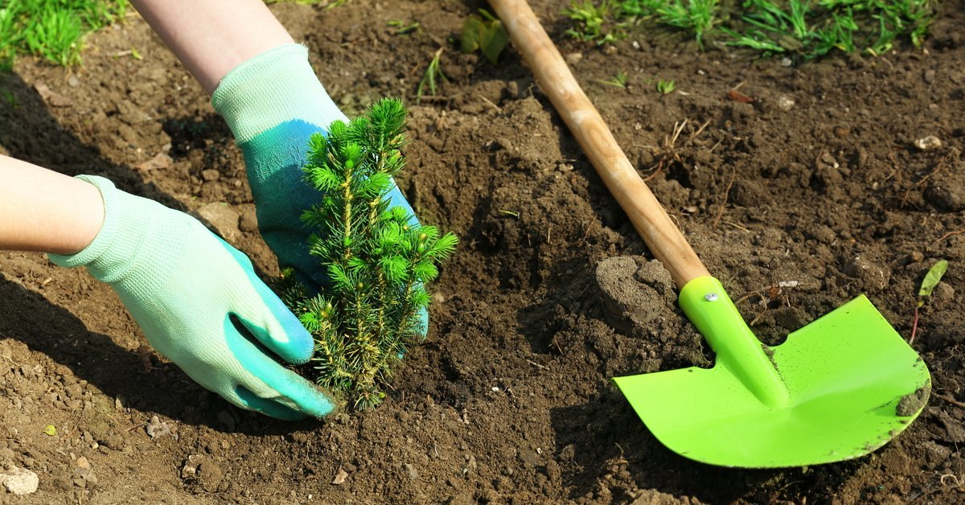
Please everyone follow these warnings because our world is becoming an uninhabitable place.
I hope you found my presentation useful.

