Slide 1
Architecture of Hungary
Made by: Gergő Serfőző and Kitti Zsiros

Slide 2
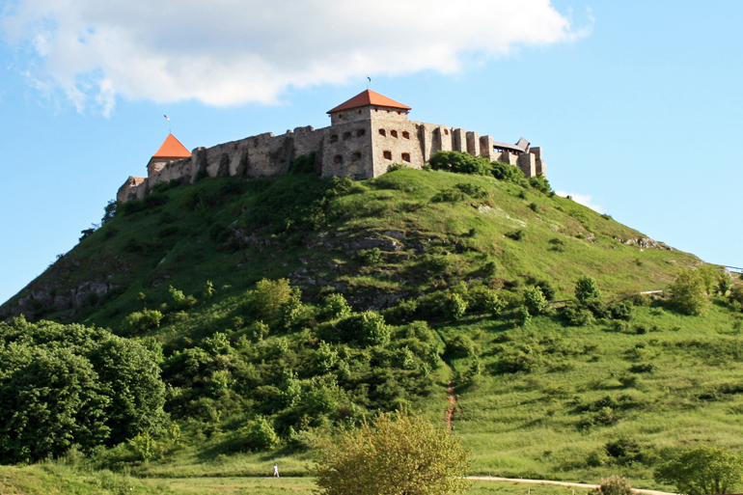
The creations of the Hungarian architecture have remained with us ever since the Foundation of Hungary. From the early days, mainly churches and castles were preserved, and later our ancestors also left castles, useful public buildings and beautiful residential buildings. The Carpathian Basin was exposed to way more wars and conflicts than the western side of Europe, thus we a have slightly less amount of monuments from the Medieval Era.

Slide 3
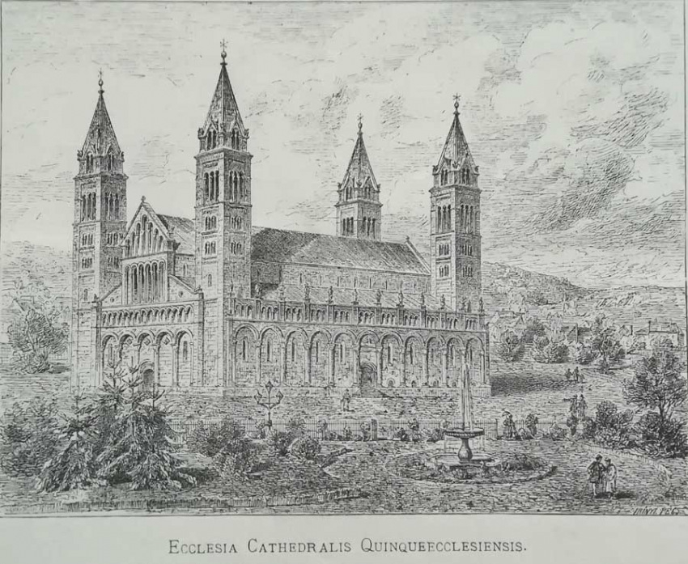
Church Architecture
The Hungarian church architecture followed the Central European customs, using the architectural remains of the Roman Empire, and the Byzantine model. The cathedral of Pécs, which was preserved straight from the 11th and 12th century, is a four towered dome, with a Romanesque crypt. Also, we can find Romanian styled churches in Székesfehérvár, Esztergom, Veszprém, Győr, Vác, Eger, Ják and Zsámbék as well.

Slide 4
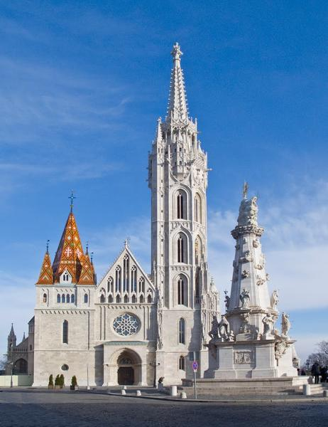
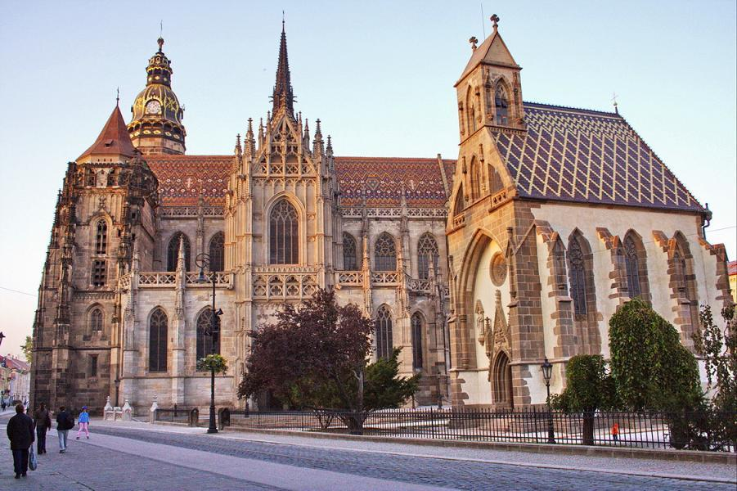
Our cathedrals were built in the 13th to 14th century. They are a great example of the medieval styles, and can still be seen in Gyulafehérvár, Buda, Poszony, Kassa, Kolozsvár, Brassó, and our similar curches at Ják, Pannonhalma, Sopron, Zirc, Lőcse, Bártfa, Garamszentbenedek, Lébény and Feldebrő. The curches of the 15th to 16th century, particularly in the lower town of Szeged, Debrencen, and Gyöngyös were built in the spirit of the late gothic and early renaissance.

Slide 5
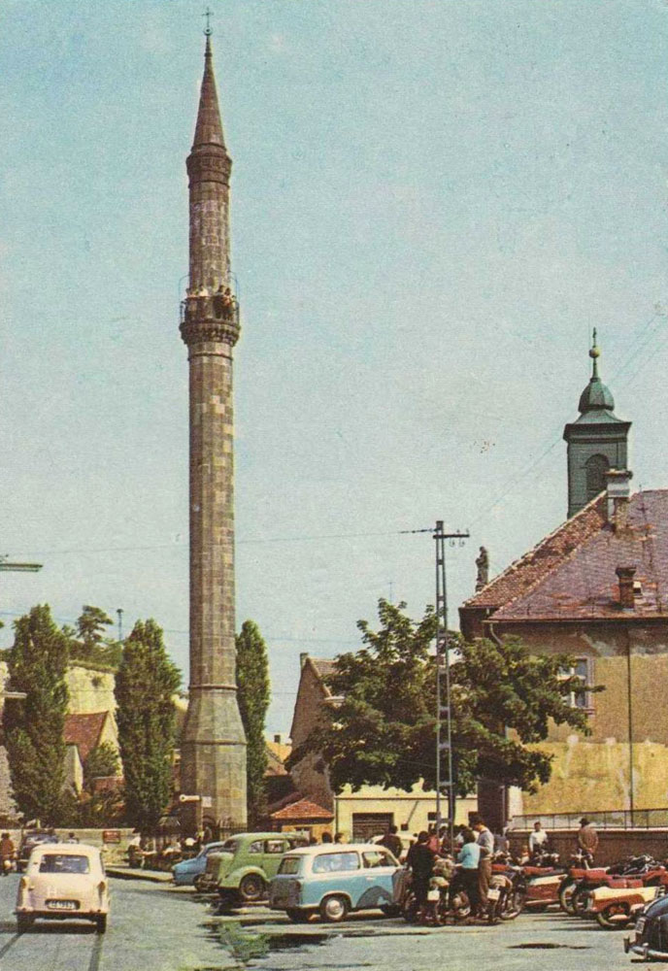
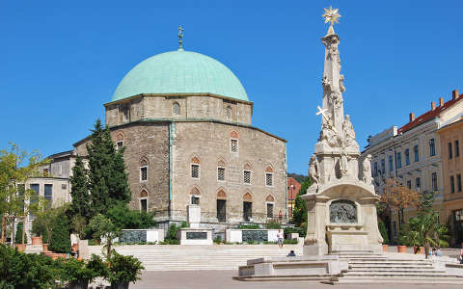
Architecture of the Turkish Era
From the Turkish era, between the raging wars and crumbled ruins, some distinctive Turkish architectural memories remain, for example the minaret in Eger, the Rudas and the King’s Bath in Buda, the tomb of Gül Baba, the mosques of Gázi Khászim pasha and Jakováli Hasszán, and the tomb of Idrisz Baba in Pécs.

Slide 6
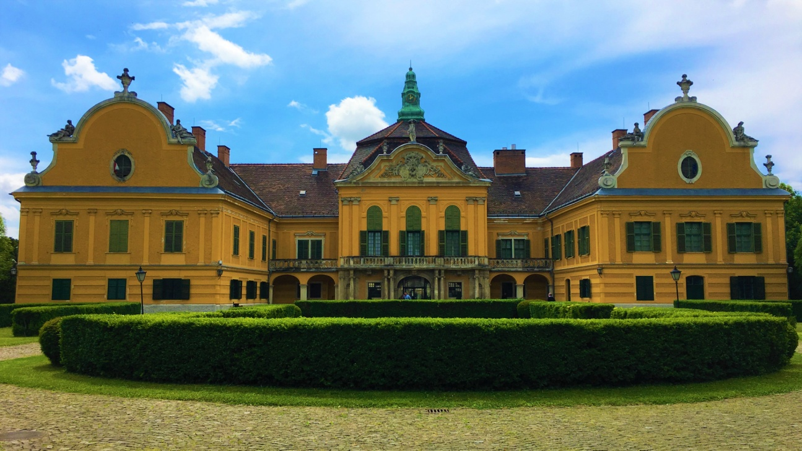
The Vestiges of the Baroque
In the 18th century, the counter-reformation got stronger, which resulted in the huge scale construction and renovation of the Hungarian catholic churches. The majority of these buildings still carries signs of the baroque style. The common buildings also benefited from this architectural path. Castles, palaces, countryside mansions, hotels, and garrisons were built in massive numbers in the spirit of the rediscovered style, by popular German and Italian architects.

Slide 7
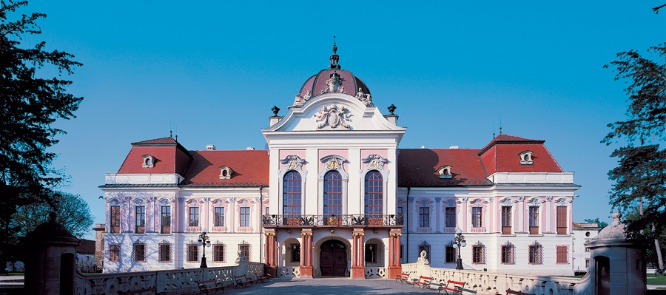
Our parlament, the former Erdődy-Palace, the Zichy-Castle,, the Town hall of Pest, the King’s Castle in Gödöllő, the Grassalkovich Castles in Hatvan and Nagytétény, the Lyceum in Eger, The Festetics Castle and the Georgikon in Keszthely, and the famous Castle of Savoyai Jenő in Ráckeve were built in this time. In Fertőd, the grandiose Esterházy-Castle, which Haydn and Mozart also visited, was built according to the model of the one in Versailles.

Slide 8
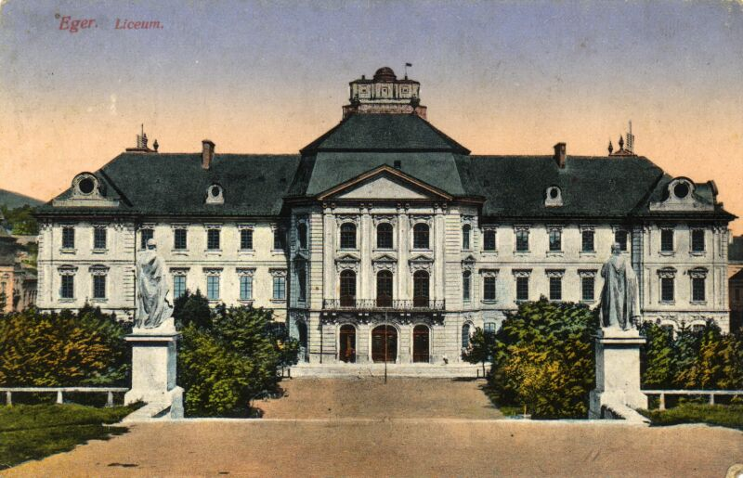
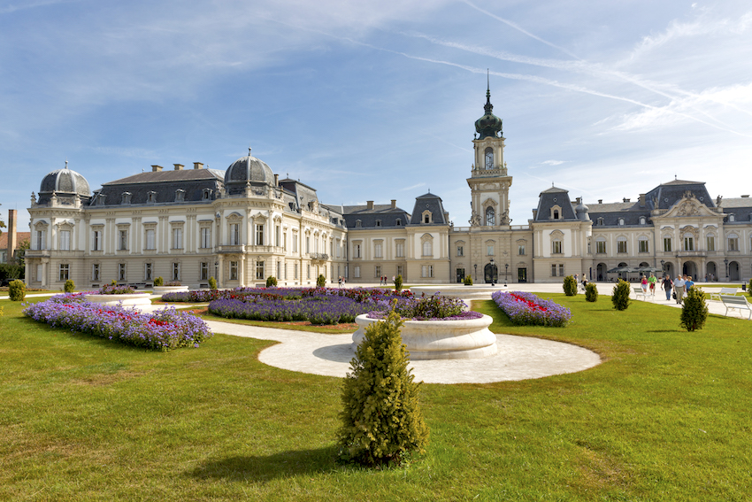
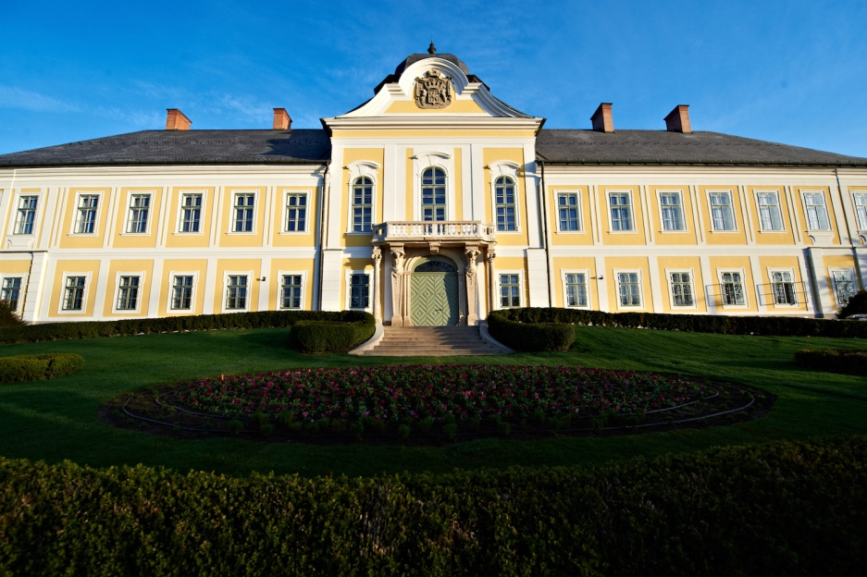
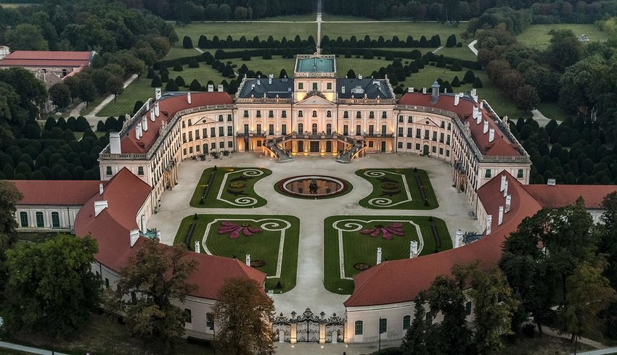

Slide 9
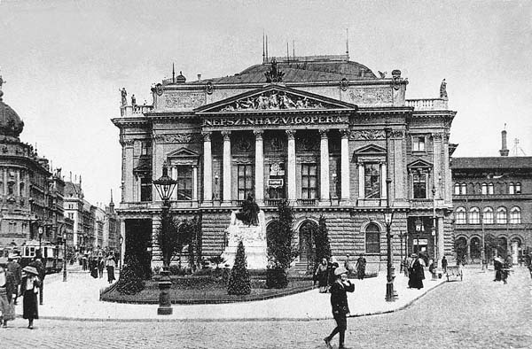
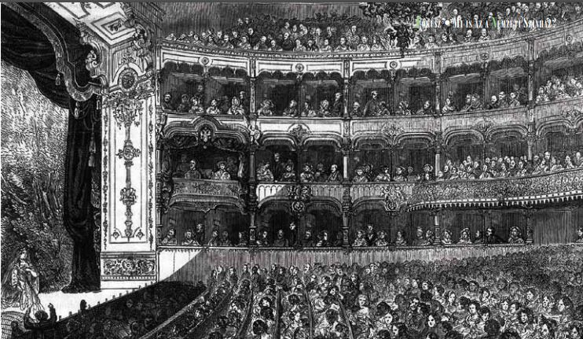
The Grand Architects of the 20th century
Mihály Pollack (Vienne, 1773 – Pest, 1855) A master of the Hungarian classicism. The evangelic church in Pest at the Deák Tér, the Ludovika, the Festetics-mansion, the County Hall in Székesfehérvár, and the castles in Alcsút and Deg were designed and built by him. His main piece of art is the building of the Hungarian National Museum, one of the best examples of the European classicism.

Slide 10
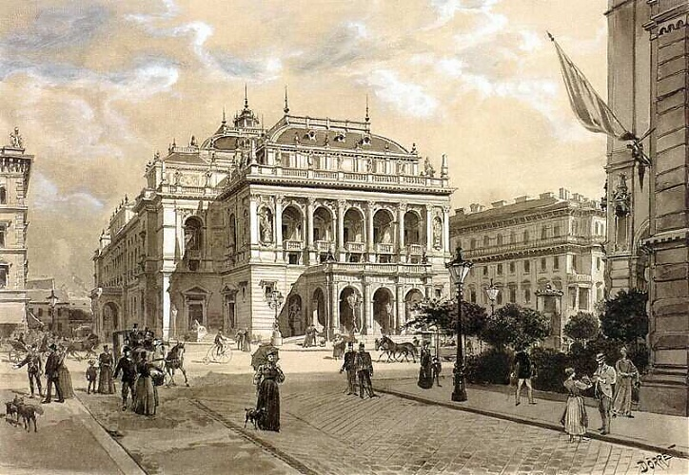
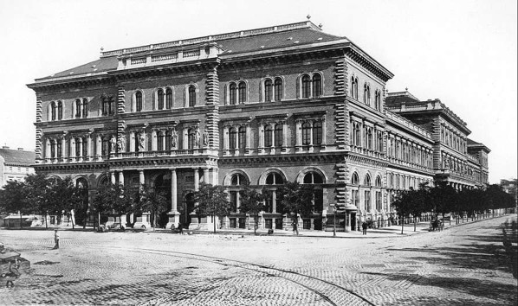
Miklós Ybl (Székesfehérvár, 1814 – Budapest 1891). The main artistic perfection of the Hungarian Eclectic period is the Roman Catholic Church in Fót, the Castles in Parád, Doboz, Csurgó, Surány, Lengyeltót and so on, the church in Pest at the Bakáts tér, the Magnate Palaces in the Puskin street, the present main building of the University of Economics. His main work was the Opera House.

Slide 11
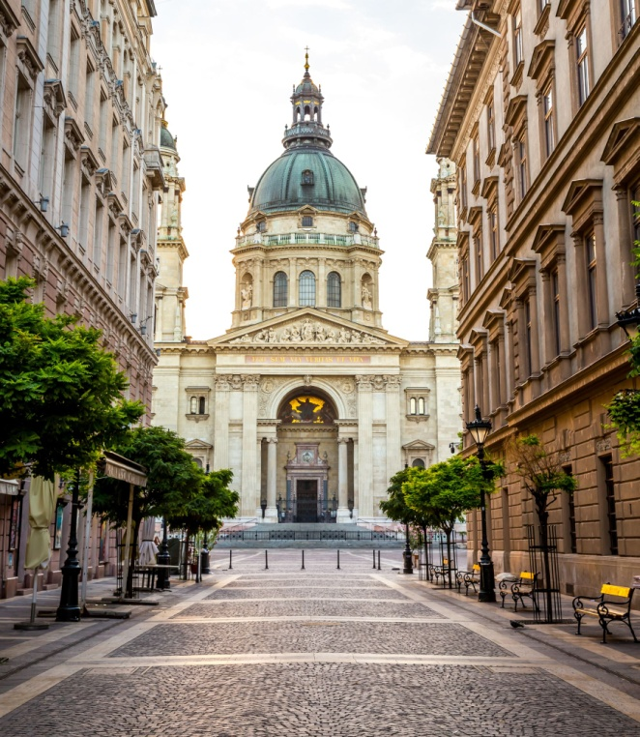
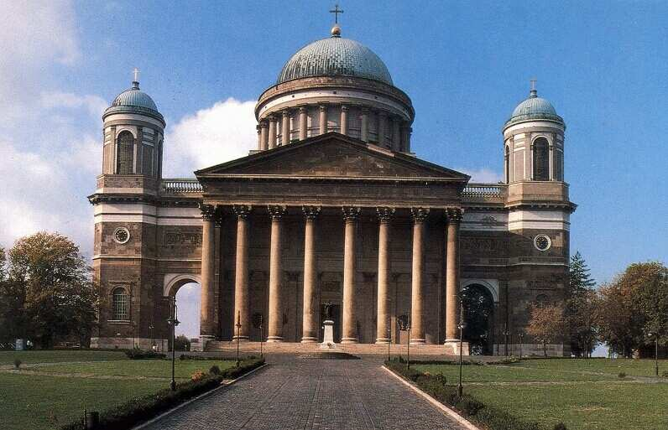
The architect József Hild (Pest, 1789- Pest, 1867) learned by the side of his father, and later abroad. During this period of time, he designed almost one thousand buildings, mainly classicist citizen houses and palaces in the Reform Era in Pest. His main works are The Main Cathedral in Esztergom, the Cathedral of Eger, The Saint Stephen Basilica, and the Calvinistic church in Cegléd.

Slide 12
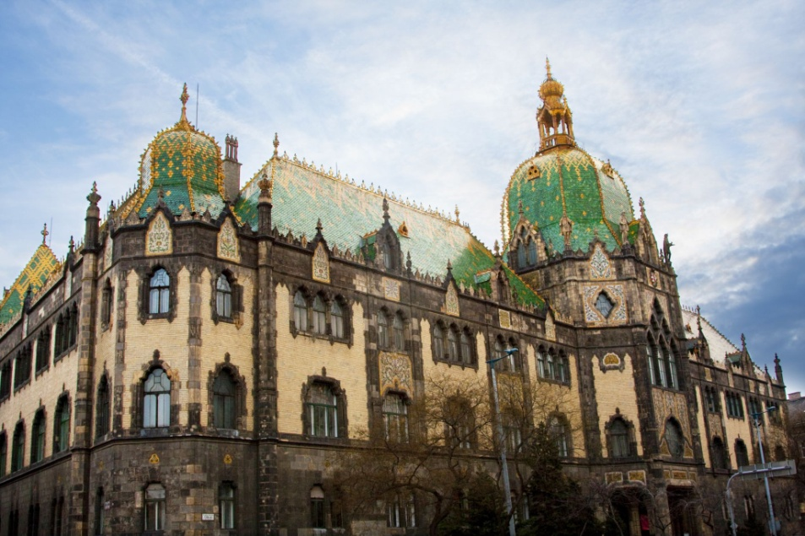
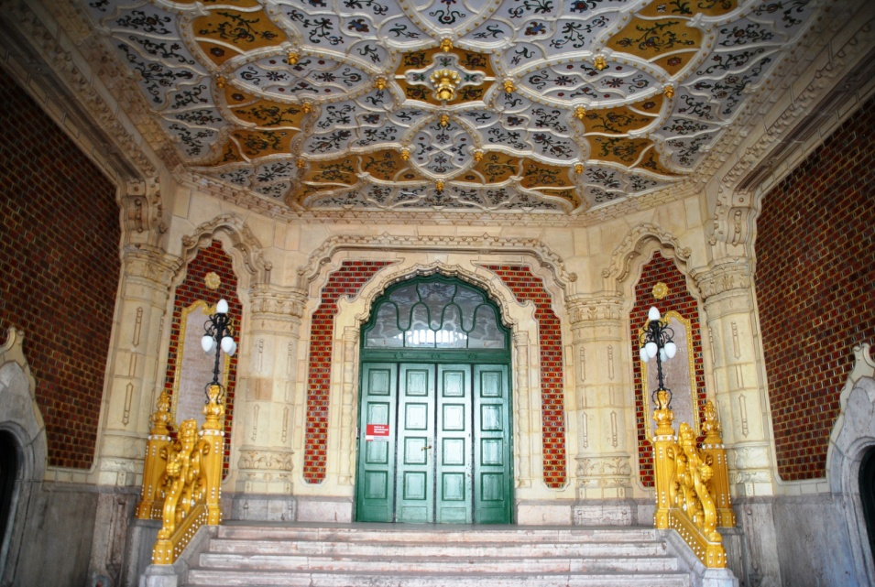
Ödön Lechner (Pest, 1845 – Budapest, 1914) He merged elements of the Eastern architecture with the Hungarian folk themes. His designed were inspired by secession, and became one of the leader artists of the style. His most known works are the Town Hall of Kecskemét, the Museum of Applied Arts, the Parish Church of Kőbánya, and the building of the Post Office Savings Bank.

Slide 13
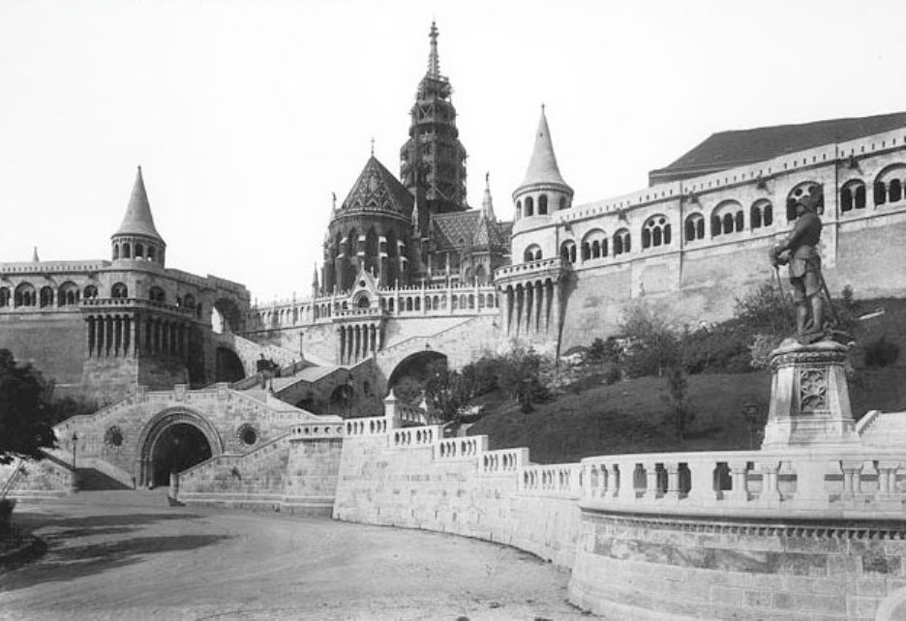
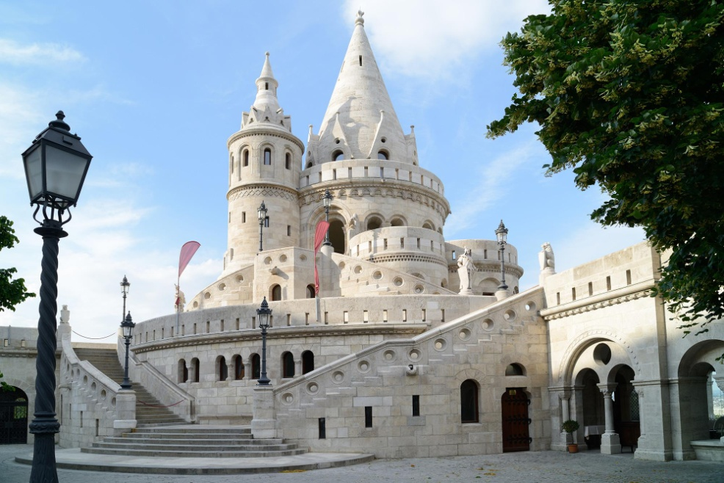
Frigyes Schulek (Pest, 1841 – Balatonlelle, 1919) The Church of Kisszeben and Ják, the Mathias Church in Buda, and the Restauration of the Town Hall of Lőcse are tied to his name. His main work is the Fisherman’s Bastion, part of the world legacy.

Slide 14
Thank you for your attention!
- The creators, who hope you’ve got a bit smarter.

