Slide 1
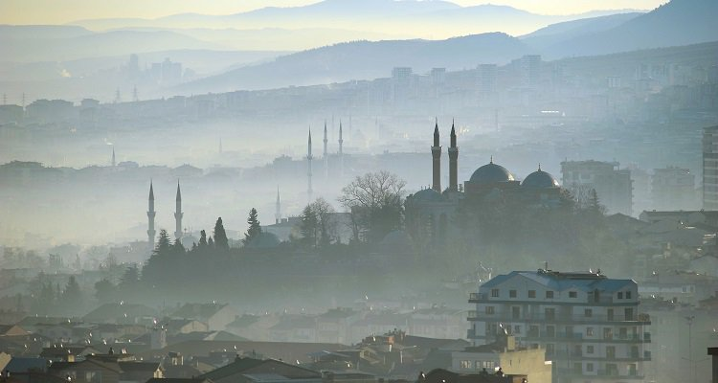
AIR POLLUTION FACTORS

Slide 2
Natural Sources Causing Air Pollution:
There are some substances that harm the atmosphere with nature's own structure.

Slide 3
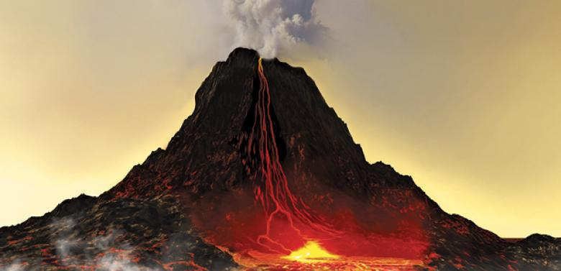
1.Volcanic eruptions
Gas particles such as sulfur dioxide released during volcanic activity disrupt the balance of nature. dusts, forest fires and evaporation.

Slide 4
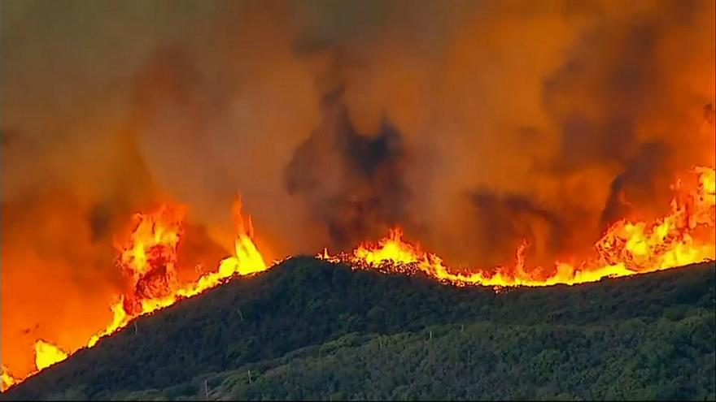
2. Forest fires
Increased air temperature or man-made forest fires cause air pollution in the pursuit of pollution of plants and trees and contamination of water resources.

Slide 5
3. Evaporation
Sulfur dioxide, particulate matter, nitrous oxide, carbon monoxide and ozone to evaporate from the oceans are among the reasons to spread to the air.

Slide 6
Artificial Sources Causing Air Pollution:
Unfortunately, we are the cause of air pollution caused by people willingly and unintentionally. Artificial sources causing air pollution; traffic, heating and industry are examined in 3 groups.

Slide 7
1. Traffic-induced air pollution
The air pollution caused by the public transport and private vehicles used to make our lives easier is undisputed. The reasons for polluting the air are the gases emitted from the exhaust pipe, the fuel tank, the carburetor, the brake pads and the tires. According to statistics from TURKSTAT;
- Total number of motor vehicles in Ankara was 1,777,756. 1.297.145 of this car
- Number of motor vehicles in Istanbul total 3.845.349. 2.644.411 of these car

Slide 8
1. Traffic-induced air pollution
- Total number of motor vehicles in Izmir was 1,276,347. It was reported that 694.464 cars were used.
When we look at the numbers and take the individuals who go to work or school by using their special vehicle every day, air pollution seems inevitable. Inhalation of carbon monoxide, hydrocarbons and nitrous oxide gases in the exhaust pipes of the cars has the potential to cause death.

Slide 9
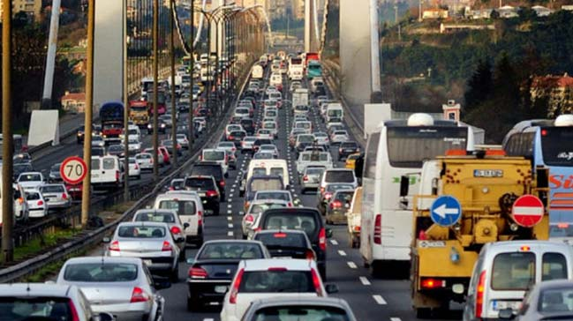

Slide 10
2. Heating-induced air pollution
The cause of increased air pollution, especially in the winter months, is the content of the heating fuels used. The toxic gases coming from the stoves and heaters are mixed into the air. Inhalation of carbon monoxide, sulfur dioxide and particulate matter into the air by living organisms causes damage to the lungs.

Slide 11
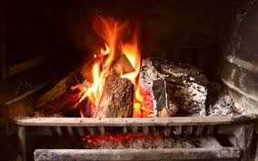

Slide 12
3. Air pollution from industry
In recent years, a serious increase in the production of air pollution has brought with it. The gases in the chimneys of the factories pollute the air. The factory, which provides development and job opportunities, damages the environment and living things due to misuse. Actually, it's kind of an eyebrow.

Slide 13
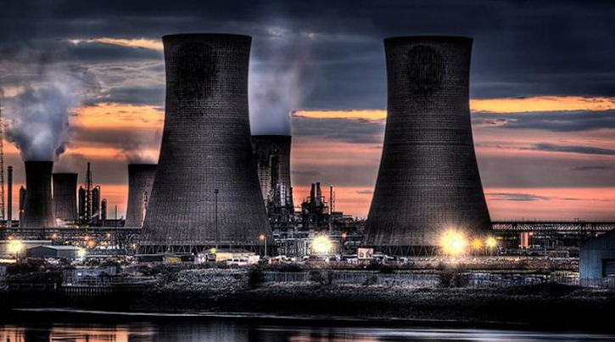

Slide 14
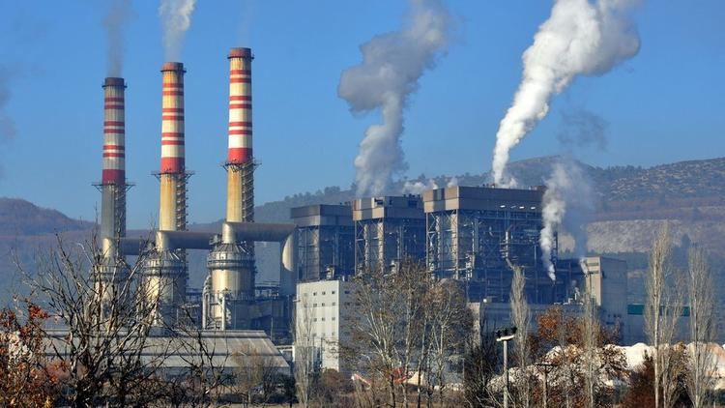
4. Thermal power plants
The high sulfur content of Sulfur dioxide is harmful to the environment and agricultural areas. It causes agricultural areas to become inefficient and disappear.

Slide 15
NATURAL AND ARTİFİCİAL AGENTS

Slide 16
NATURAL AGENTS

Slide 17
ARTİFİCİAL AGENTS

