Slide 1
Hagiographies
Konstantina Tsoutsia
Elisabeth Simou
Dionysia Vilara

Slide 2
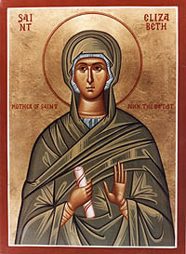
An icon is a religious work of art, most commonly a painting.The most common subjects include Christ, Mary, saints and angels. Although especially associated with "portrait" style images concentrating on one or two main figures, the term also covers most religious images in a variety of artistic media produced by Eastern Christionity , including narrative scenes. Icons can represent various scenes in the Bible.
Saint Elisabeth

Slide 3
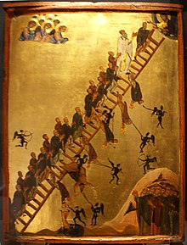
The Ladder of Divine Ascent icon showing monks ascending to Jesus in Heaven, top right. 12th century, Saint Catherine's Monastery
Icons may also be cast in metal, carved in stone, embroidered on cloth, painted on wood, done in mosaic or fresco work, printed on paper or metal, etc. Comparable images from Western Christianity are generally not classified as "icons", although "iconic" may be used[by whom?] to describe a static style of devotional image.

Slide 4
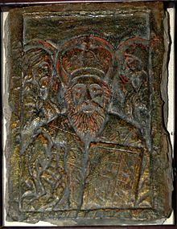
The icon of St Nicolas carved in stone. Between the 12 and 15th cc. Radomysl Castle, Ukraine[1]
Eastern Orthodox tradition holds that the production of Christian images dates back to the very early days of Christianity, and that it has been a continuous tradition since then. Modern academic art history considers that, while images may have existed earlier, the tradition can be traced back only as far as the 3rd century, and that the images which survive from Early Christian art often differ greatly from later ones.

Slide 5
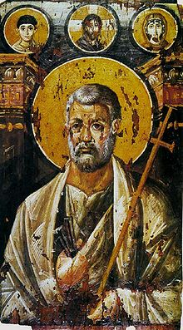
St Peter encaustic on panel, c. 6th century (Saint Catherine's Monastery).
The icons of later centuries can be linked, often closely, to images from the 5th century onwards, though very few of these survive. Widespread destruction of images occurred during the Byzantine Iconoclasm of 726–842, although this did settle permanently the question of the appropriateness of images. Since then icons have had a great continuity of style and subject; far greater than in the images of the Western church. At the same time there has been change and development.

Slide 6
THE END
THANKS FOR YOUR ATTENTION

