Slide 1
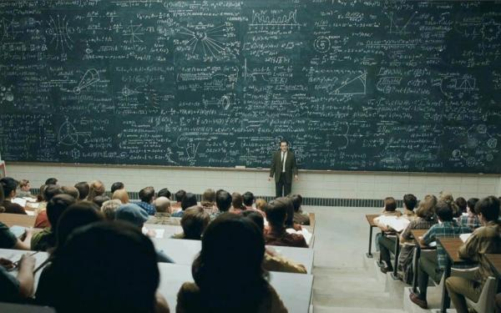
The Greek Educational System Kefala Eleni-Eirini

Slide 2
The Greek Educational System
Adapting state-of-the-art research in the field of education has resulted in a multilayered education system, which caters for all students in the country.
Most students in Greece attend public schools of all levels, for which there are no tuition fees, while less than 10% of the student population enrolls in private schools.
source: Paideia-Ergasia.gr - for further resources see The Greek Educational System)

Slide 3
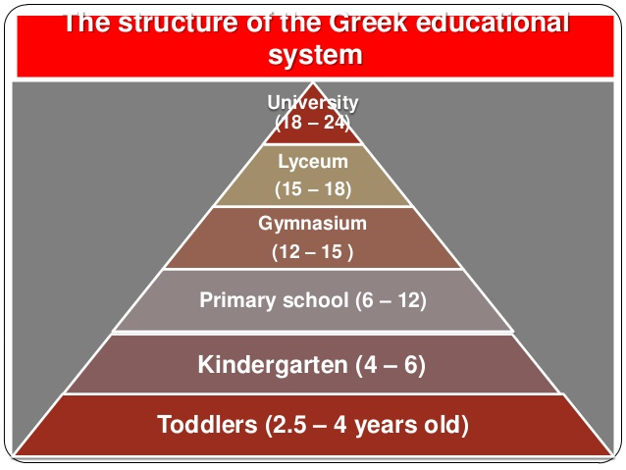
Structure of the Greek Education System
Education in Greece is compulsory for all children between the ages of 6 -15.
The education system is divided into
Early Education and Care for children up to the age of 6;
Primary Education for schoolchildren between the ages of 6-12,
Secondary Education for teenagers between the ages of 12 -18,
Higher Education for those wishing to attend university courses, and, finally
, Lifelong Learning, which caters for adult students of all ages.

Slide 5
School categories
Early childhood education
Daycare center Vrefonypiakos stathmos (AGE 0-4)
Kindergarten school Nypiagogio (AGE 5)
Experimental Kindegarten School Piramatiko Nipiagogio

Slide 6
Structure of the Greek Education System
Early Education and Care
In Greece there are Daycare Centers which provide children up to the age of 5 with pre-school education.
The last stage of pre-school education is carried out in Kindergarten Schools, where young students take preparatory courses just before enrolling in primary/elementary schools.

Slide 7
Primary education
AGE 6-12 (COMPULSORY)
Primary school Dimotiko scholio
Experimental Primary School Piramatiko Dimotiko Scholio
Primary School for students with Special Needs Ediko Dimotiko Scholio

Slide 8
Structure of the Greek Education System
Primary Education
Primary Schools welcome children of the age of 6. Some of these schools are termed “Experimental”.
There are also primary schools which cater for students with physical or mental impairment, or special needs.
Students learn basic skills in a number of subjects, like Language Reading and Writing, Environmental Studies, Maths, English.
Primary Schools in Greece operate between 8am and 1pm, while the majority of those offer extra classes on Physical Education, Art and Music until 4pm.

Slide 9
Secondary education
AGE 16-18 (OPTIONAL)
AGE 12-15 (COMPULSORY)
General High school Lykio
General Evening High School Esperino Geniko Lykio
Experimental High School Piramatiko Lykio
Music High School Mousiko Lykio
Arts High School Kallitechniko Lykio
Multicultural High School Lykio Diapolitismikis Ekpedefsis
Special Vocational Education & Training Institutes Ergastiria Epagelmatikis Ekpedefsis & Katartisis
Vocational High School Epagelmatiko Lykio
Vocational Evening High School Esperino Epagelmatiko Lykio
Vocational Training Schools Scholi Epagelmatikis Katartisis
Middle School Gymnasio
Evening Middle School Esperino Gymnasio
Experimental Middle School Piramatiko Gymnasio
Music Middle School Mousiko Gymnasio
Arts Middle School Kallitechniko Gymnasio
Multicultural Middle School Gymnasio Diapolitismikis Ekpedefsis
Middle School for students with Special Needs Ediko Gymnasio

Slide 10
Structure of the Greek Education System
Secondary Education
All students graduating from primary education must attend courses in a Middle School.
. A student may attend the Middle School which is located in his neighborhood, or he/she may be admitted to an Experimental Middle School through a lottery system.
There are also Middle Schools which address students with special needs.
Most Middle Schools operate from 8am to 2pm, but there are also evening schools that operate from 7pm till 10pm for students – mainly adults – who work during daytime.
Subjects that are taught in Middle Schools, including Modern and Ancient Greek Language, Maths, Physics, Chemistry, Geography, History, Physical Education, Religious Studies, Music and Art, while emphasis is given to foreign language learning, as students are taught both English and another European language of their choice (students tend to choose between French and German).
Students take exams in all subjects at the end of each school year.

Slide 11
Structure of the Greek Education System
There are Vocational Training Schools; in these schools, as well as in all Vocational High Schools, students attend general education courses combined with workplace courses.
At the final stage of studies, a student may work as an apprentice.
High Schools offer a combination of General Education courses and Advanced Placement courses.
Students who wish to pursue studies in Higher Education take Panhellenic exams in 4of Advanced Placement courses which fall into one of the following categories: Humanities, Science, Technology. This is a tough and highly competitive exam proces.
Secondary Education
Although upper level Secondary Education is not compulsory in Greece, most students attend High School.
Students may opt to attend a General High School or an Experimental High School or any High School specializing in music or the arts.
There are Special Vocational Education & Training Institutes for students with special needs.
Students may also pursue vocational training in Vocational High Schools, or, once they are 16, they may enroll in a Vocational Evening High School and graduate after 4 years of study.

Slide 12
Panellinies

Slide 13
Higher Education
FROM THE AGE OF 18
University Panepistimio
School of Pedagogical and Technological education Anotati Scholi Technologikis & Pedagogikis Ekpedefsis
School of Fine Arts Scholi Kalon Technon
Hellenic Open University Elliniko Anichto Panepistimio
Lifelong Learning Centers Kentra Dia Viou Mathisis
Second Chance Adult Education School Scholio Defteris Efkerias
Vocational Training Schools Scholi Epagelmatikis Katartisis
Vocational Training Institutes Institouta Epagelmatikis Katartisis

Slide 14
Structure of the Greek Education System
Higher Education
Most of graduates attend four-year studies in University departments.
Students who wish to enroll in the School of Fine Arts take special exams, and graduate after five years of studies.
Courses in Higher Education institutes in Greece take the form of either lectures or workshops.
Most university departments in Greece offer the opportunity to pursue a doctoral degree.
Students may also enroll in the Hellenic Open University for graduate or postgraduate studies, where they pay tuition fees and where they are admitted through an annual lottery system.

Slide 15
"νους υγιής εν σώματι υγιεί (= ‘a healthy mind in a healthy body’

Slide 16
Thank you for your attention!
Kefala Eleni-Eirini

