Slide 1
Folk Art
Τraditional costumes

Slide 3
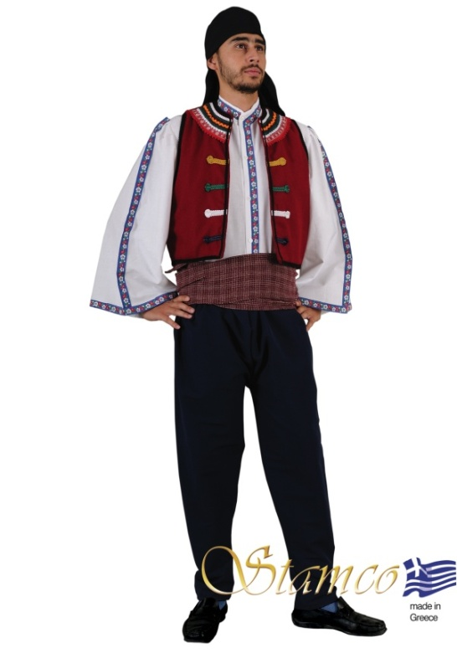
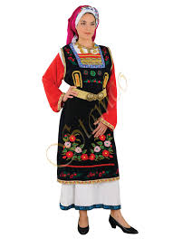
THRACE

Slide 4
MAN COSTUME THRACE
This outfit is imported from Greece and made by the premiere manufacturer of traditional Greek costumes. This traditional dancing costume is a favorite amongst dancing troupes and churches.
The costume consists of • decorated vest • decorated shirt • trousers • waist sash • head scarf costume weight:1050 grams

Slide 5
WOMAN COSTUME THRACE
This outfit is also imported from Greece and the information is similar to man’s costume
the costume consists of • sleeveless dress • dress with red sleeves apron with embroidery buckle and scarf are sold separately costume
weight:2000 grams

Slide 6
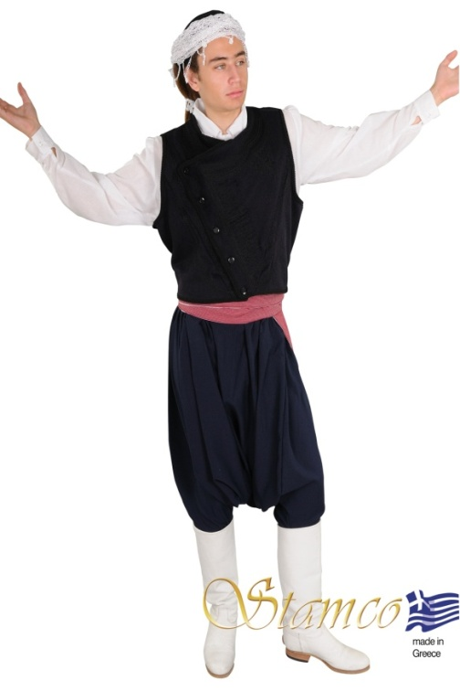
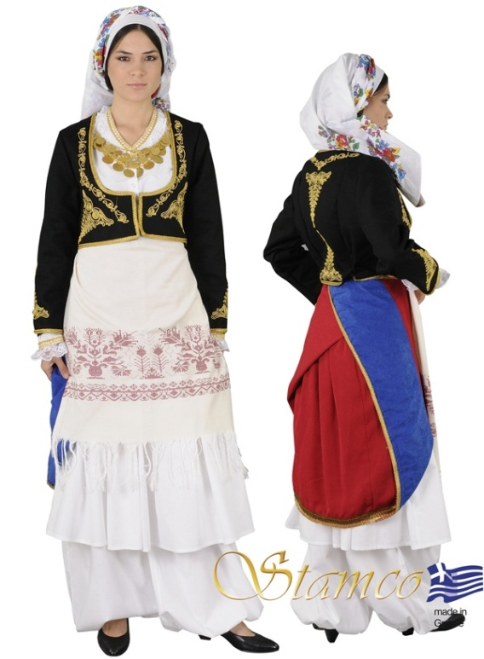
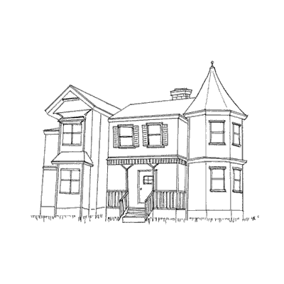
CRETE

Slide 7
MAN COSTUME CRETE
This costume is traditional
the costume consists from • blue woolen vest with embroidery • trousers vraka •white shirt and red sash • the hand • made white Crete headscarf and the boots are sold separately costume
weight:2000 grams

Slide 8
WOMAN COSTUME CRETE
This costume is traditional
costume consists of • waistcoat with embroidery • dress • back apron • apron • vraka trousers headscarf and necklace are sold separately costume
weight:2000 grams

Slide 9
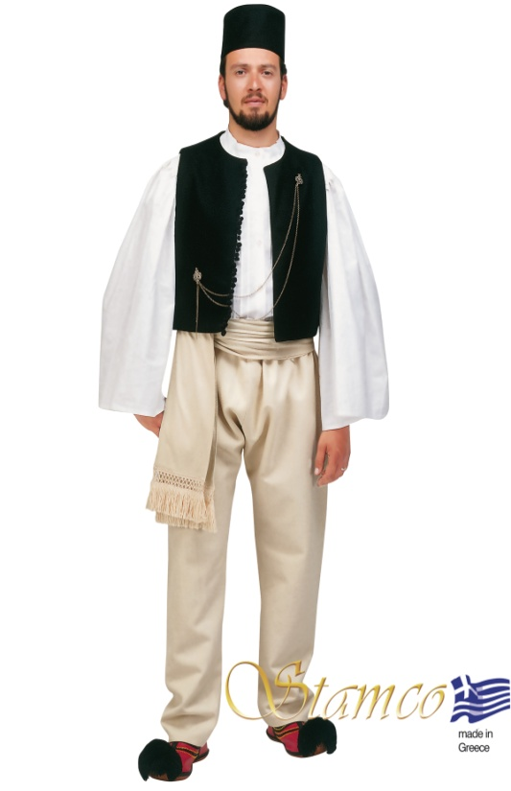
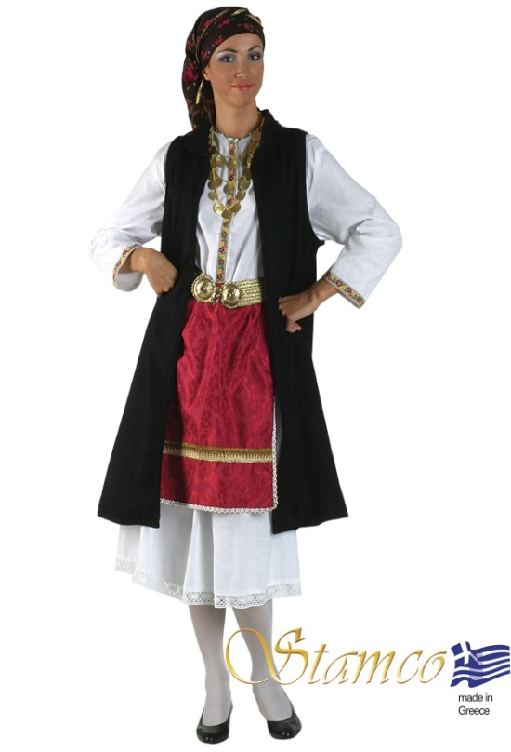
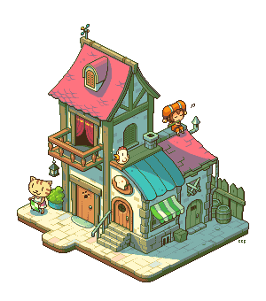
EPIRUS

Slide 10
MAN COSTUME EPIRUS
This costume is traditional
The costume consists of • felt vest • shirt • cloth belt • hat (kalpaki) • wool trousers (bourazana) • The tsarouchia and the jewelry are sold separately • tsarouchia and jewel are sold separately

Slide 11
WOMAN COSTUME EPIRUS
This costume is traditional
The costume consists of • interior cotton dress • long sleeveless felt coat and velvet apron • The necklace the buckle and the headscarf are sold separately costume
weight:1500 grams

Slide 12
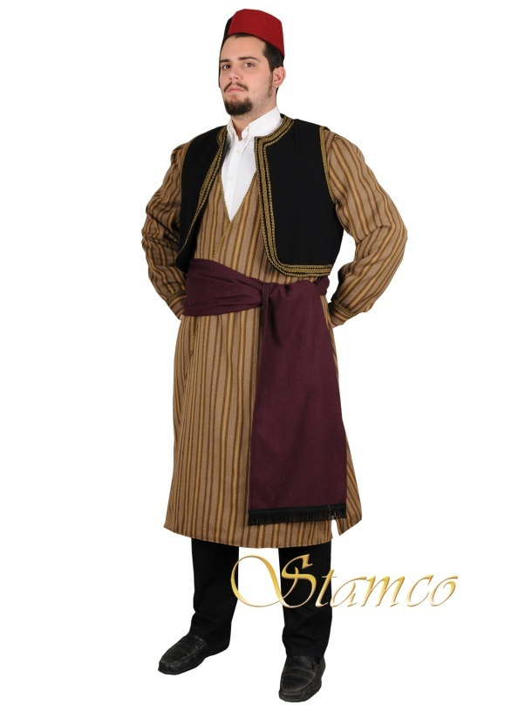
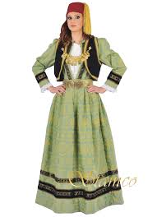
MACEDONIA

Slide 13
MAN COSTUME MACEDONIA
The costume consists of • striped long dress • black vest • hat • sash

Slide 14
WOMAN COSTUME MACEDONIA
The costume consists of • brocade dress with velvet finishing • velvet waistcoat • shirt and fez • The necklace and the buckle are sold separately

Slide 15
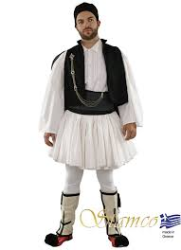
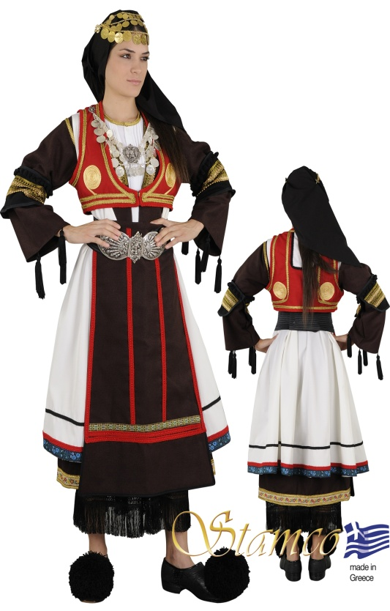
THESSALY

Slide 16
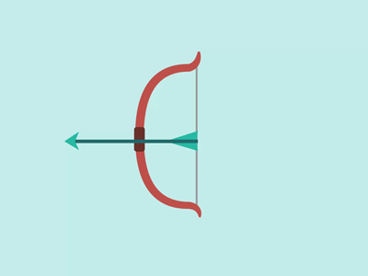
Woman costume Thessaly
the costume consists of • waistcoat • sagias • long vest • shirt • skirt • apron • brassards • head scarf • buckle & tsarouchia are sold separately

Slide 17
Man costume Thessaly
The costume consists of • felt vest • fustanella • shirt • waistband • fez • garters and elastic trousers • The tsarouchia and the jewelry are sold separately

Slide 18
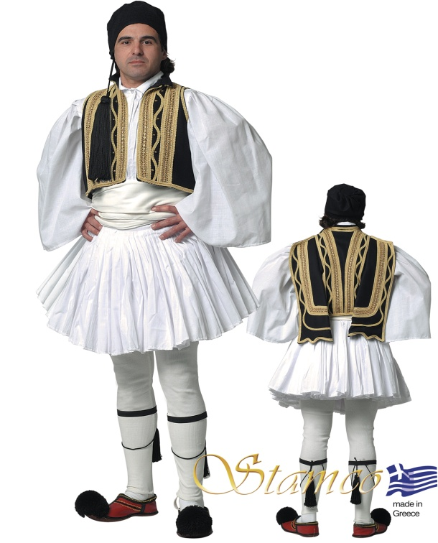
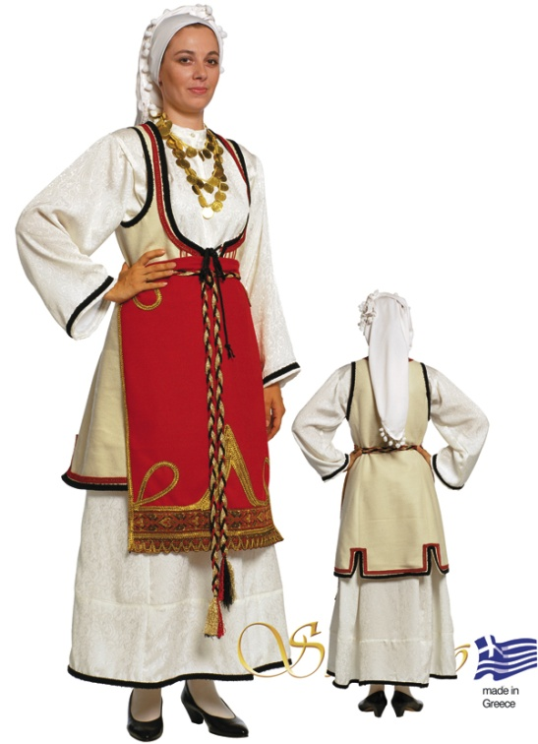
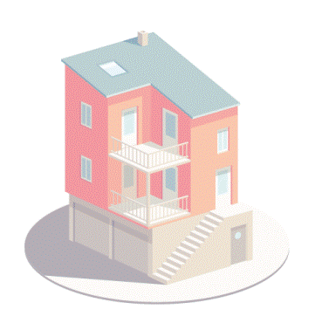
Central Greece

Slide 19
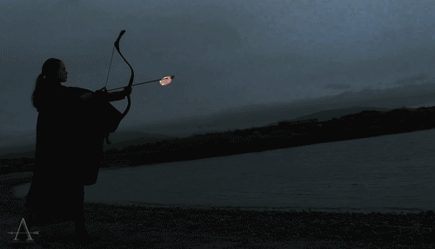
Man costume central Greece
Τhe costume consists of • waistcoat • fustanella • shirt • cloth belt • fez • knee bands(gonatoures) and elastic trousers • Tsarouchia are sold separately

Slide 20
Woman costume central Greece
The costume consists of • segouni (coat) and apron • made of felt • long dress and headscarf • The necklace is sold separately

Slide 21
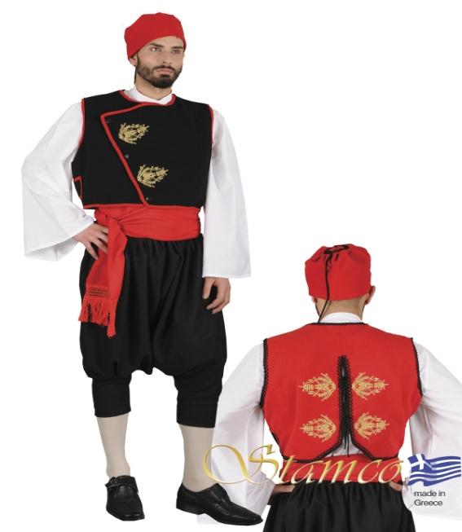
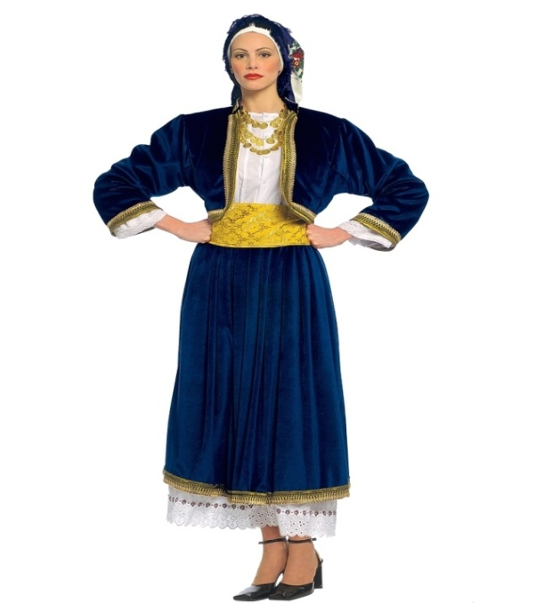
CYCLADES

Slide 22
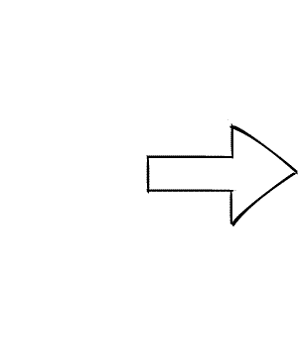
MAN COSTUME CYCLADES
The costume consists of • waistcoat • shirt • trousers • hat • sash vest with embroidery • shirt • waistband • breeches • fez with tassel costume
weight:2000 grams

Slide 23
WOMAN COSTUME CYCLADES
the costume consists of
•velvet waistcoat and skirt
• dress
• waistband
• The necklace and headscarf
weight:1500 grams

Slide 24
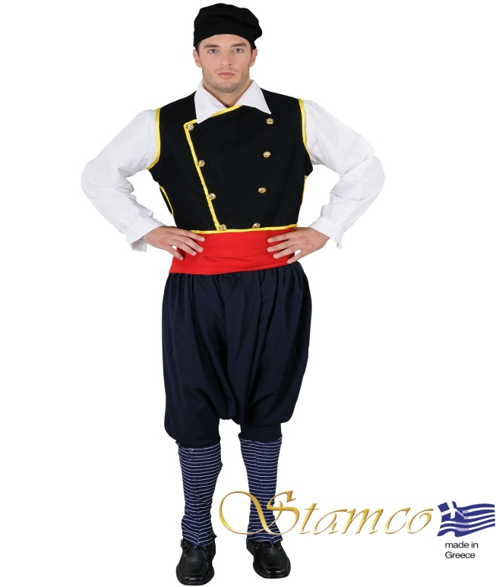
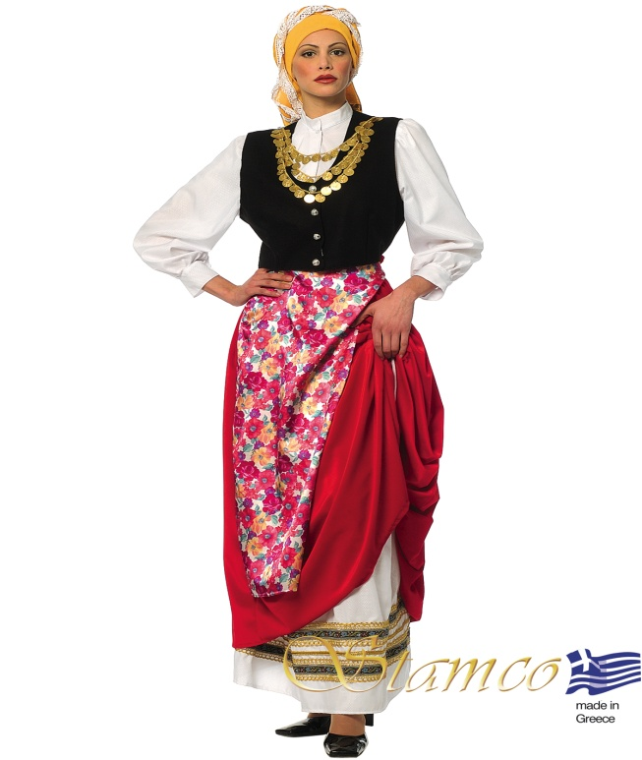
IONIAN ISLANDS

Slide 25
MAN COSTUME IONIAN ISLANDS
The costume consists of • vest • shirt • waistband • trousers • leggings • head piece costume
weight:2000 grams

Slide 26
WOMAN COSTUME IONIAN ISLANDS
the costume consists of • vest • shirt • skirt • apron • headscarf • necklace is sold separately costume
weight:2000 grams

Slide 27
GREEK TRADITIONAL WEDDING DRESSES

Slide 28
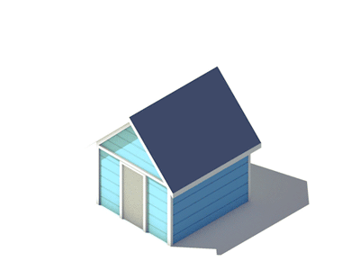
Thank you for your attention
Ευχαριστούμε για την προσοχή σας
Grazie per l'attenzione
Dziękuję za uwagę
Ačiū už dėmesį
İlginiz için teşekkür ederim
Vă mulțumim pentru atenție

Slide 29
Greek folk dances
https://www.youtube.com/watch?v=7Vr30h8P7bA
https://www.youtube.com/watch?v=UYZMrFWnMes
https://www.youtube.com/watch?v=lnldhpNIYI4
https://www.youtube.com/watch?v=0hYboPvGzIo

