Slide 1
BÉLA BARTÓK
25 March 1881 – 26 September 1945
Youtube:https://www.youtube.com/watch?v=gVGp7d9vC0U

Slide 2
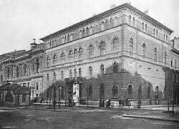
Childhood, early musical career
Bartók studied playing the piano at the Royal Academy of Music in Budapest
The music of Richard Strauss strongly influenced his early works
He blended Hungarian and European traditions
Works of a strong national character (e.g. Kossuth symphony)

Slide 3
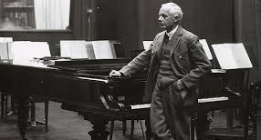
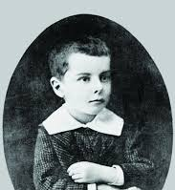
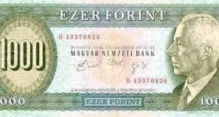

Slide 4
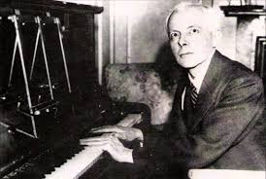
a Hungarian composer, pianist, and ethno-musicologist

Slide 5
ZOLTÁN KODÁLY
(Kecskemét) 16 December 1882
–
6 March 1967 (Budapest)

Slide 6
Béla Bartók and Zoltán Kodály, teachers at the academy of music

Slide 7
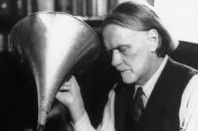
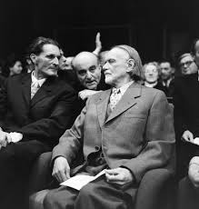
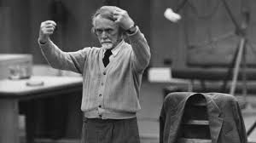

Slide 8
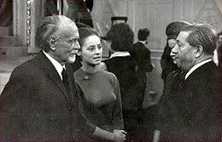
Compositions:
Idyll Summer Evening (1906, revised 1929)
Variations on a Hungarian folk song (Fölszállott a páva, or The Peacock Roared, 1939)
Dances of Marosszék (1929; orchestration of the 1927 piano set)
Dances of Galánta (1933)
Concerto for Orchestra (1940)
Symphony in memoriam Toscanini (1961)
Youtube:
https://www.youtube.com/watch?v=G6akQwb0494

Slide 9
FERENC LISZT
22. October 1811 Doborján, Hungary

Slide 10
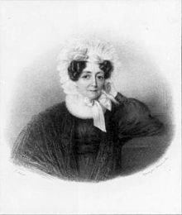
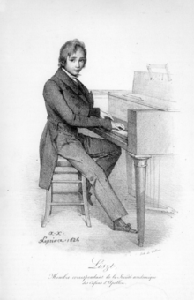
Ferenc Liszt’s mother,
Anna Lager around 1830
Ferenc Liszt’s
birthplace
Ferenc Liszt in 1824

Slide 11
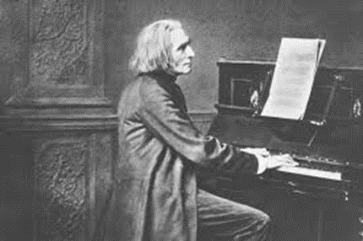
Awards
Order of Arts and Science
Order of the Golden Spur Bavarian Maximilian Order of Science
Knight of the Order of Christ

Slide 12
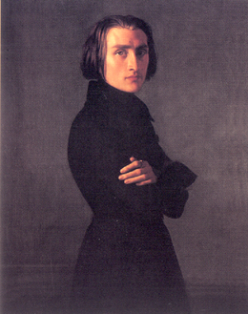
„Love Dream”
Youtube: https://www.youtube.com/watch?v=KpOtuoHL45Y

Slide 13
Thank you for your attention

