Slide 1
Uses of water

Slide 2
Distribution of population and water resources

Slide 4
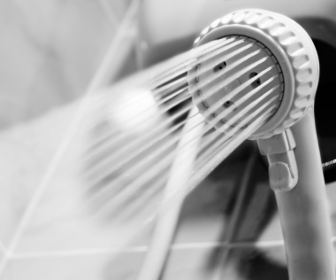
Uses of Water
Bathing
Toilets
Cleaning
Food preparation
Cooling
Fire protection
Industrial purposes
Drinking water = Potable water
©iStockphoto.com
Notes:
Today, almost all commercial, industrial, or residential structures must have a water supply. Water is also used for such things as bathing, toilets, cleaning, food preparation, cooling, fire protection, and industrial processes.

Slide 5
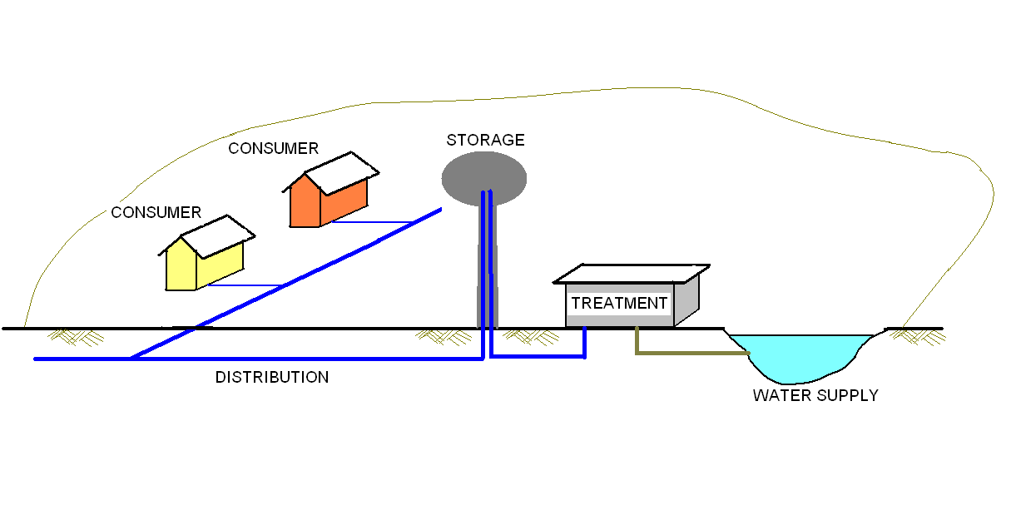
Water Supply System
Notes:
Some civil engineers are responsible for designing systems that provide a reliable and clean water supply.
A water supply system begins at a water source.
Water is transported to a treatment facility where the water is treated to ensure the supply is safe.
Once treated, the water is transported to a storage facility (for example, a water tower) where it is stored for future demand.
When a water faucet is opened or a fire sprinkler is activated, water is transported through the distribution system to the consumer.

Slide 6
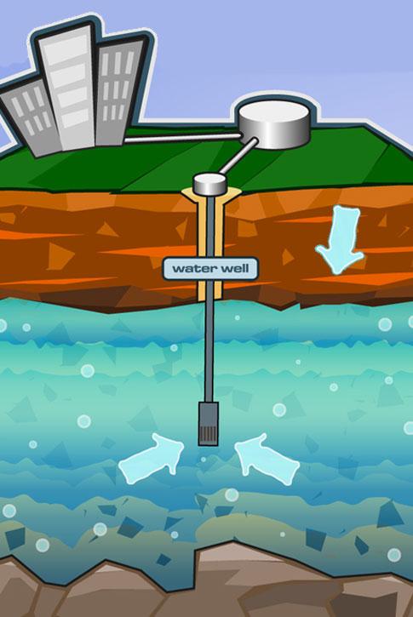
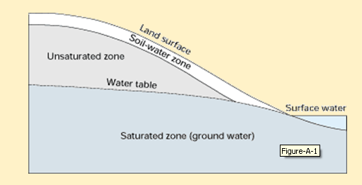
Sources of Water
Aquifers (Groundwater)
  Primary source of drinking water
  Porous consolidated rock or unconsolidated soil
  Groundwater fills spaces
  Wells and pumps used to remove water
Aquifer
This image was reproduced from groundwater.org with the permission of The Groundwater Foundation. © 2010 The Groundwater Foundation. All Rights Reserved
Courtesy USGS at http://pubs.usgs.gov/circ/circ1139/htdocs/boxa.htm

Slide 7
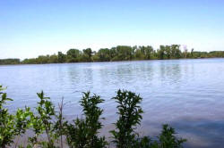
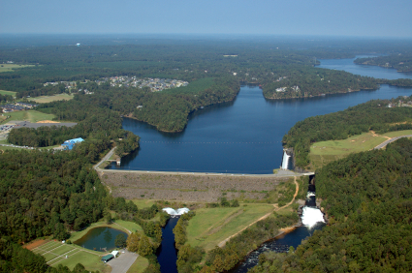
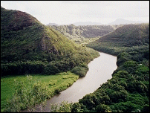
Sources of Water
Surface Water
  Lakes, reservoirs, rivers
  Rivers dammed to create reservoirs
  Reservoirs store water during heavy rain/snow
Courtesy USDA http://www.ks.nrcs.usda.gov/news/highlights/2006_april.html
©iStockphoto.com
Courtesy NASA http://www.ghcc.msfc.nasa.gov/surface_hydrology/water_management.html
Lake Tuscaloosa Dam

Slide 8
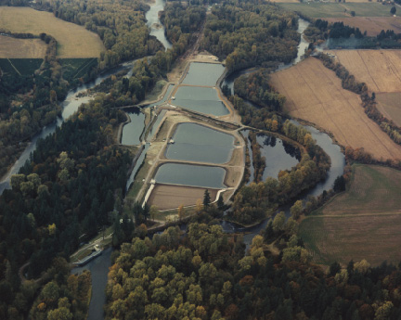
Water Treatment
Amount of treatment depends on quality of the source
Ground water requires less treatment than surface water
Courtesty USGS http://pubs.usgs.gov/fs/2004/3069/
The city of Salem water treatment facility withdraws water from the North Santiam River.
Notes:
The method of water treatment and the size of the plant are dependent on the quality of the water supply and the water demand. In general ground water requires less treatment than surface water because surface water is exposed to more contaminants. Water from some private well sources may require no treatment.

Slide 9
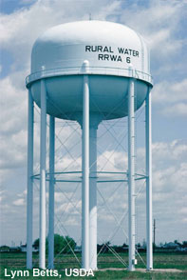
Water Storage
Pumped to Storage Tank
  Storage
  Water pressure
    psi
    1 psi = 2.31 feet of water
NOAA http://www.csc.noaa.gov/alternatives/infrastructure.html
Notes:
Treated water is pumped to a storage tank. Storage tanks are often elevated. A storage tank serves two purposes.
It stores the water until it is needed, which reduces the peak demand on the treatment facility.
Elevated water tanks create pressure in the water distribution system.

Slide 10

Water Distribution System
Consists of water lines, fittings, valves, service lines, meters, and fire hydrants
Loop system more desirable than branch system
  Isolation valves
  Water flows in more than one direction
LOOP SYSTEM
BRANCH
SYSTEM
Notes:
The water distribution system includes all of the water lines and components attached to the water lines.
There are basically two different distribution system configurations: Loop systems and branch systems.
Loop systems are more desirable because they provide redundancy. If a leak occurs in a loop system, installed isolation valves can be used to close off a small area near the leak but allow the remainder of the system to continue to provide water. In a branch system, the entire system must be shut down to repair a leak.
In addition, the loop system allows water to flow from more than one direction which can reduce the negative effect felt in a branch system when upstream demand reduces pressure and flow rate.

Slide 11
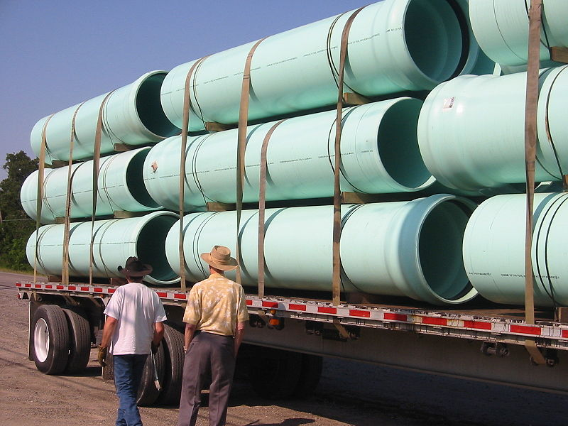
Water Distribution System
Typical new system pipe
  Thermoplastic or ductile iron
  Reinforced concrete in larger mains
Older system pipe
  Cast-iron or asbestos cement
Typical distribution pressure of 65 – 75 psi
Designed for less than 150 psi
wikimedia
Notes:
New systems are often constructed with thermoplastic or ductile iron piping. Because the efficiency of the system depends on a smooth interior pipe surface, cement linings or coatings are sometimes used to reduce the pitting and corrosion associated with iron pipes. For larger diameter water mains, reinforced concrete pipe is often used.
Cast-iron pipe and asbestos cement pipe have been a popular choice for water distribution systems in the past, so you may encounter these materials when tying into older existing systems.
A distribution system pressure of 65 – 75 psi is often recommended. Pressures over 150 psi can cause leaks and damage to the system.

Slide 12
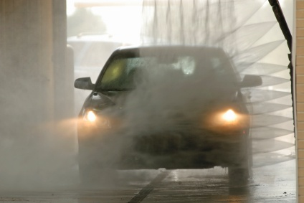
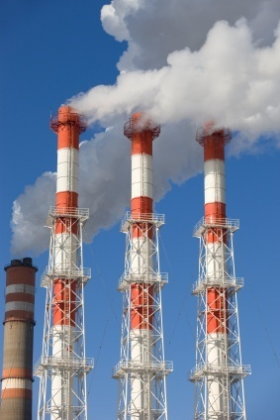
Consumer
Residential, commercial, and industrial facilities
Residential
  Min. distribution pressure = 40 psi
  Max. distribution pressure = 80 psi
    Pressure-reducing valve
Commercial or industrial facilities
  May require higher pressure
  Pumps can increase pressure
©iStockphoto.com
©iStockphoto.com
Notes:
The water supply system must adequately serve all customers including residential, commercial, and industrial facilities. The water pressure, flow rate, and demand times may vary significantly among users.
For residential consumers, the minimum desirable distribution pressure is 40 psi. A pressure over 60 psi is considered high. Because it increases the flow rate, high water pressure can lead to increased water use (waste) and increased energy use (due to heating the excess water). In addition, high water pressure can damage appliances and fixtures and cause them to wear out more quickly. Codes often require pressure-reducing valves at the service meter when the distribution pressures exceed 80 psi.

Slide 13
Play kahoot quiz:
https://create.kahoot.it/details/uses-of-water-and-water-footprint/766ed4bd-88c8-41d9-958f-4b5701636815
http://tiny.cc/ljoa4y

