Slide 1
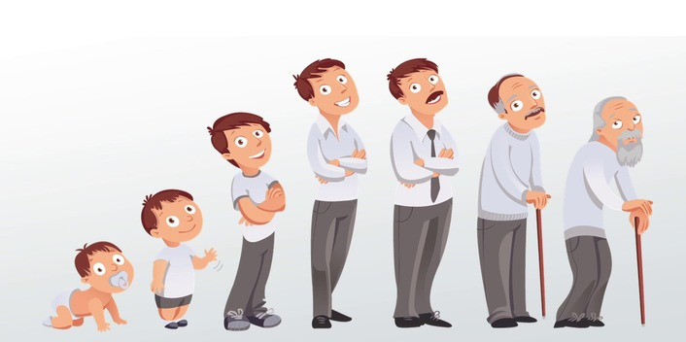
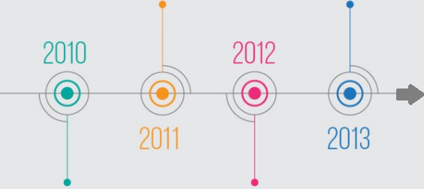

Slide 2
FRANCE | HOLAND | IRELAND
DEUTSCHLAND | LUXEMBOURG | GREECE
ITALY | UNITED KINGDOM | SPAIN
BELGIUM | DENMARK | PORTUGAL

Slide 3
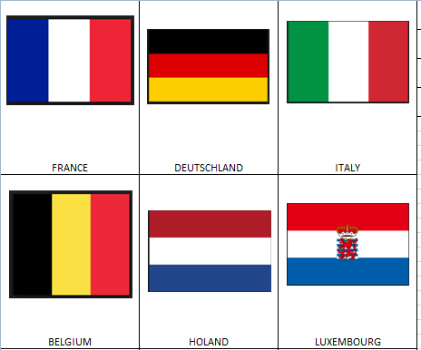
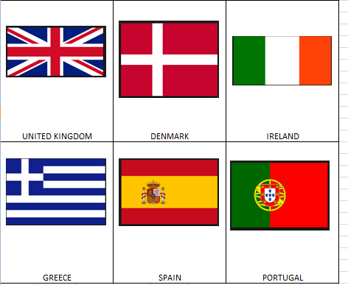

Slide 4
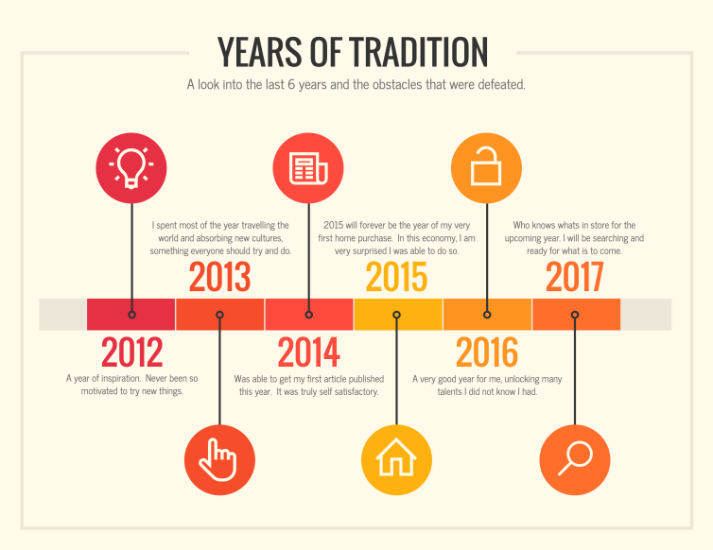
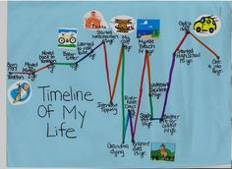
MAKE TIMELINE BASED ON CALCULATED YEARS
WHEN DONE, SEND PICTURE OF IT ON email:
martinovicantonija21@gmail.com

