Slide 1
Stand up and
chose one shape from the table

Slide 2
Find your partners by the shape you got and make a group

Slide 3
Saving water tips
What can I do to make a change?

Slide 4
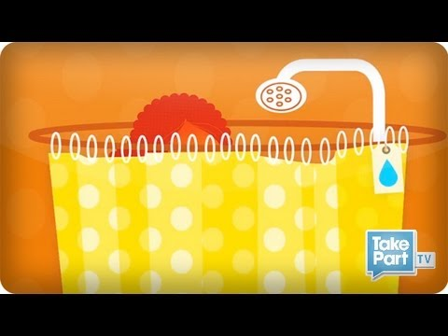
Let’s see who is the biggest problem?

Slide 5
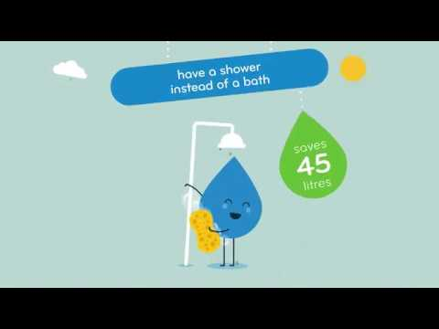
What can you do to help?

Slide 6
Could you remember all the tips?
Let’s play the game!

Slide 7
Above all your heads
there are
colorful balloons!

Slide 8
Who is going to try it first?

Slide 9
OK - pierce the balloon and one ribbon will fall out!
Read the task aloud and solve it together as a groupe!
Remember,
the whole group is doing the physical part of the task!

Slide 10
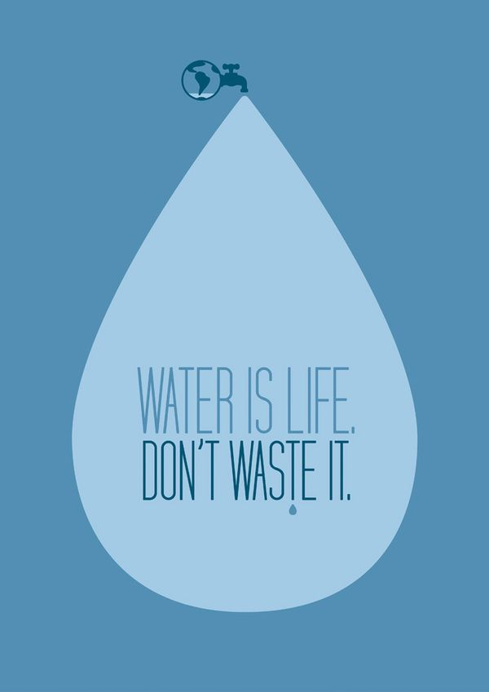
Thank you! :)
This project has been funded with support from the European Commission.
This publication [communication] reflects the views only of the author, and the
Commission cannot be held responsible for any use which may be made of the information contained

