Slide 1
Protection of species

Slide 2
(Direct) protection of species
• if the environment of a species is inadequate, they are relocated to another place where they are safe or declared to be protected
• to lock a single male and female from one species to be reproduced

Slide 3
The meaning and degrees of the "protected species"
Meaning: a species protected in a given geographical area.
Degrees - The scope of the species extends to all species of the species
-all forms of development of the individual
- All protected species have an intellectual value - if someone kills a protected animal they are fined

Slide 4
Legislation
This is a preview of restrictions on prohibitions and prohibitions on buying and selling.
Law on the Protection, Conservation, Use and Presentation of Protected Species.
Two of the relevant laws are:

Slide 5
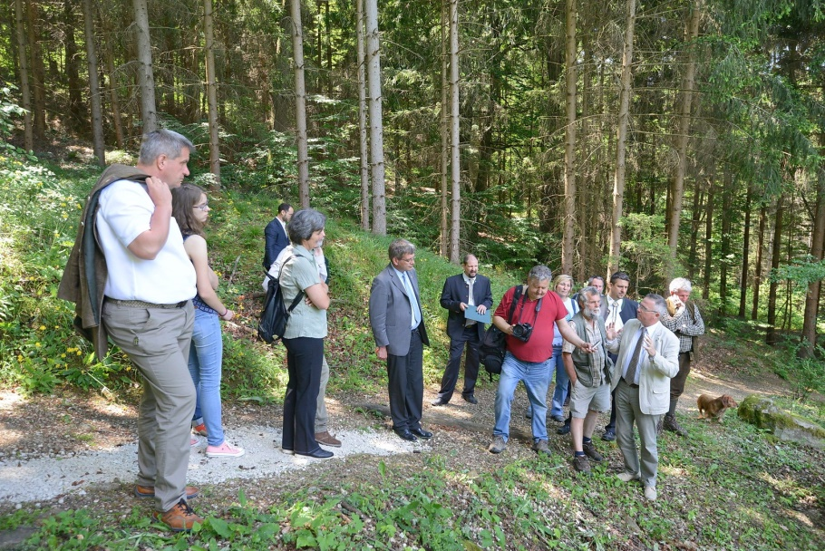
Experience
Protecting animal species is a lot of work.
Only a certain number of individuals can watch
Free-living individuals die for direct or indirect reasons
Indirect: : - global warming - (for example, sooner or later the polar bears will not have their homes, their food)
Direct : - human influence - people's hobby - illegal hunting for their fur, for their flesh, or to be put out and sold.
Protecting species, breaking rules.

