Slide 1
Natura 2000

Slide 2
Our prosperity is becoming more and more burdensome for the systems of the planet.Living creatures that have been living together with predators for millions of years, with their parasites in the extreme weather, are going to be destroyed by the influences of the civilization within years or decades.

Slide 3
One of the conventions which has been established to avoid it is the Natura 2000 convention.
The Natura 2000 is the network of areas to be designated under two nature directives of the European Union.
- The Bird Protection directive, established in 1979.
-The Habitat Protection directive, established in 1979.

Slide 4
Purpose of the Convention
-to create a common environmental protection policy for Eu members
-to ensure the conservation and the restoration of biodiversity in the wild fauna and flora through the protection of wildlife and its conservation status.

Slide 5
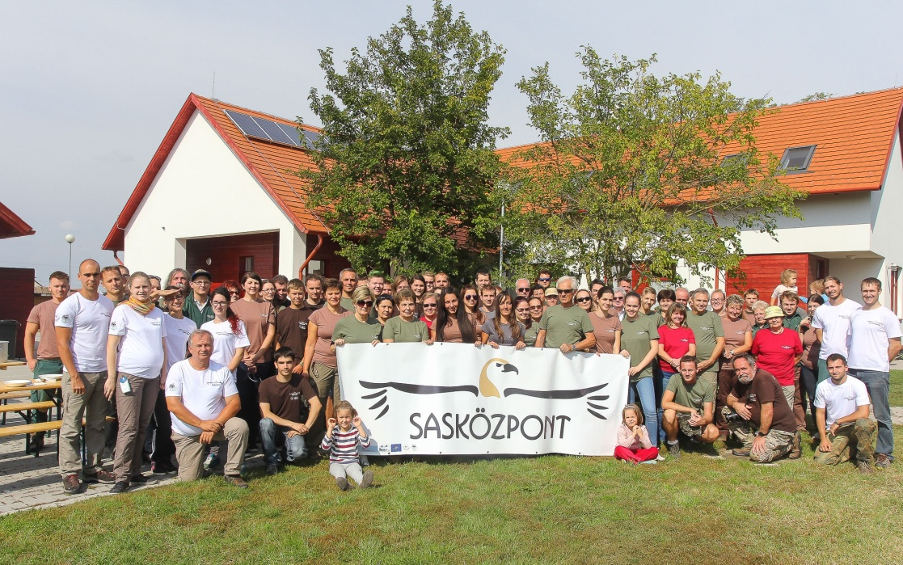
Partnership for the elimination of intoxications involving the Imperial Eagles (Hungary won the „Natura 2000 award”in 2018)

Slide 6
Natura 2000 in Hungary
21.4% of the territory of Hungary belongs to the Natura 2000 network. The domestic Natura 2000 network involves 46 habitat types; 105 animal species; 525 Natura 2000 areas: 105 animal and 56 Special bird Protection (SPA) areas, 479 special conservation (SCI) areas. All the domestic protected areas are part of the network, but the total domestic Natura 2000 network is its double: forests, grasslands, farmed slits have been put under protection.

Slide 7
In Hungary

Slide 8
Sárvíz (in Vas County)
-Protects migratory aquatic birds
-Preservation of population size of species
To be treated as priority species in the protection: big egret, spoonbills, ferruginous, the bluethroat and the moustached warbler.

Slide 9
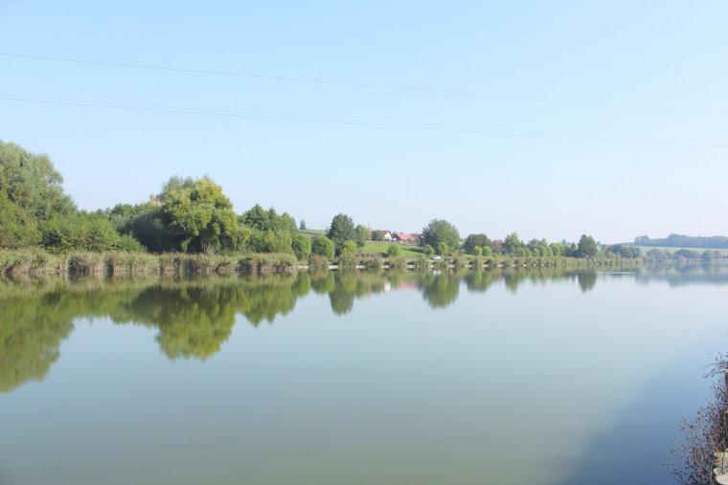
Sárvíz

Slide 10
Lake Balaton (Transdanubia)
It is highly protected: The Chellig is the “kakalin”, the flour “kakalin”, the Cucalin, the marsh blossom, the wading flower and the swamp Gladioli.
The number of protected, rare and interesting species is several hundred.

Slide 11
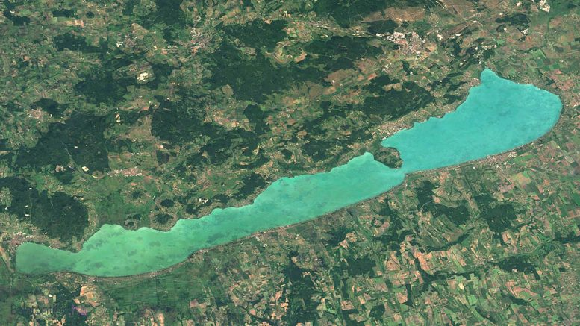
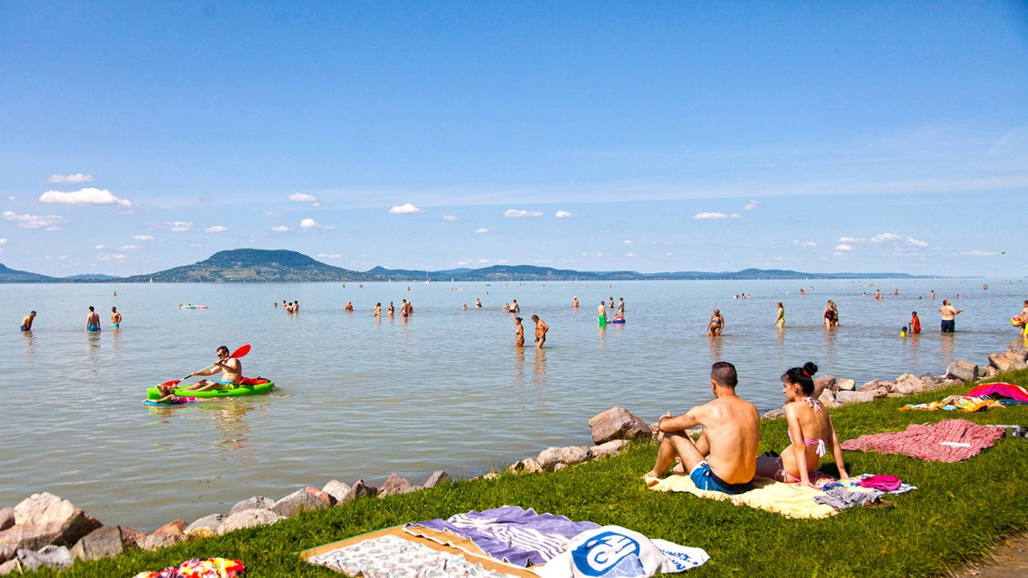
Lake Balaton

Slide 12
Thank you for your attention!
Made by: Mercédesz Tóth, Márton Gergely, Luca Nagy

