Slide 1
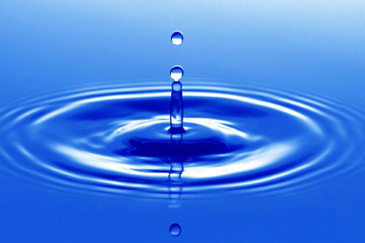
WORLD WATER DAY

Slide 2
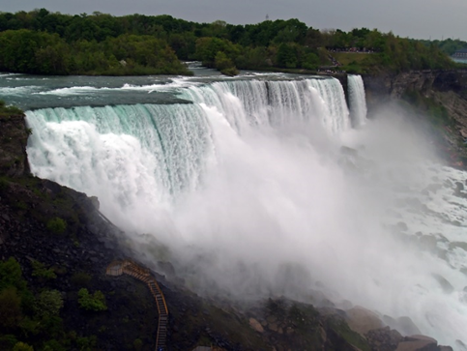
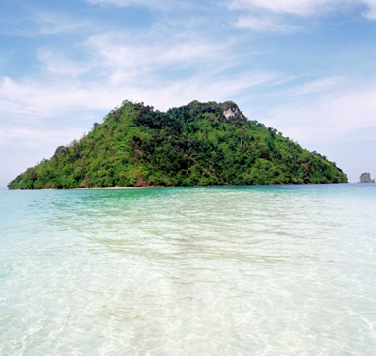
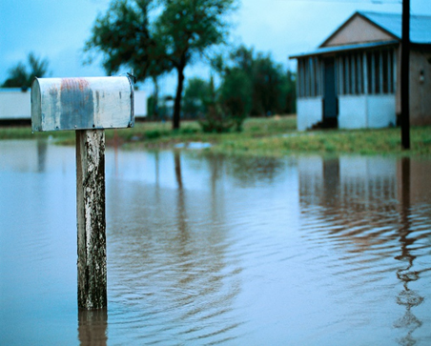
The largest part of our planet's surface is covered with water.

Slide 3
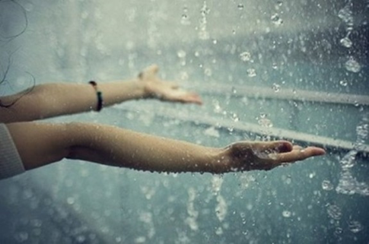
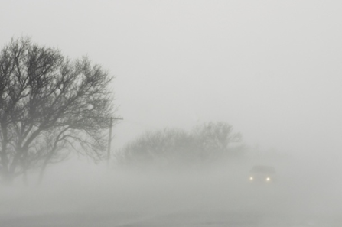
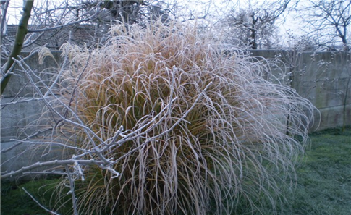
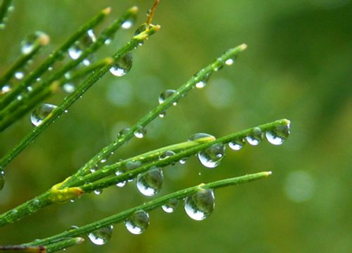
In various forms ...

Slide 4
Earth is about 1.4 billion km³ of water (71% of Earth's surface).
Most of them water up to 97.5% of salt water (sea and ocean), fresh water 2.5%, of which <1% of rivers and lakes, 30% of ground water and 69.9% are frozen poles.
Only 0.8% of the total water available for human use is 11.2 million km³.

Slide 5
The World Water Day is celebrated every year on March 22nd.
The first important recommendations on water and water resources issues were formulated at the United Nations Conference on Waters, held in Argentina in 1977.
Following the United Nations Conference on Environment and Development in Rio de Janeiro, the UN General Assembly resolved on March 22, 1993 to mark March 22 every year as World Water Day.

Slide 6
On March 22, every year, around the world, special attention has been paid to water and water resources issues, with each year being marked by another motto.

Slide 7
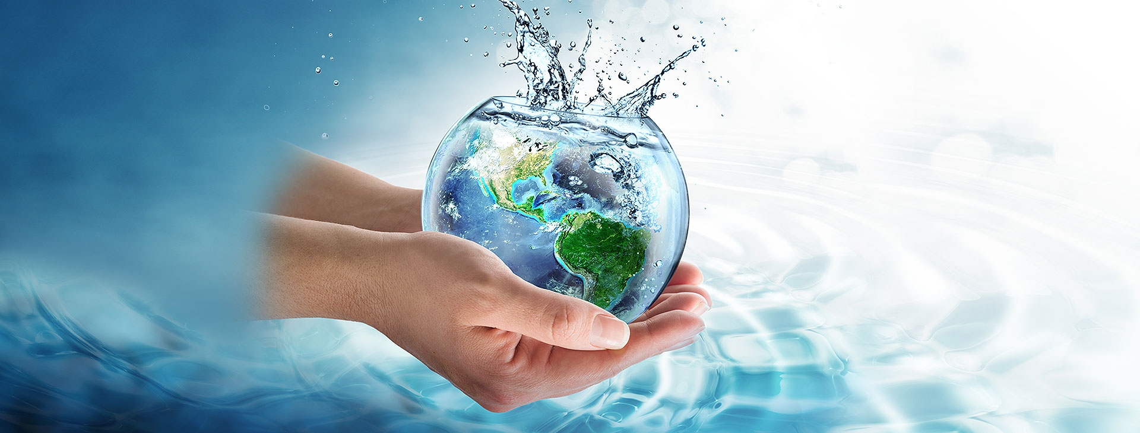
The theme of the World Water Day in 2018 was "Water Nature" along with the "Response in Nature" campaign.

Slide 8
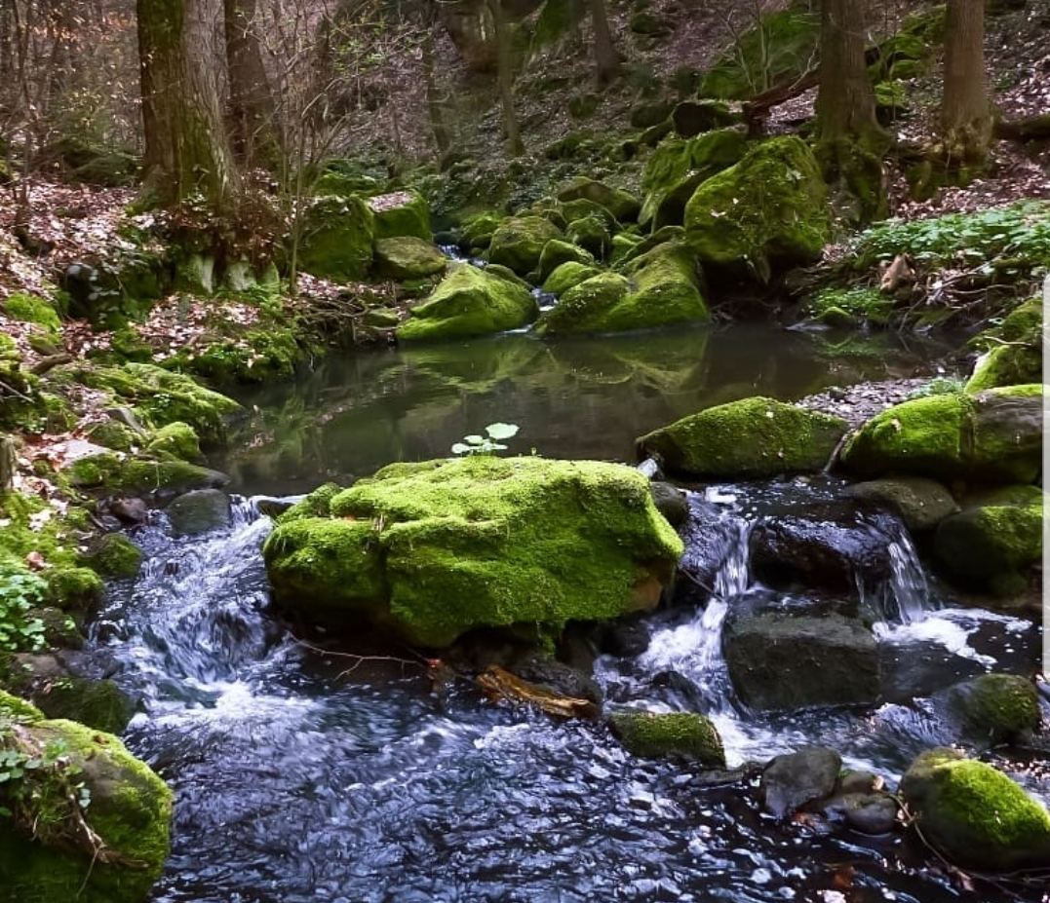
Globally, 70% of water is used for agricultural purposes, 20% uses the industry to produce and produce energy while the remaining 10% is used for domestic use.
Today, 2.1 billion people live without safe drinking water at home, affecting their health and life.
Water in such areas is not protected from pollution because about 80% of waste water returns back to nature.

Slide 9
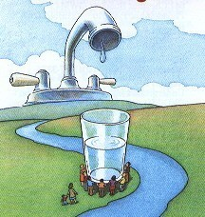
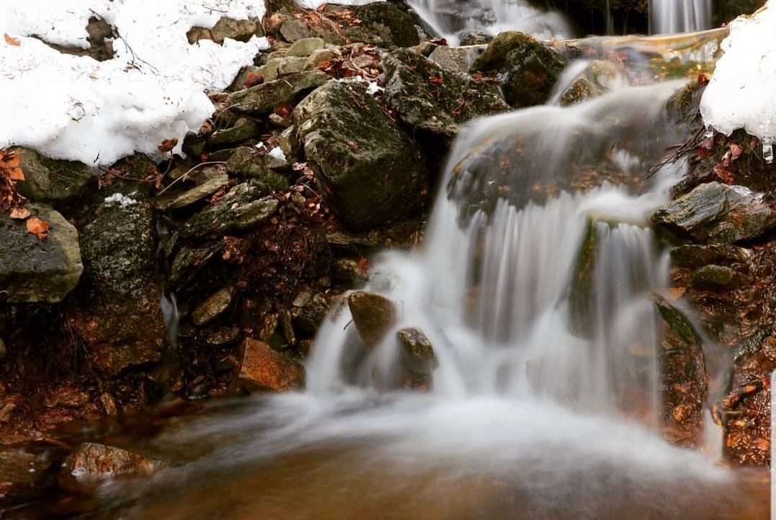

Slide 10
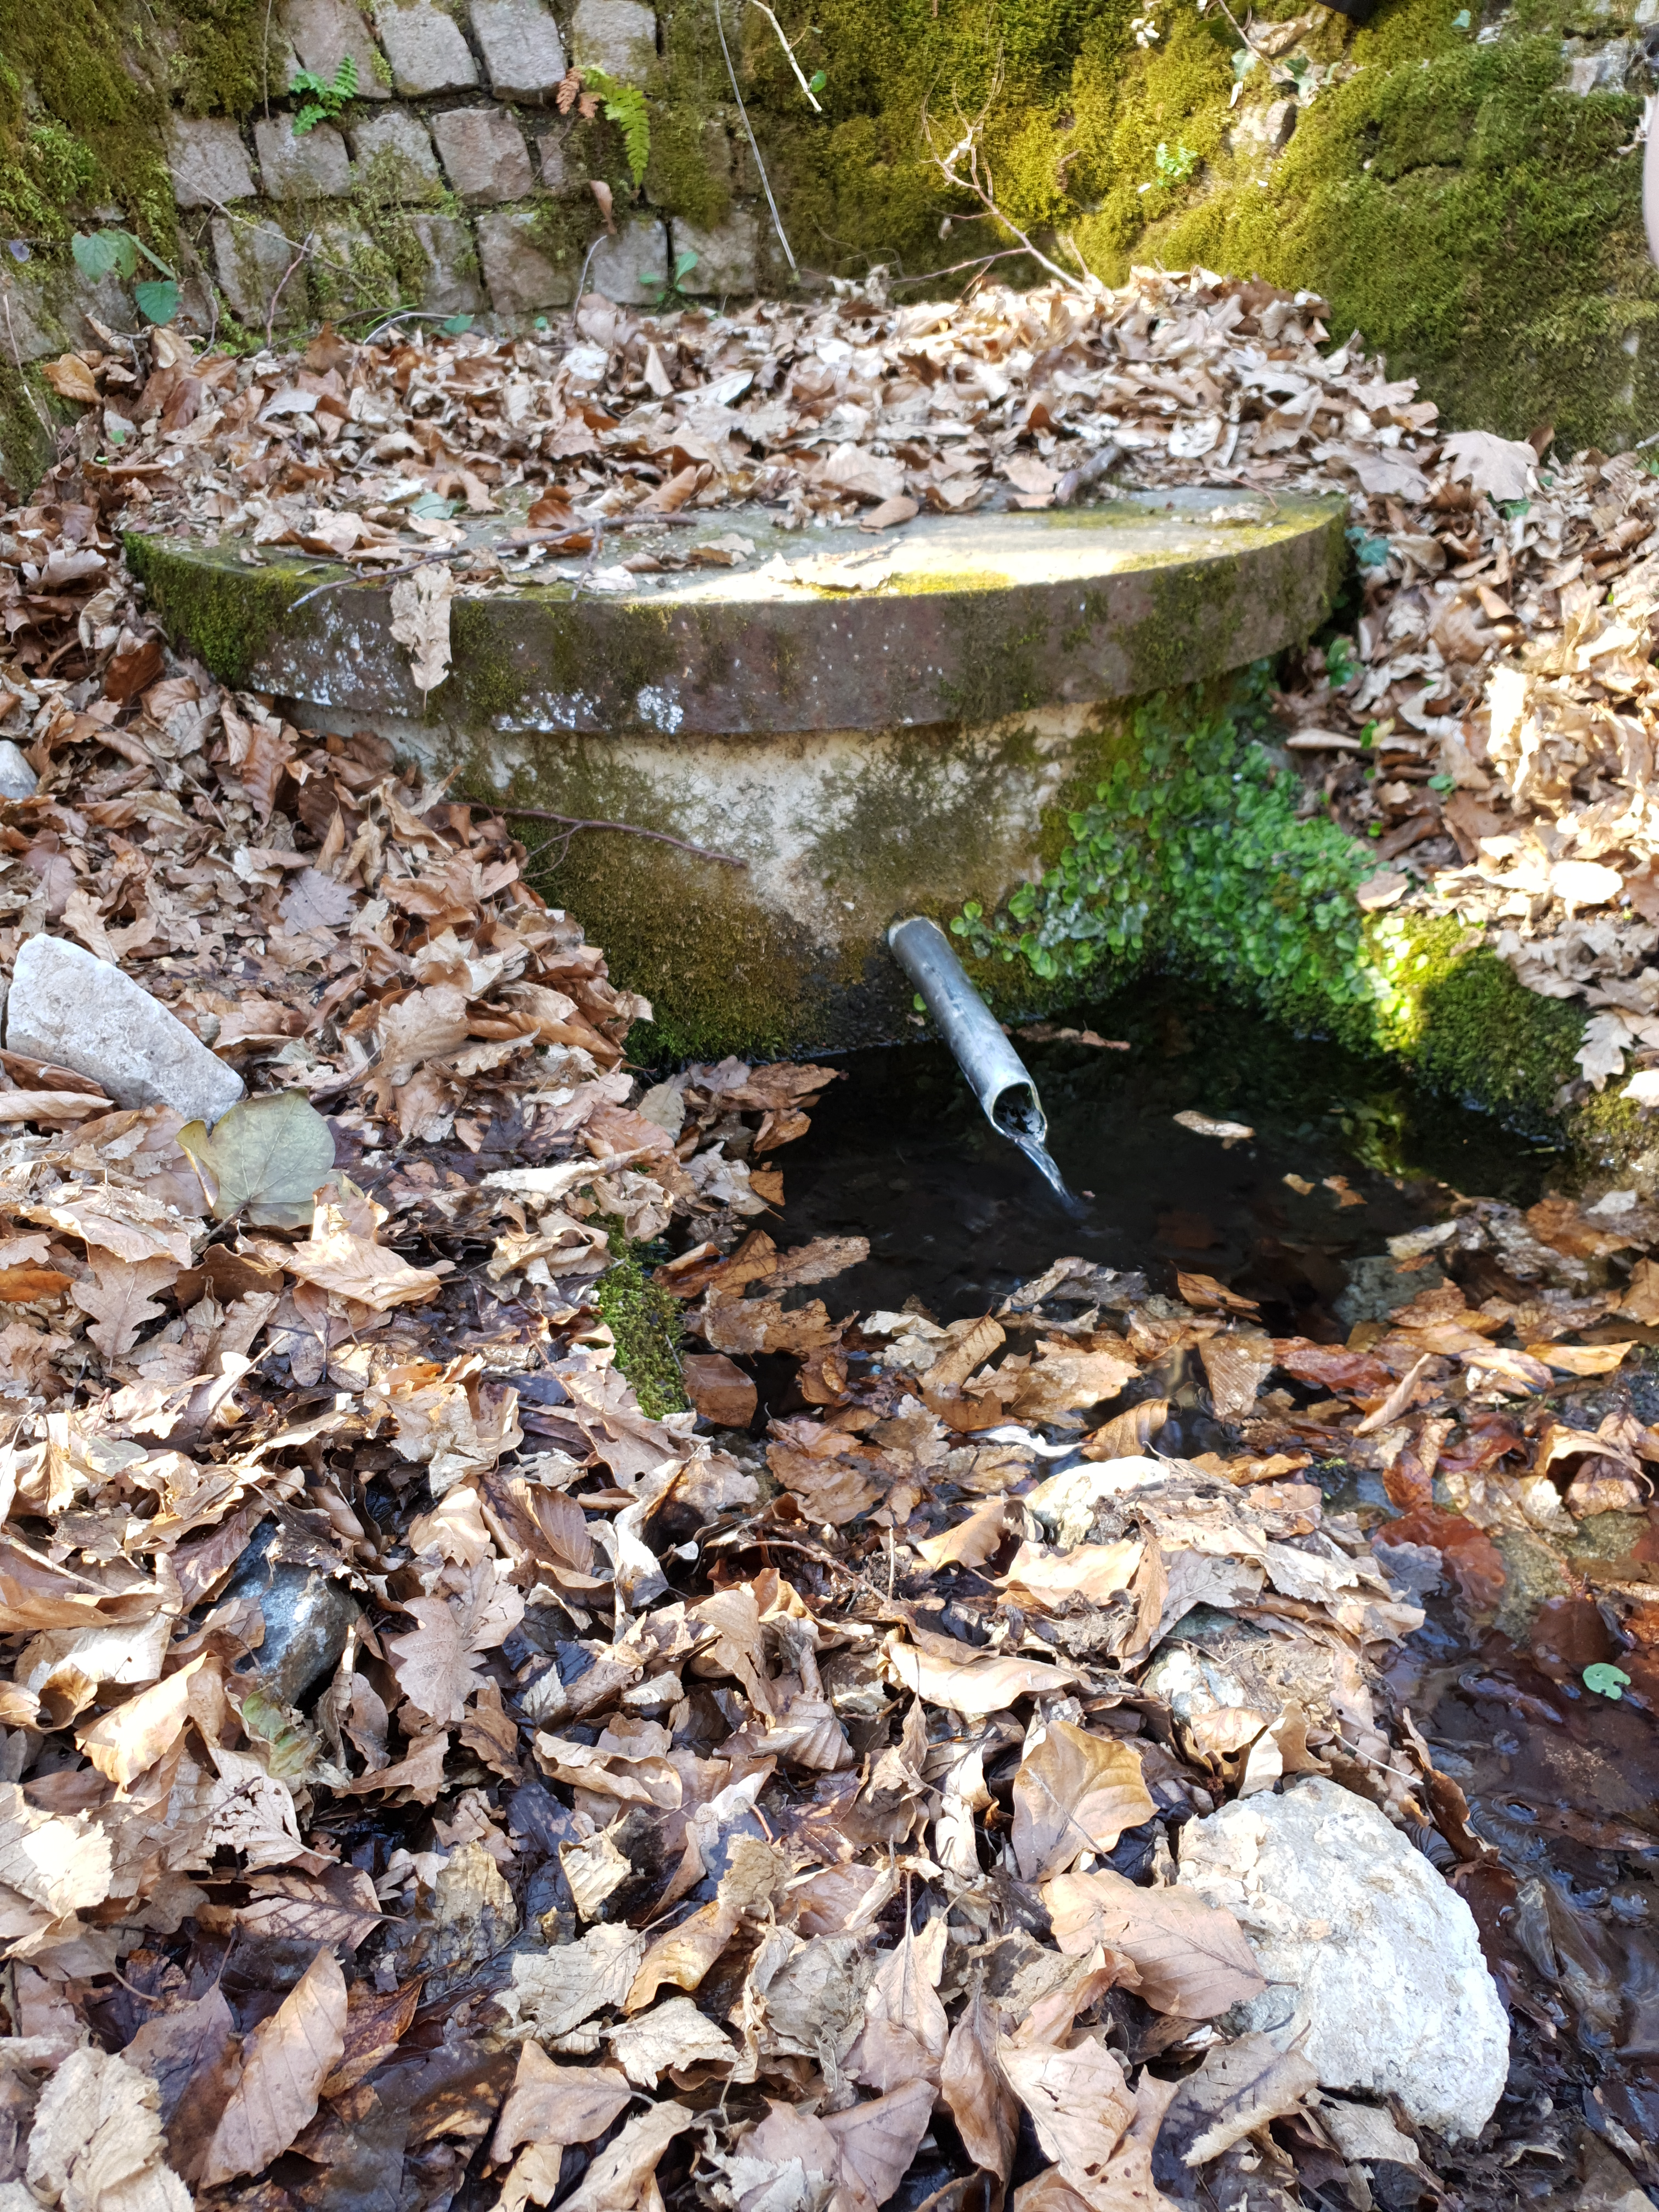
"Every drop of water is on an infinite journey through the sky, the ground and the streams, through our lives and back to nature”

