Slide 1
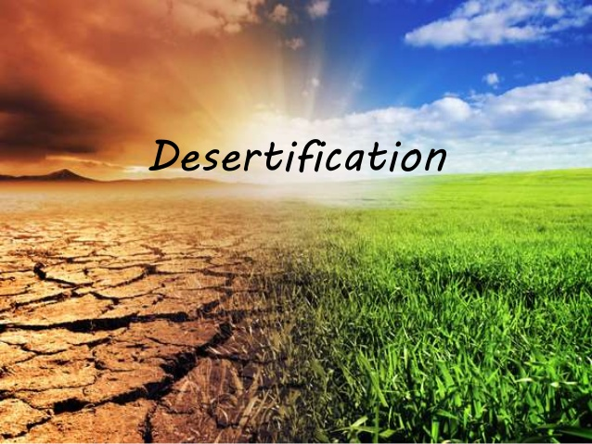
5o Gel Petroupolis, Athens, Greece
Kefala Eleni

Slide 2
What’s desertification
The United Nations’ official definition says desertification is land degradation in typically dry areas resulting from various factors, including climatic variations and human activities.

Slide 3
Causes of Desertification
Human activities
Overgrazing
Drought
Over cultivation
Deforestation
A long period of time with little or no rainfall.

Slide 4
Overgrazing
the rearing of too much livestock
in a limited pasture
too many cattle graze in an area
eat up all the grass and shrubs
the pounding and trampling of the animals’ hooves
kill the grass
the vegetation cover disappears
the soil is exposed
blown away by wind or washed away by occasional rain

Slide 5
Over cultivation
the continuous growing of crops on the same piece of land without replacing soil nutrients
it gradually loses its nutrients
the fields are no longer left to lay fallow
the land becomes infertile
crop yields fall and crops cannot be grown on the infertile soil

Slide 6
Deforestation
people cut more trees for fuel and wood
the vegetation cover is being cleared away
the soil is loose
winds can carry the soil away
the population is increasing

Slide 7
Drought
The term “drought’’ means a long period of time with little or no rainfall.
In drought-prone areas the soil is already exposed and its gets blown up the wind, or the occasional rain.

Slide 8
How desertification can be controlled?
crop rotation
controlled grazing
wind brakes

Slide 9
Crop Rotation
Crop rotation is the cultivation of different crops in a specified order on the same fields, in gap to a one- crop system or to random crop sequences
It helps in reducing soil erosion and increases soil fertility
The plant absorbs the nutrients from the soil. The farmer then, plants a plant which replaces the soil nutrient

Slide 10
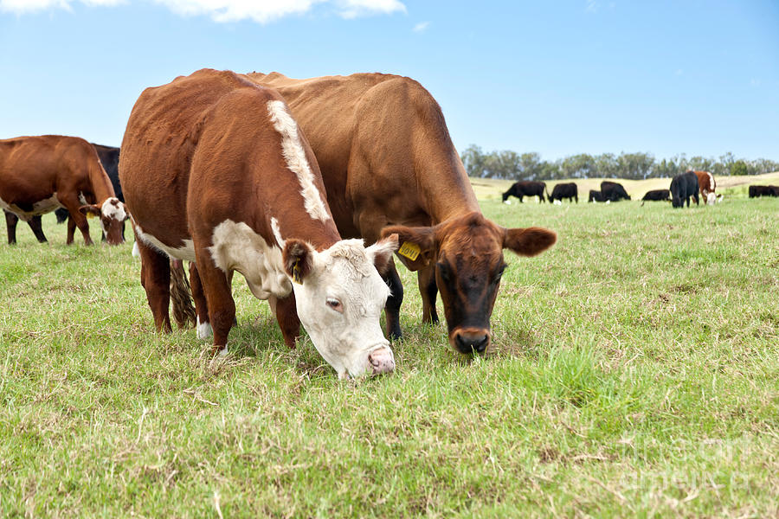
Controlled Grazing
allow grazing animals in an area for a certain period of time
so that the soil can regain its fertility
allowing rest and recovery of the vegetation

Slide 11
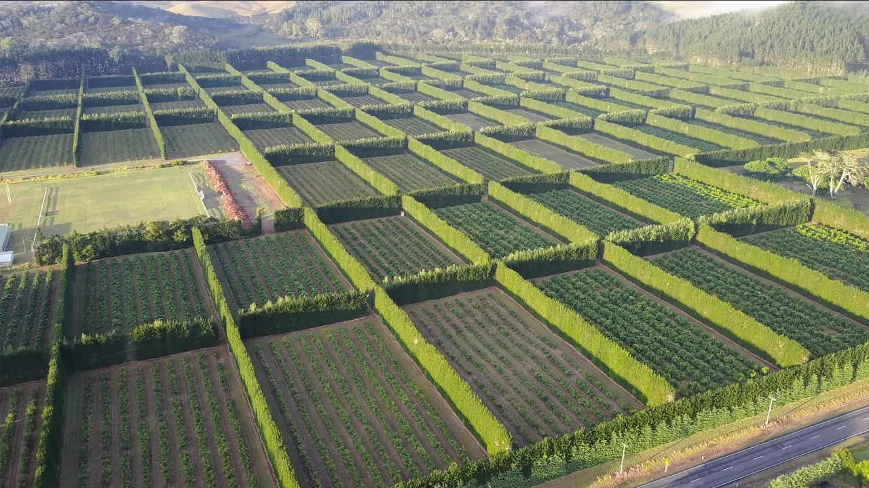
Wind brakes
people plant trees in a line to protect the soil from soil erosion is called windbreak
these trees are planted in a row so that the force of the wind is not strong
it protects the soil from soil erosion

Slide 12
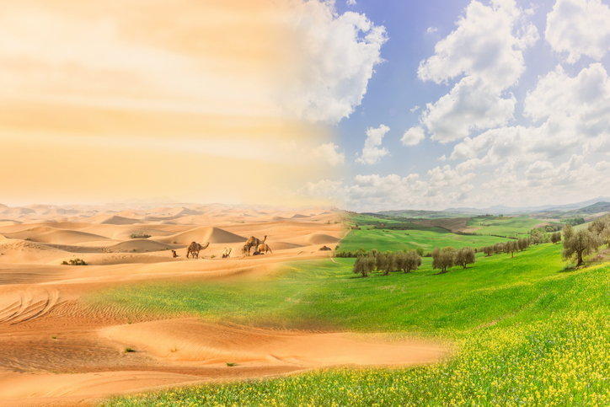
Questionnaire
1
2
3
4
5
What are the two main causes of desertification?
Human activities
Drought
Name those three activities.
Overgrazing
How desertification can be controlled?
crop rotation
Over cultivation
Deforestation
controlled grazing
wind brakes

Slide 13
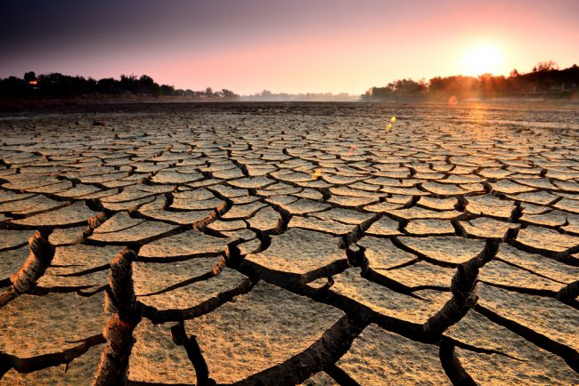
Thank You!

