Slide 1
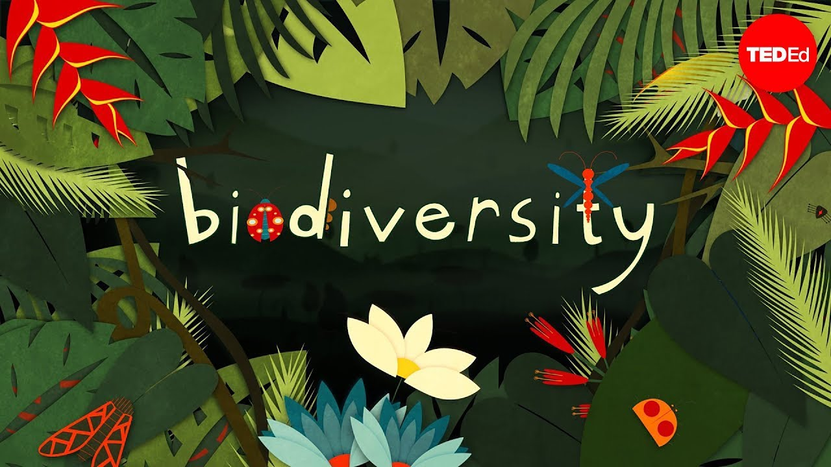
The Rio Convention

Slide 2
The Rio Convention:
UN 1992 – Rio de Janeiro:
Convention on Biological Diversity
Framework Convention on Climate Change
Principles of Sustainable Forest Management
This is the summary of the Rio Convention!

Slide 3
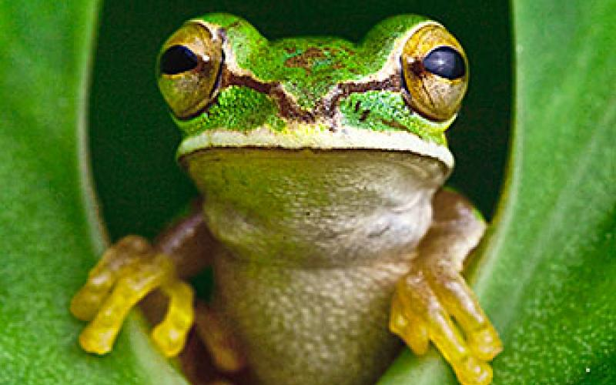
The specific objectives of the Convention :
Preservation of biodiversity
Sustainable use of its components
Fair and equitable distribution of the benefits of the exploitation of genetic resources
The essence of the convention is the preservation, using and sharing of benefits

Slide 4
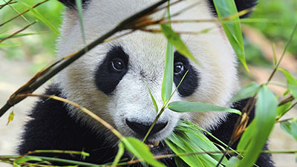
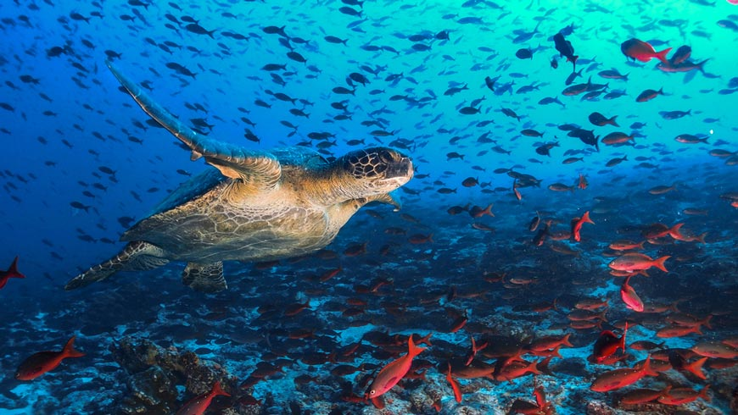
Biodiversity
Biodiversity means diversity between living beings of all origins
This includes the diversity of species, specimens, and the ecosystems themselves

Slide 5
Tasks
Proper In-situ, Ex-situ protection
Sustainable usage
Research, training, public education, information
Environmental impact assessment and minimization of damage
Ensuring accessibility of technologies

Slide 6
Functioning of the Convention
Conference of the Parties (COP)
Function: To guide and check the operation and implementation of the Convention.
Their meetings are held every 2 years
Extraordinary meetings may also be convened (e.g.: adoption of the Cartagena Protocol)
The secretariat
Function: Organization and assistance of meetings, coordination of cooperation with international bodies
The COP contributes a fixed amount of money to cover their costs
Scientific, Professional and Technological, Advisory Board of the Convention
Function: To make scientific, professional and technological recommendations to the COP.

Slide 7
Thank you for your honoring attention!
Created by: Áron Tóth, Dániel Lelkes, Gergő Serfőző

