Slide 1
Biodiversity

Slide 2
Idea
= Biodiversity
The diversity of living beings and habitats and the changes within the species
The science of ecology deals with it UN Convention:
Includes intra-species, inter-species diversity and the diversity of ecosystems themselves

Slide 3
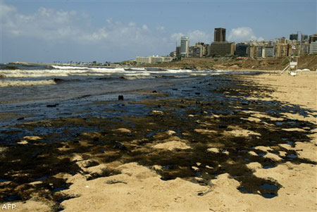
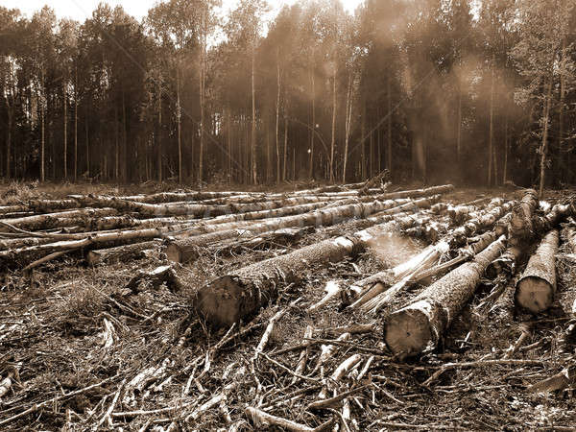
Reasons of falling:
Rapid growth of human race
Destroyed of natural habitat
Excessive use of natural resources
Pollution of seas and fresh waters

Slide 4
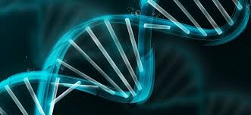
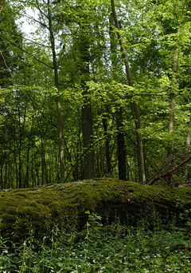
Levels
Genetics diversity
Taxon diversity
Ekological diversity

Slide 5
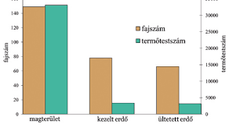
Statistics
Number of species
Production number
Number of species
Production number
Core area
Treated forest
Planted forset

Slide 6
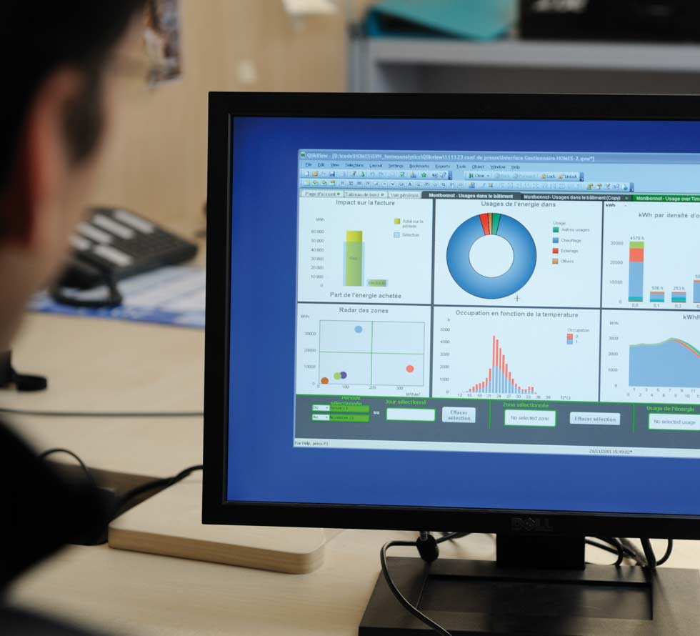
Measurement ways
In a particular area
System approach
Quantity approach
Monitor system

