Slide 1
Foreign exchange / Currency
Quick guide
Made by: Serfőző Gergő

Slide 2
Definitions:
Currency: a system of money in general use in a particular country. Forms: cash (bills, coins)
Foreign currency account: A foreign currency account is a bank account in the currency of another country (e.g. a dollar account in the UK). Forms: Bank accounts
Exchange rate: a the value of one currency for the purpose of conversion to another.

Slide 3
Where do we use it?
Every country has it’s own unique currency, which can be used inside the borders of the nation by the locals, but with the agreement of different countries one currency can be official in said countries.
Amidst the cross country trading, the increasing production rates and other economical processes the idea of currency exchange came up. The essential difference between foreign currency and foreign currency accounts is just formal.

Slide 4
Interpretion and Grouping of exchange rates
As means of payment:
Currency exchange rate: the value of one country's currency in relation to an another country’s currency.
Foreign exchange rate: the price of the domestic currency stated in terms of another currency.
As means of transaction:
Buyer: The buyer is willing to buy the foreign currency at the predetermined price.
Seller: The seller is willing to sell the foreign currency at the predetermined price.

Slide 5
Currency conversion
A conversion from one currency to another In most cases it happens because the type of currency between the two parties differ. It can occure between banks as well as individual persons usually due to the money transfer between countries, or in an international bank if one has multiple bank accounts with different currencies.
Convertibility: One of the properties of the currency is that it can be exchanged to a different type.
Requieremnt:
Monetary reserves
Liberal economical politics
Market economy

Slide 6
Levels
Levels of central banks: Only the central bank is permitted to exchange
External convertibility: Exchange is only allowed for the foreign currency users
Internal convertibility : Exchange is only allowed to the locals
De facto: You need permission to exchange, but they give it without any requirements
De jure: Permission is not needed, anyone can exchange
Restricted convertibility: It only spreads out to the balance of payments
Complete: Anyone can do it

Slide 7
Types of Exchange rates
Fix exchange rate: In this case the fluctuation gap is really small due to the intervention of the state. Tied exchange rate: The currency exchange rate is locked by the government, thus the demand/supply rate is negated
Flexible exchange rate: It is based on the principle of demand/supply, the state cannot intervene

Slide 8
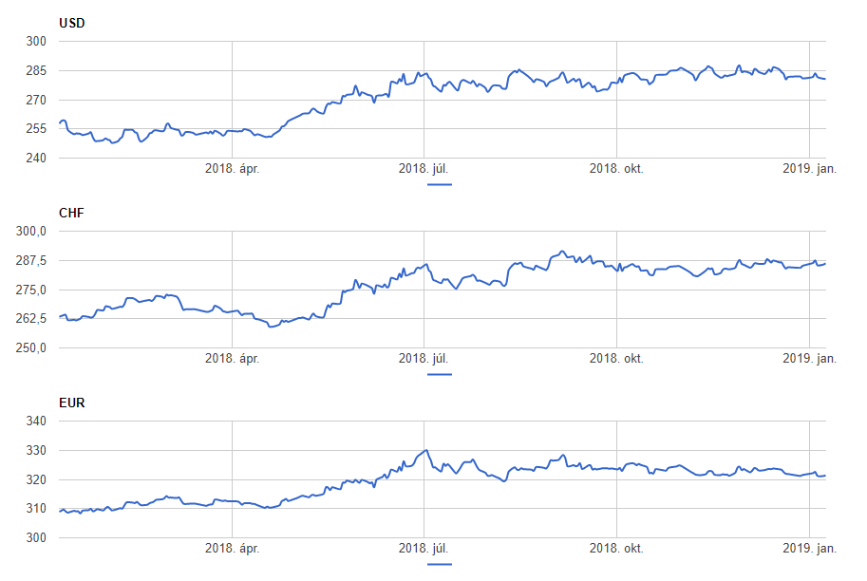
The currency exchange rate of Forint

Slide 9
Increase / Decrease Increasing / decreasing
Increase / Decrease: According to the unanimous decision of the leaders of the system, the value of the currency is precisely monitored and controlled
Increasing / Decreasing: According to the demand/supply principle, and the item structure the value of the currency raises or falls

Slide 10
Strengthening / Weakening
The change in the exchange rate is measured in currency points or percentages.
The currency, or base point: I the case of 1 unit of the listed currency the fourth decimal point, In the case of 100 units the second decimal point -> base point
Base point: The hundredth of a percent, the smallest measurement in an exchange rate.
The changes in the echange rate | Strengthening | Weakening
Home currency: | Minus (-) | Plus (+)
Foreign currency: | Plus (+) | Minus (-)

Slide 11
Eurozone
One of aims of Hungary is to get into the eurozone but it has a lot of strict and predetermined requirements: The loss of budget needs to be lower than 3% of the gross income
The state debt needs to be lower than 60% of the gross value of all products
The inflation of the country can only exceed the 3 member states with lowest inflation rate by 1,5 %.
The long term interest can only exceed the 3 member states with the lowest interest rate by 2%
The exchange rate of the home currency needs to be held between the fluctuation lines determined by the European Monetary System for two years without any serious cases of monetary tension

