Slide 1
Hungary

Slide 2
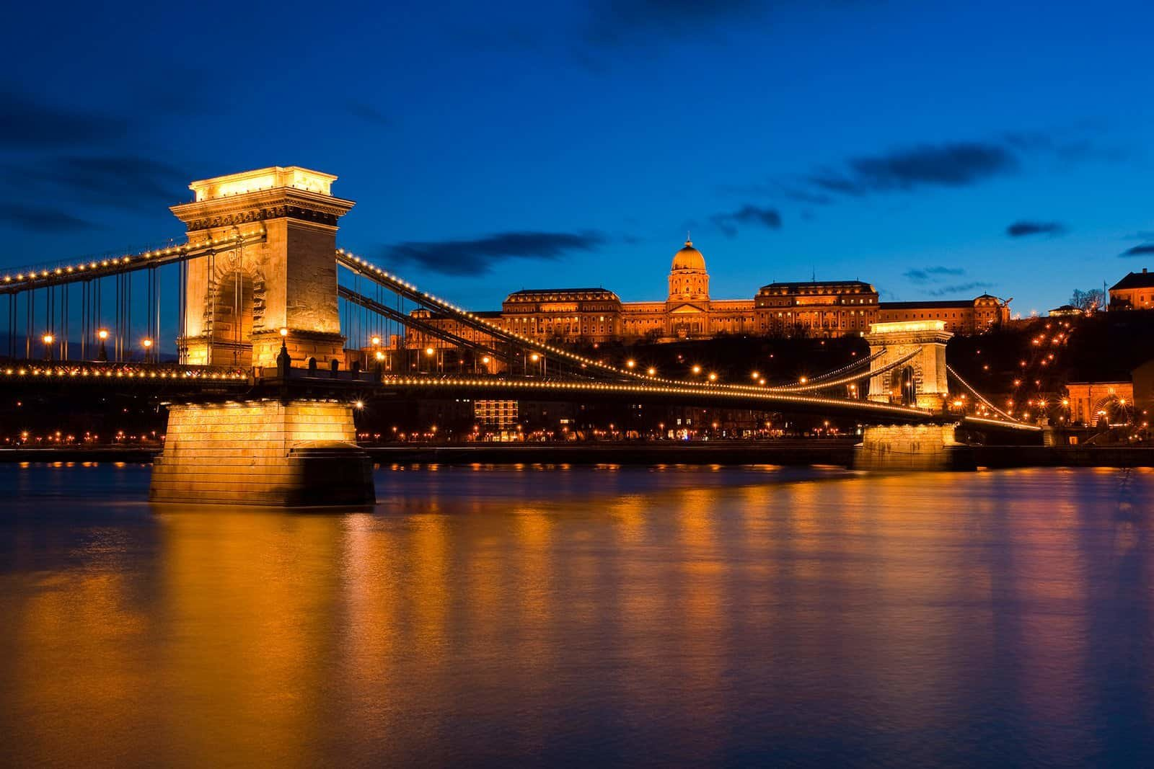
General Facts
Population : 9,7 million people
Area : 93.030 km²
Highest „Mountain”: Kékes (1014m)
Capital : Budapest*
Currency: HUF (Forint)
Ethnic Groups :
83.7% Hungarian
3.1% Roma
1.3% German
14.7% not declared

Slide 3
Hungaricums

Slide 4
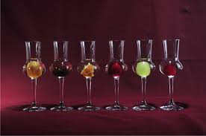
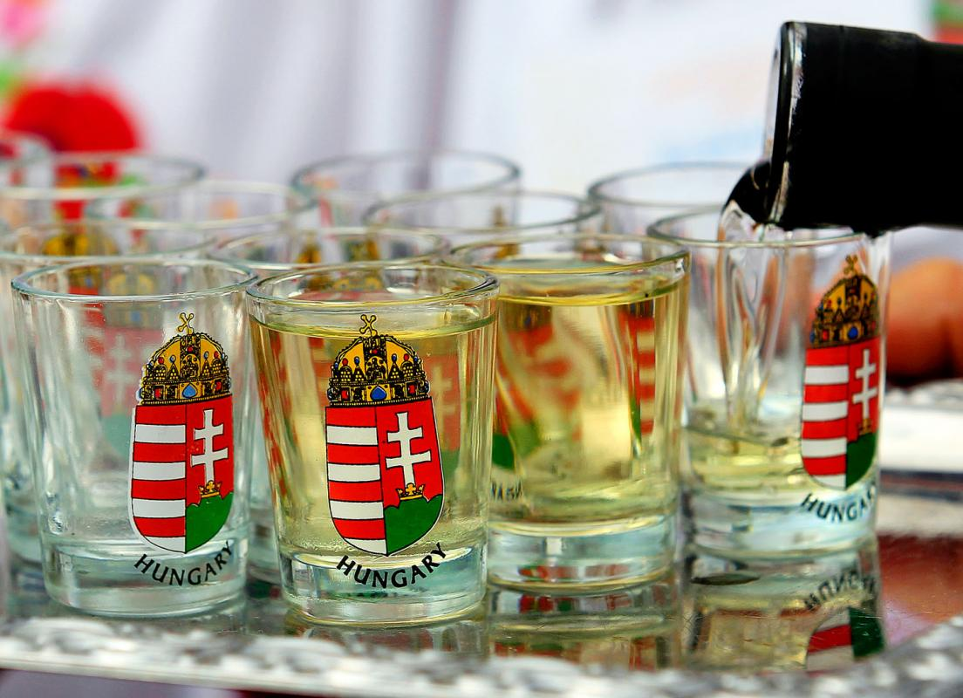
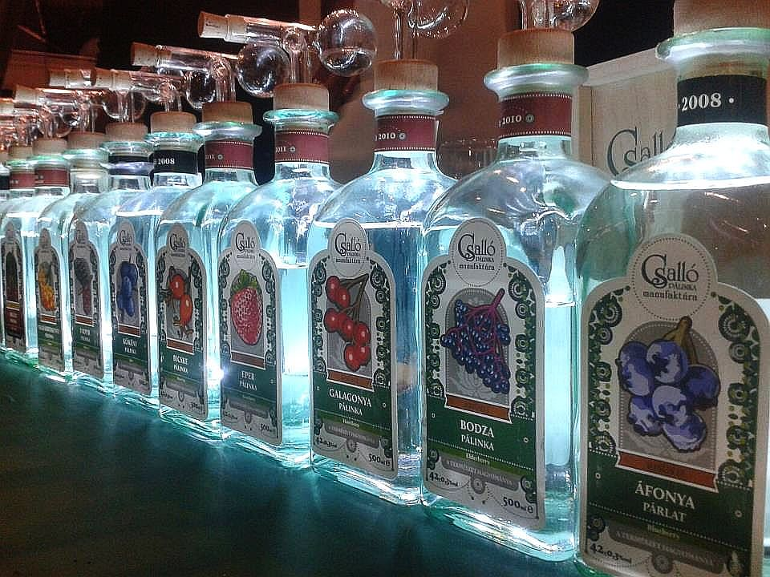
Pálinka
In English -> brandy

Slide 5
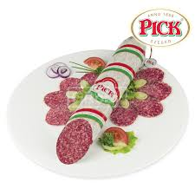
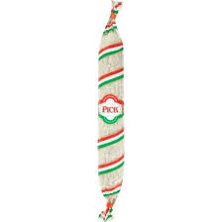
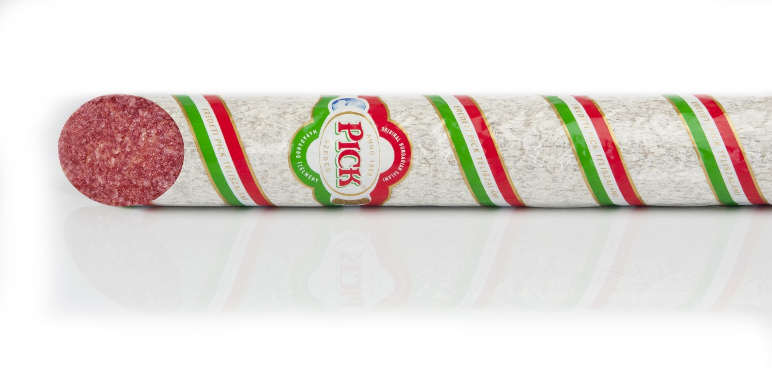
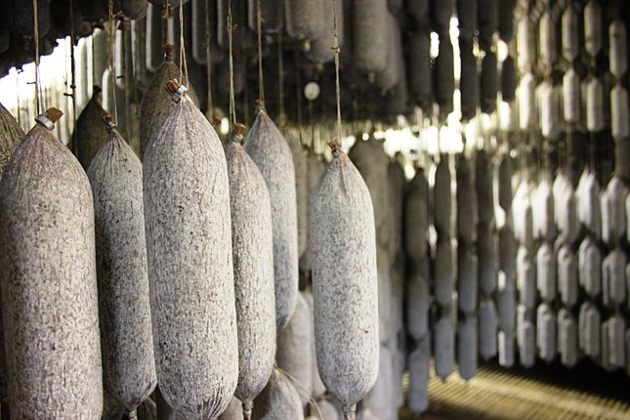
Téliszalámi
In English -> „Winter” Salami

Slide 6
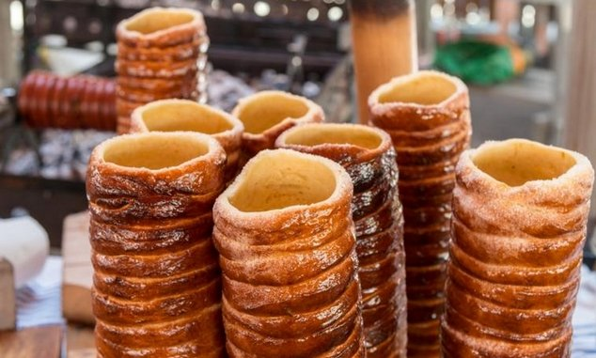
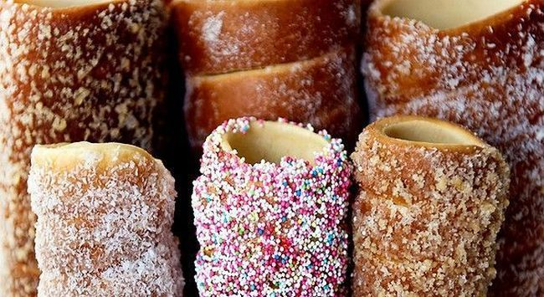
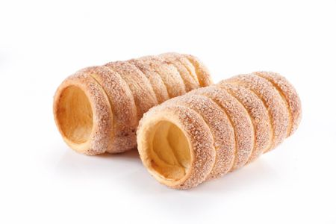
Kürtős kalács
In English -> ‚chimney cake’ (there is no such expression in English)

Slide 7
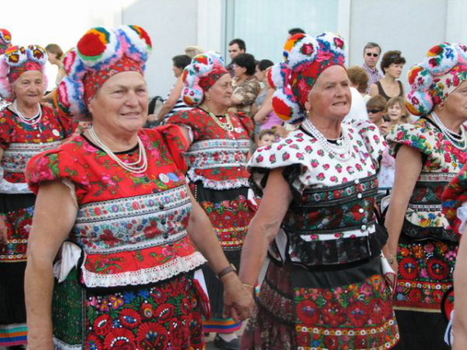
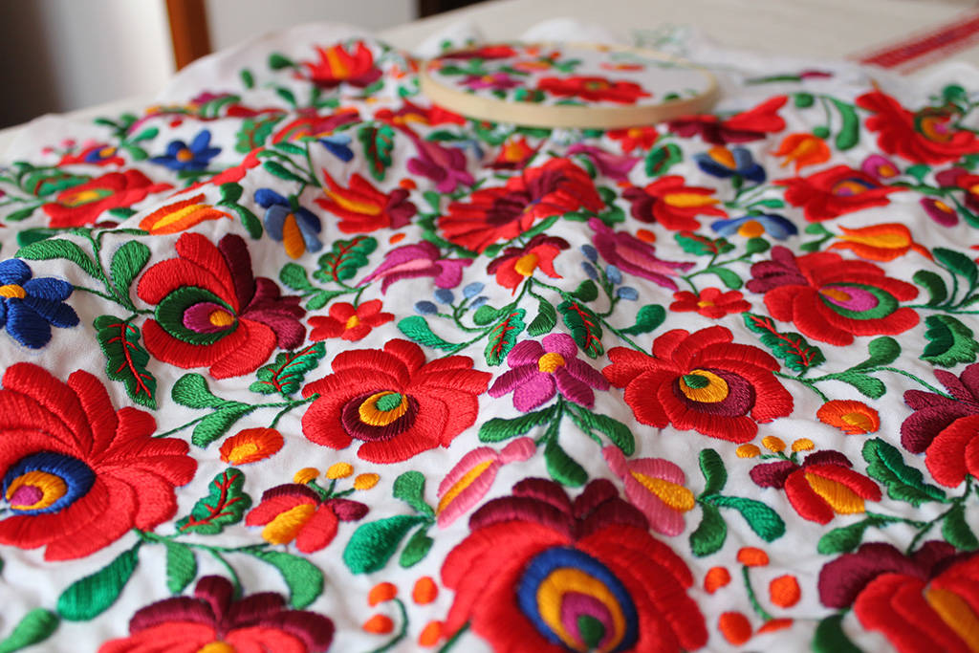
Matyó embroidery

Slide 8
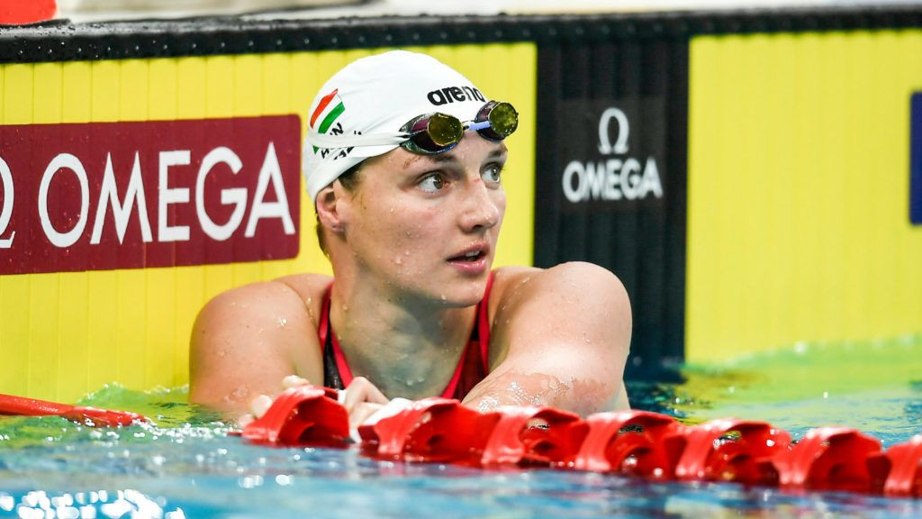
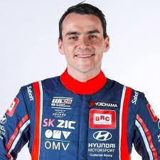
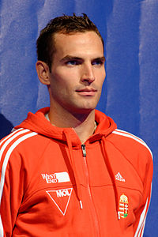
World-famous Hungarian champions
Hosszú Katinka
Michelisz Norbert
Szilágyi Áron

Slide 9
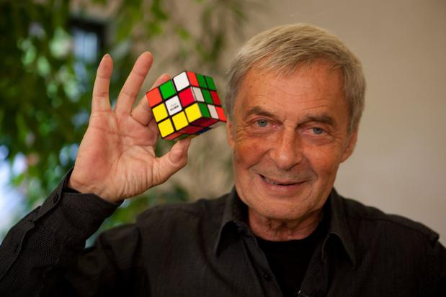
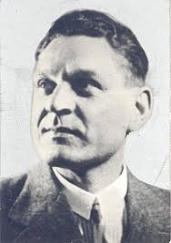
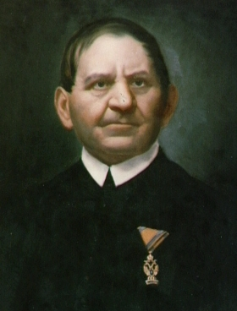
World-famous Hungarian inventors
Rubik Ernő
Asboth Oszkár
Jedlik Ányos

Slide 10
Hungary’s sights

Slide 11
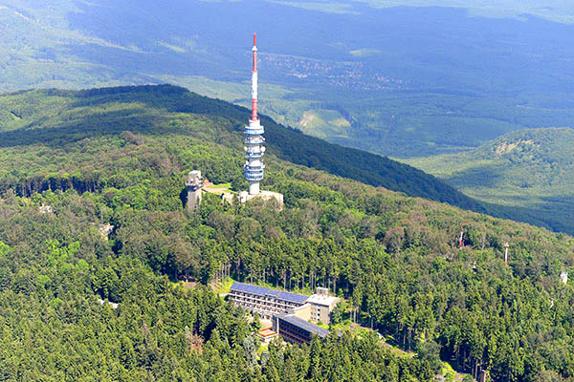
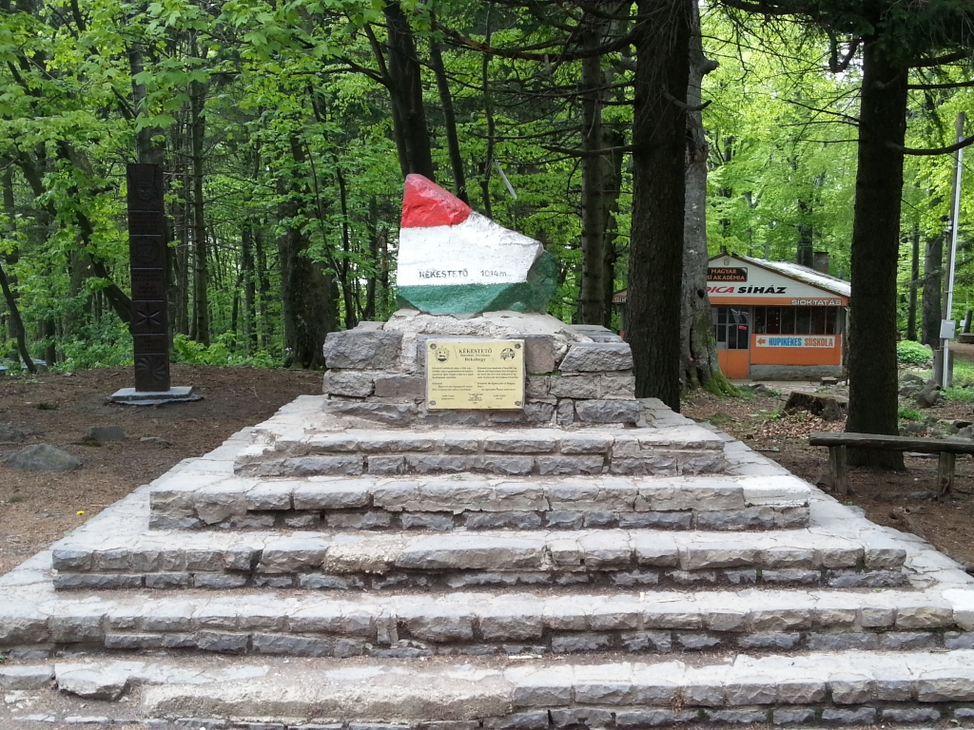
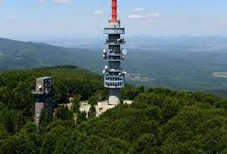
Kékes
Height : 1014m

Slide 12
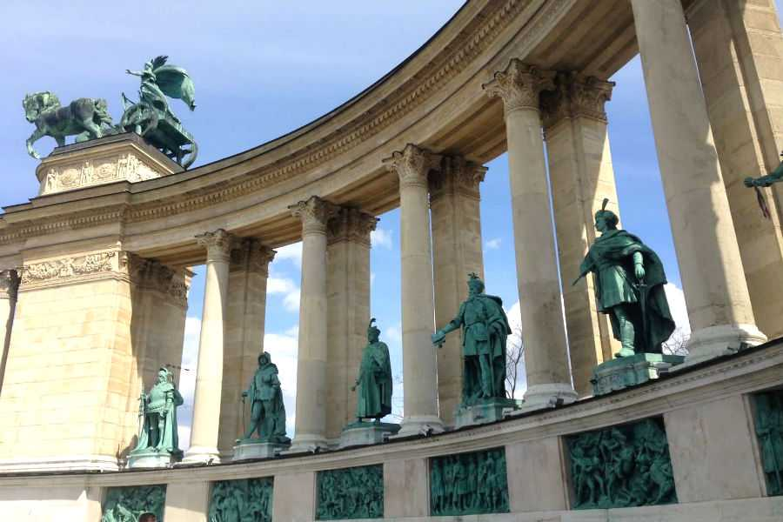
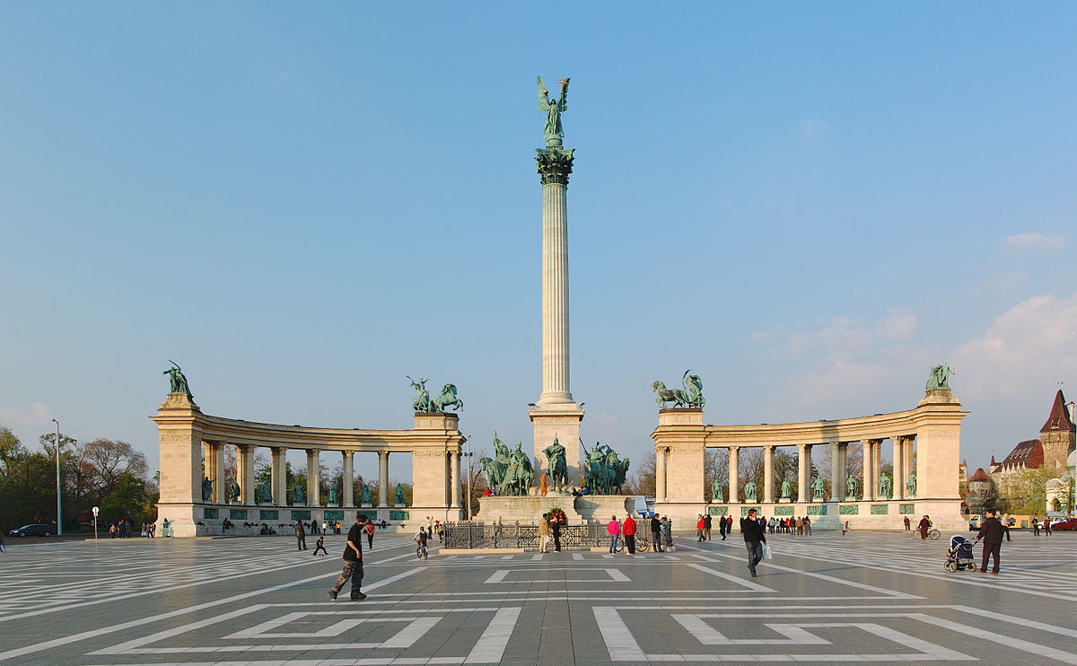
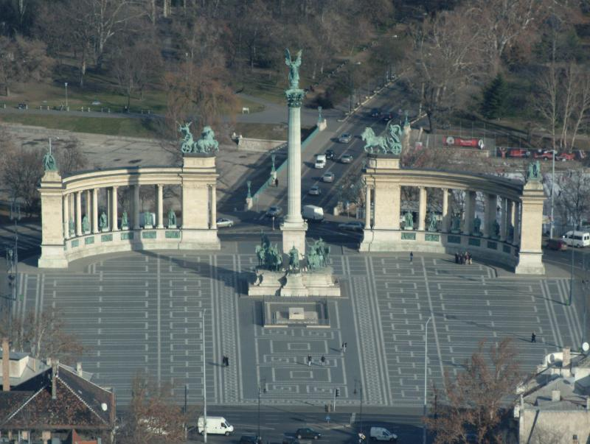
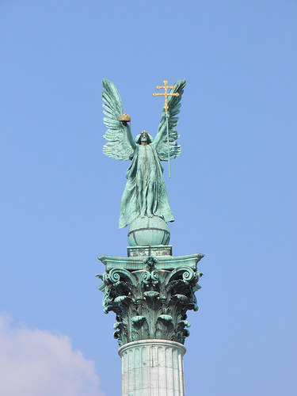
Heroes’ Square
Budapest

Slide 13
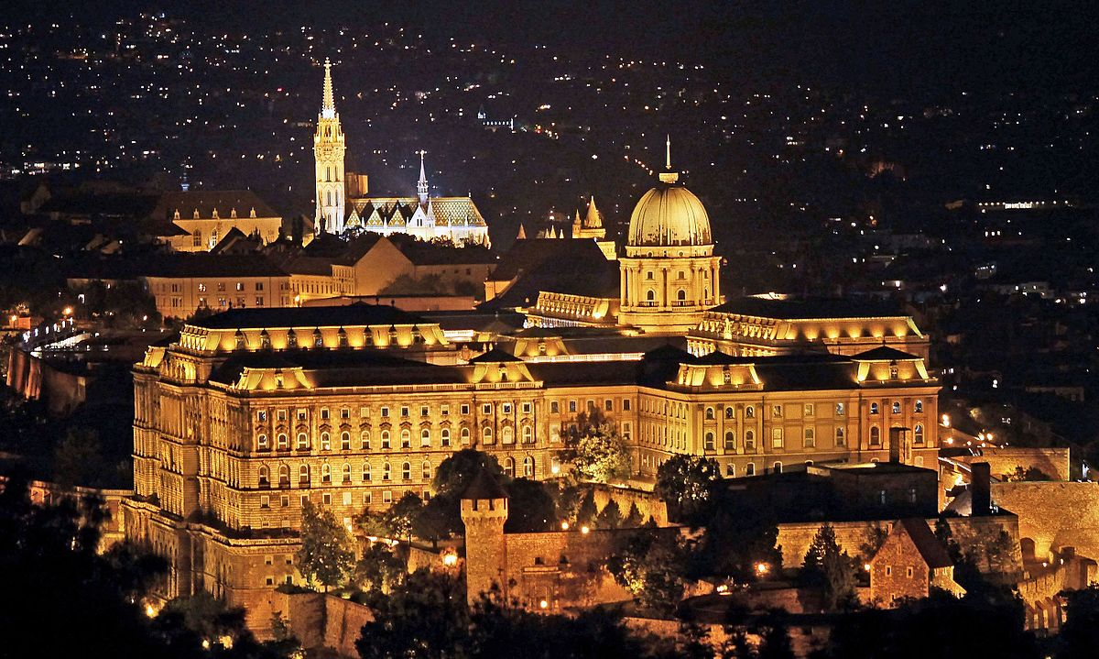
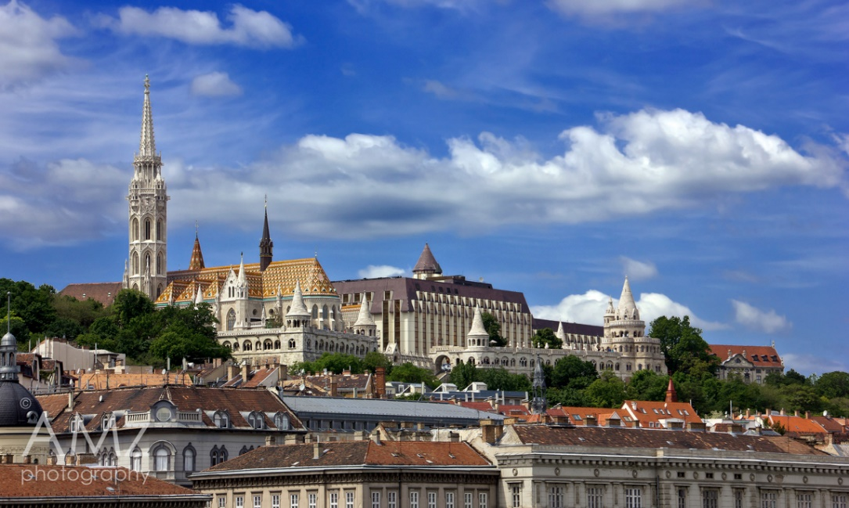
Buda Castle
Budapest
3 main parts :
Buda Castle
Saint George place
Historic residential area

Slide 14
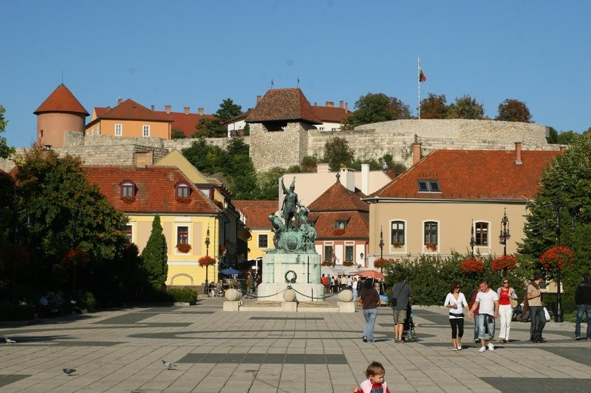
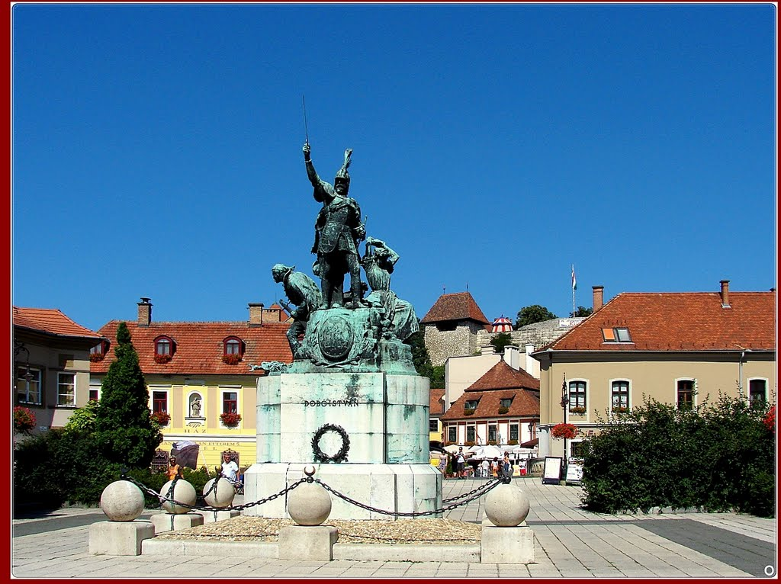
Dobó Square
Eger
Sights in the square :
Statue of István Dobó
Spraying fountain
Baroque bridge

Slide 15
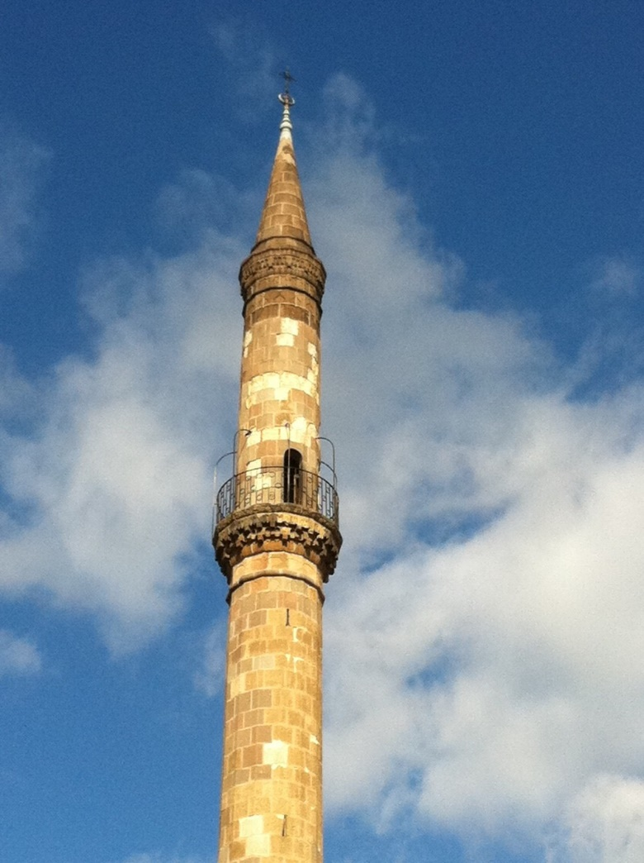
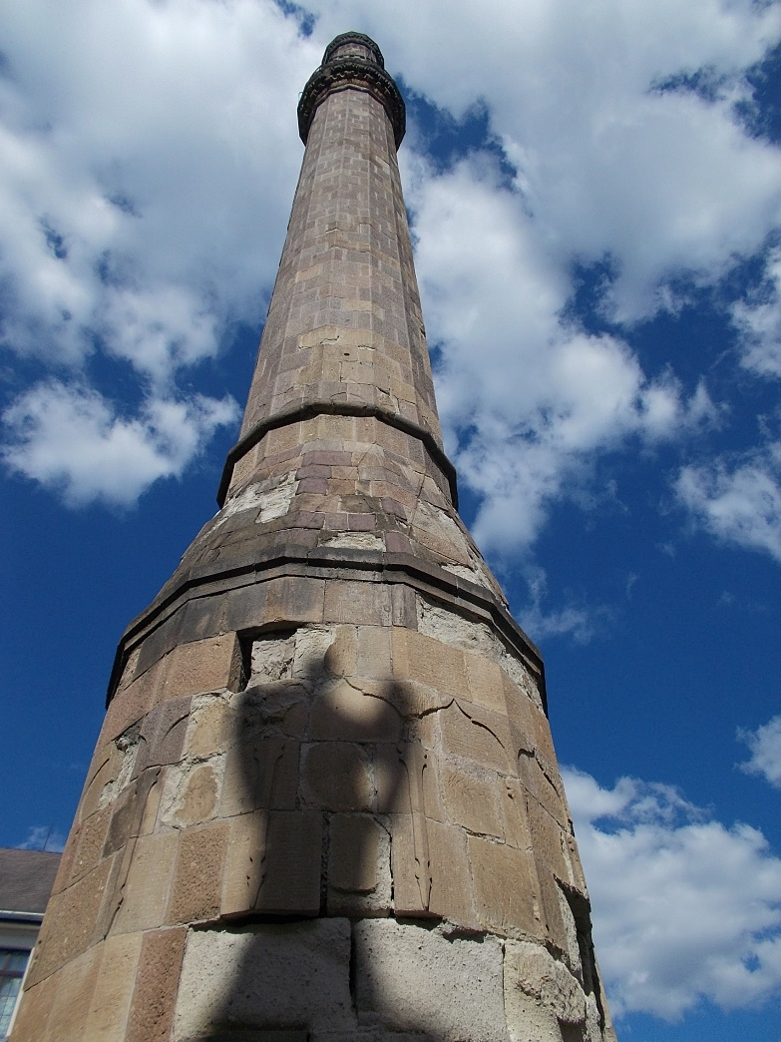
Turkish Minaret
Eger
Built in about 1700
Height : 40m

Slide 16
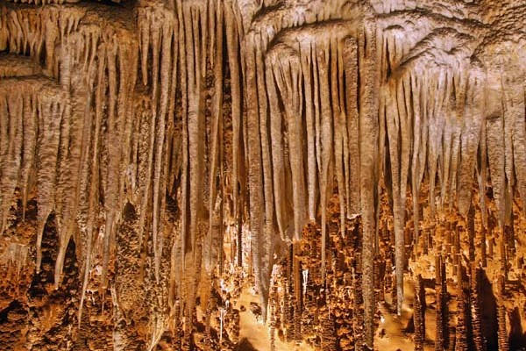
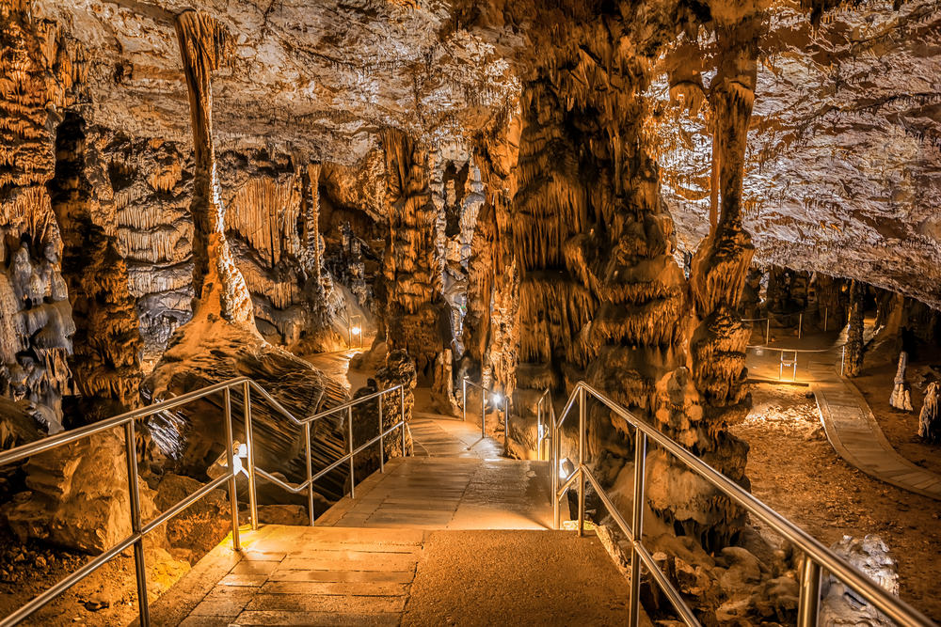
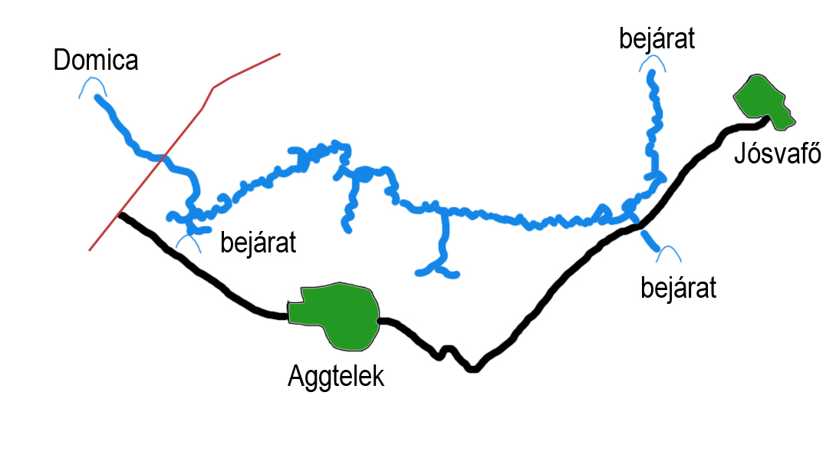
Aggtelek stalactite cave
Aggtelek
Length : 25km
bejárat = entrance

Slide 17
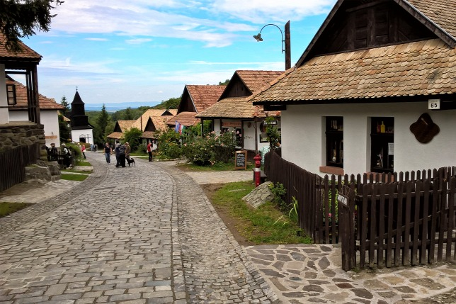
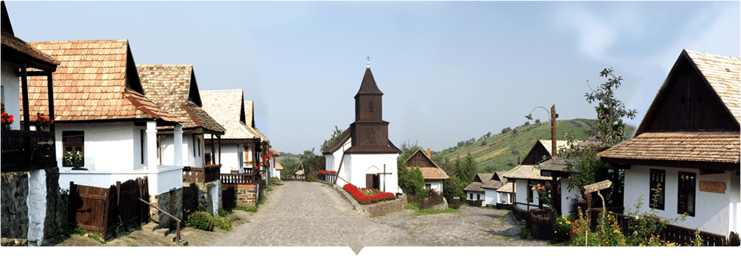
Hollókő
Hollókő
Part of the UNESCO World Heritage
Was built in the 17th century

Slide 18
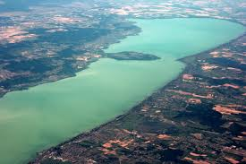
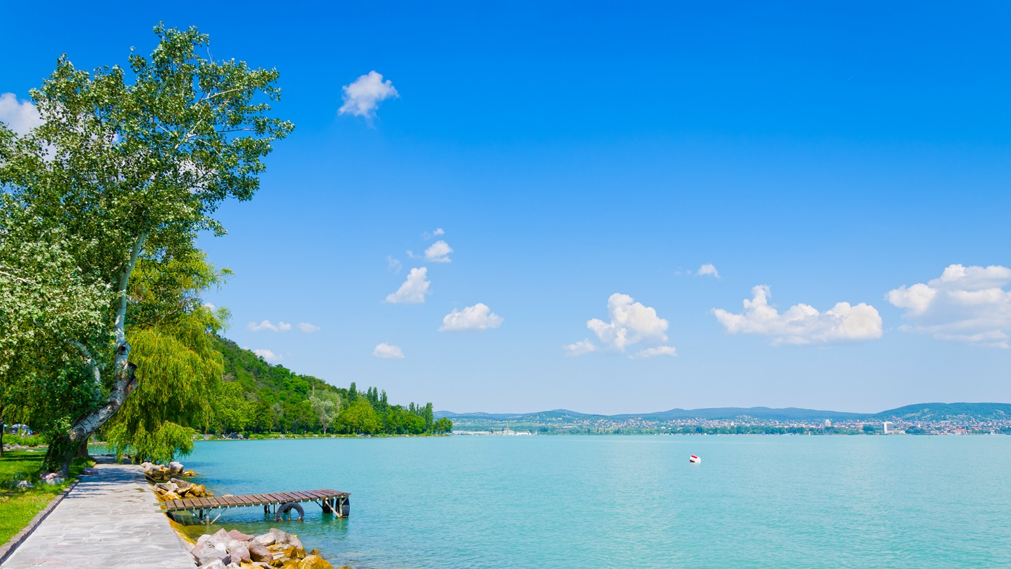
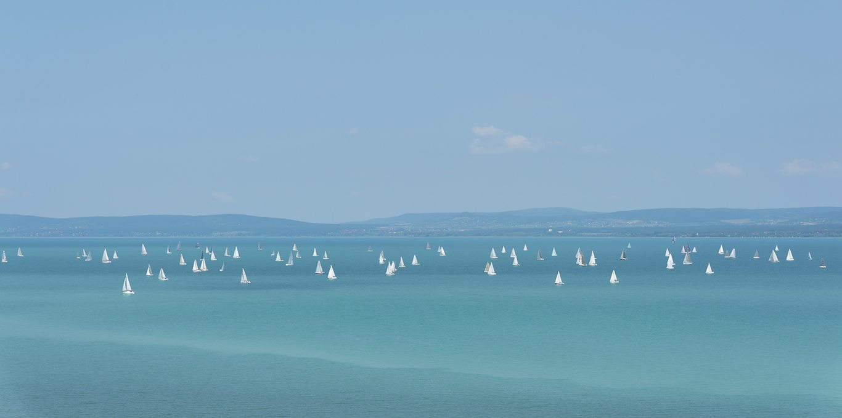
Lake Balaton
Length : 78km
Width : 1-14km
Maximum Depth : 12m

Slide 19
THANK YOU FOR YOUR ATTENTION

