Slide 1
Competition policy
Made by : Mádi Vivien

Slide 2
What is competition?
Competition puts companies under constant pressure to offer the best possible goods at the best possible price so that consumers continue to buy them.
They need to regulate their behavior for fair competition.

Slide 3
The Commission will monitor the following activities:
agreements between undertakings to limit competition
abuse of a power
merger
market openings
financial support

Slide 4
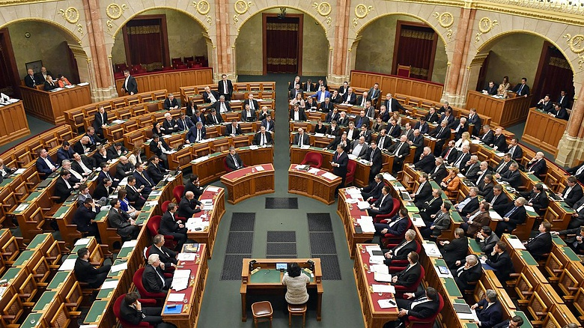
EU and Hungarian competition law rules are designed to ensure fair and equal conditions for businesses, also helping innovation and the growth of small businesses.

Slide 5
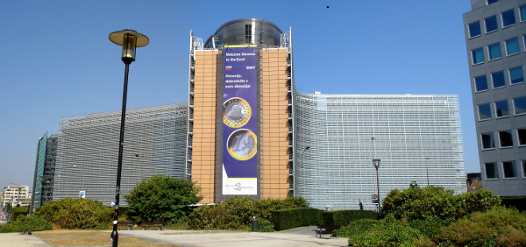
According to EU rules, businesses:
they cannot fix prices
they cannot use their dominant market position
they cannot merge only with the approval of the European Commission

