Slide 1
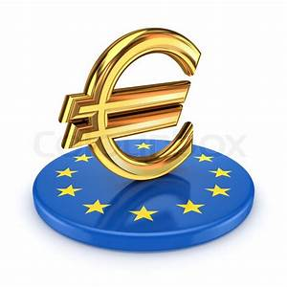
EU funding in your region
Safe and easy travel in the EU
A common currency in 19 EU countries: the euro
Study, train and work anywhere in the EU
Sub Topic
ERASMUS+
The youth guarantee scheme
HOW IS THE EUROPE RELEVANT TO YOUR LIFE?
The European Solidarity corps
Healthcare and safety throughout the EU
Free movement of goods, services and capital
Quality telecommunications in the EU
Consumer rights in the EU

