Slide 1
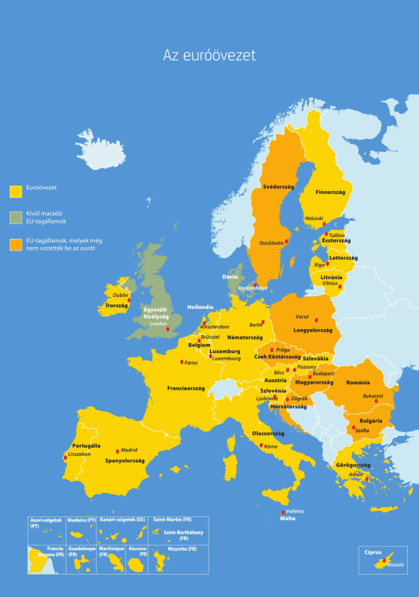
The causes of the 2008 economy crisis, measures in the European Union

Slide 2
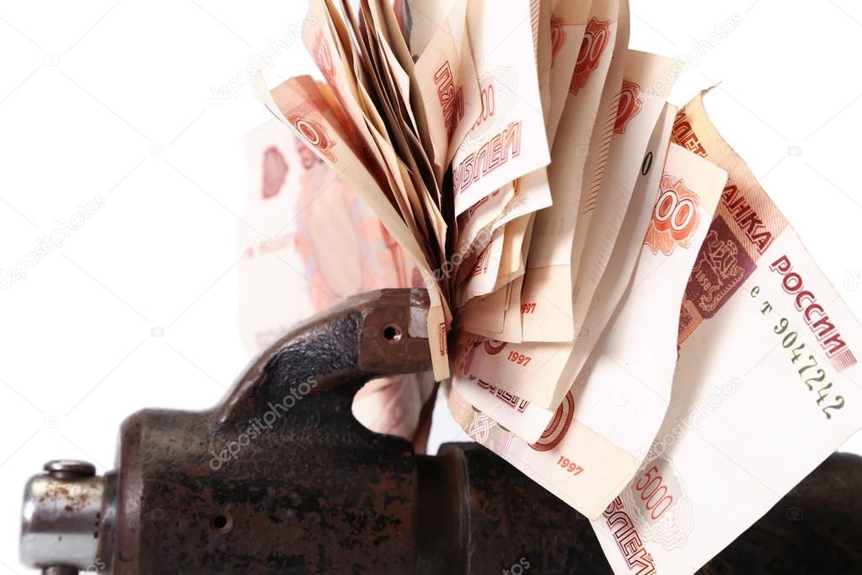
Description
The 2008-2009 global economic crisis is the most significant economic crisis that emerged from the previous global financial crisis.

Slide 3
Background,causes
The US subsidiary mortgage crisis. The financial crisis with varying intensity that started at the end of 2006 affected other countries too.
Several companies went bankrupt or merged with their competitors.
Tthe Eugot also involved into it.

Slide 4
Measures
Restoring financial stability and providing favorable conditions for creating job facilities.
Making savings secure.
Enterprises and housholds can borrow loan at reasonable costs.

