Slide 1
Cunsumer policy in the European Union

Slide 2
What does consumer policy mean?
guards the customers’ well being and safety
protects customers economic interests
Informs and teaches the customer
validates the interests of customers
Acts for customers

Slide 3
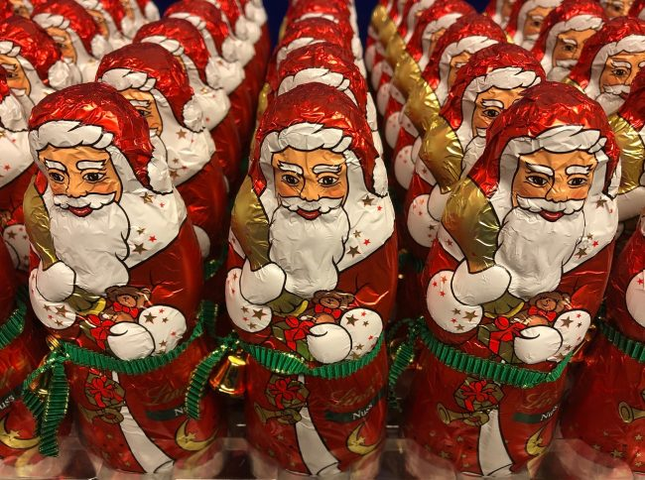
Chocolate Santa Claus
This year’s chocolate santas were also checked
15 milk chocolate and 5 dark chocolate
Fat and sugar content and all of them were of good quality

Slide 4
Major tasks of customer protection:
guarantee
Warranty
Checking webshops and product presentations

Slide 5
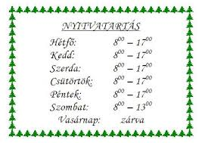
Tasks in catering business
The trader is obliged to inform the customers about opening hours of the shop and the changes in them

Slide 6
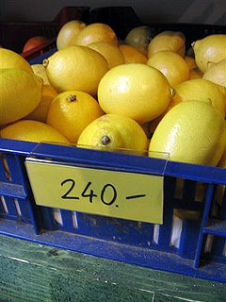
Has the obligation to provide price information within the business been fulfilled?
The selling price of the product should be indicated on the induvidual pricelist placed directly next to the product or on the price list available to the customer when choosing the product to be purchased

Slide 7
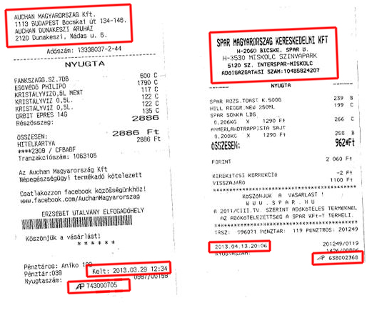
Controlling activities related to billing accuracy
A receipt/invoice must be given to the customer after each purchase
The main data content of an invoice:
-the data of issue of invoice
-invoice number
-the rate of tax applied
- the name of the seller and
the name and address of the purchaser

Slide 8
Thank you for your attention
Made by: Márton Gergely

