Slide 1
Budgeting in the European Union

Slide 2
The EU budget
Defining limits
Determining upper limits
7 years

Slide 3
Planning
Commission Council and Parliament.
annual budget determination : according to the previously accepted amounts.
multiannual financial limits
draft
Notes:
A két utóbbi intézmény módosíthatja a tervezetet, ha pedig nem értenek egyet vele, kompromisszumos megoldást kell kidolgozniuk.

Slide 4
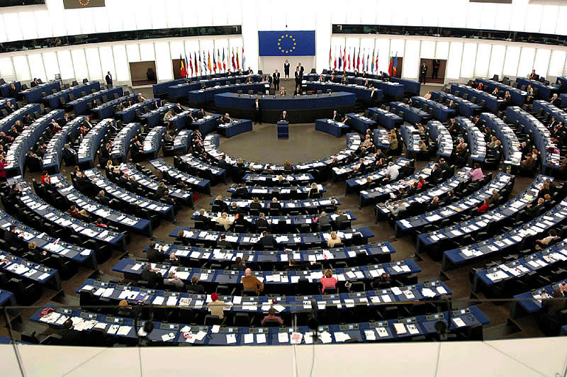
budgeting procedure
Planning the expenditure by the institutions before the 1 July , comission Council the European Parliament
Agreement or modifications
draft budget
position

Slide 5
acceptance
Council and European Parliament decision
Draft budget Commission’s proposal
The Council European Parliament
Finalizing within 14 days
If there is no agreement new budgeting
Decision as equal parties

