Slide 1
The purpose and conditions of the introduction of the euro
Erasmus
Made by : Morvai Regina

Slide 2
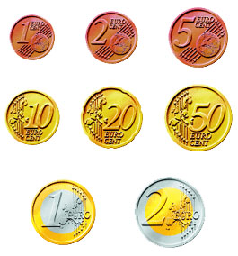
Euró
2002.
Sign
8 coin types
7 banknotes

Slide 3
Purpose of the introduction
The more powerful presence of the EU
Stable prices
More options
Euro as symbol
Economic stability
More integrated financial markets

Slide 4
Conditions
Interest rate 6%
Inflationary rate< less than 1,5%
ERM
Yearly budget deficit<
(less than)3% of GDP,
Public debt< (less than)60% of GDP

