Slide 1
The common, internal market
Created by: iglai zsófia
Tóth Áron

Slide 2
Defintion
Goods
People
Services
Free movement of capital

Slide 3
Rights of the EU citizens
Studies
Settlement
Shopping
Work
Retirement system

Slide 4
Business Opportunity
Free goods and services
Foreign investors
Economic integration

Slide 5
Barriers
Fragmentation of Member States' tax systems
Separate Member State Market
E-commerce
Service sector
Professional qualifications

Slide 6
Financial services
A strong, secure financial sector
Union Bank

Slide 7
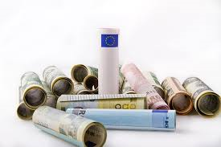
Capital Market Union
Fragmentation of Financial markets
diversify financial resources
flow of capital
access to finance for businesses

Slide 8
E-commerce
Digital market
New chances
Administrative burdens

Slide 9
nternal market problem solution
European Court
Members

Slide 10
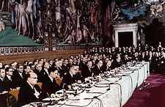
Important dates
1957
1968
1985

Slide 11
ECU
1979
Currency Unit
Cash does not exist
European Common Money
1st of Jsnuary, 1999
Symbol: ₠

