Slide 1
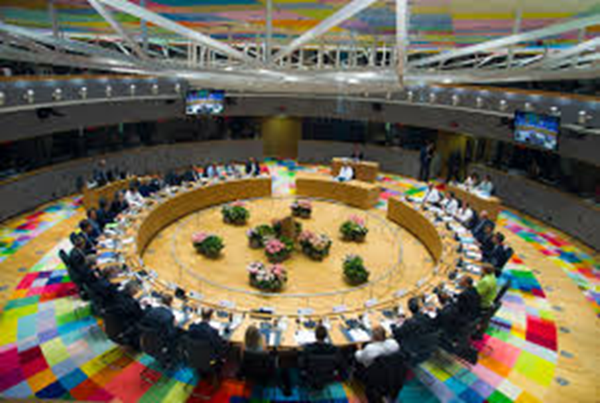
THE EUROPEAN COUNCIL

Slide 3
Overview:
Role: Defines the general political direction and priorities of the European Union
Members: Heads of state or government of EU countries, European Commission President, High Representative for Foreign Affairs & Security Policy
President: Donald Tusk
Established in: 1974 (informal forum), 1992 (formal status), 2009 (official EU institution)
Location: Brussels (Belgium)

Slide 4
What does the European Council Do?
Decides on the EU's overall direction and political priorities – but does not pass laws.
Deals with complex or sensitive issues that cannot be resolved at lower levels of intergovernmental cooperation
Sets the EU's common foreign & security policy, taking into account EU strategic interests and defence implications
Nominates and appoints candidates to certain high profile EU level roles, such as the ECB and the Commission

Slide 5
How Does The European Council Work?
It usually meets 4 times a year – but the President can convene additional meetings to address urgent issues.
It generally decides issues by consensus – but by unanimity or qualified majority in some cases. Only the heads of state/government can vote.

Slide 6
History of the European Council:
The European Council was created in 1974 as an informal forum for discussion between heads of state or government of the EU member states. It soon developed a role as the body responsible for fixing EU goals and priorities.
Under the Treaty of Maastricht in 1992, the European Council acquired a formal status and role - to provide the impetus and general political guidelines for the EU.
In 2009, following the changes introduced by the Lisbon Treaty, the European Council became one of the 7 EU institutions.

Slide 7
Setting The EU’s Political Agenda:
The European Council is one of the 7 EU institutions. However, it is not one of the EU's legislating bodies, so does not negotiate or adopt EU laws. Instead its main role is to determine the EU's general political direction and priorities - essentially setting the policy agenda for the EU.

Slide 8
A Strategic Agenda For The EU:
At its meeting in Brussels on 27 June 2014, the European Council agreed on five priority areas to guide the EU's work over the next five years. These priorities are set out in a document called the 'Strategic agenda for the Union in times of change'. This strategic agenda will be used to plan the work of the European Council and also acts as a basis for the work programmes of other EU institutions.
Jobs, growth and competitiveness
Empowering and protecting citizens
Energy and climate policies
Freedom, security and justice
The EU as a strong global actor

Slide 9
Election Of The President Of The European Council:
The European Council elects its own president. This requires a qualified majority. The president holds the post for a 2.5 year term, renewable once.

Slide 10
Appointment Of The High Representative:
The European Council is responsible for appointing the High Representative of the Union for Foreign Affairs and Security Policy.
The European Council can also decide to end the high representative's 5 year term of office, again with a qualified majority.

Slide 11
Appointment of the European Commission:
The European Council officially appoints the entire European Commission. The Parliament votes on the body of Commissioners - the Commission President, the high representative and the other Commissioners
Once the Parliament has given its consent, the European Council officially appoints the European Commission. The European Council's decision requires a qualified majority.

Slide 12
European Central Bank Appointments:
The European Council appoints all 6 members of the Executive Board of the European Central Bank (ECB), which includes both the ECB President and Vice-President, plus 4 other members.

Slide 13
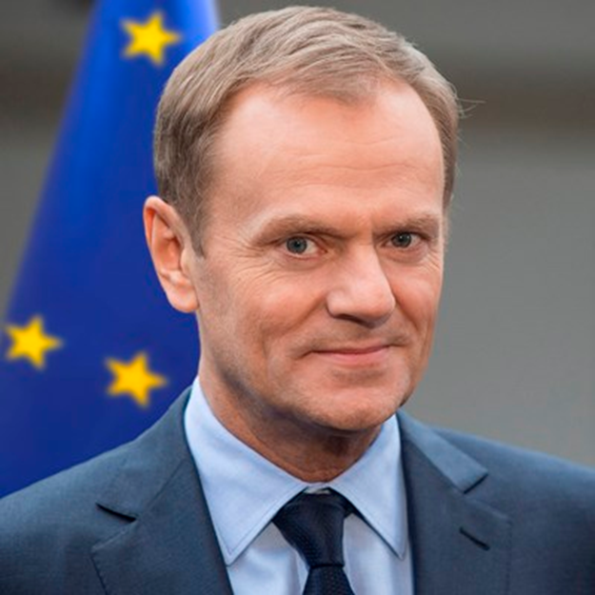
The President's:
The current President of the European Council is Donald Tusk. He replaced Herman Van Rompuy on 1 December 2014.

Slide 14
Former President of the European Council, Herman Van Rompuy:
Herman Van Rompuy was the first full-time President of the European Council. He was elected for the first time in November 2009, then re-elected for a second term from June 2012 to November 2014. He was replaced by Donald Tusk on 1 December 2014.

Slide 15
Euro Summit:
The Euro Summit brings together the heads of state or government of the euro area countries, the Euro Summit President and the President of the European Commission. Euro Summit meetings provide strategic guidelines on euro area economic policy.
Role of the Euro Summit:
The Euro Summit provides policy guidance to ensure the smooth functioning of the Economic and Monetary Union. This helps to coordinate all the relevant policy areas between the euro area member states.

Slide 16
Euro Summit Meetings:
According to the Treaty on Stability, Coordination and Governance (TSCG) in the Economic and Monetary Union, Euro Summit meetings should take place at least twice a year. If possible, they should be held after European Council meetings in Brussels.
Members:
The members of the Euro Summit are the heads of state or government from the euro area countries, the Euro Summit President and the President of the European Commission.
Where appropriate, and at least once a year, leaders of non-euro area member states that have ratified the Treaty on Stability, Coordination and Governance (TSCG) also take part in the Euro Summit meetings.

Slide 17
Euro Summit President:
Euro area leaders elect the Euro Summit President by simple majority, at the same time as the European Council elects its President. The Euro Summit President's term of office is 2.5 years.
The Euro Summit President reports to the European Parliament after each Euro Summit meeting. He also informs all the non-euro area member states about the preparation and outcome of Euro Summit meetings.

Slide 18
Members of the European Council:

