Slide 1
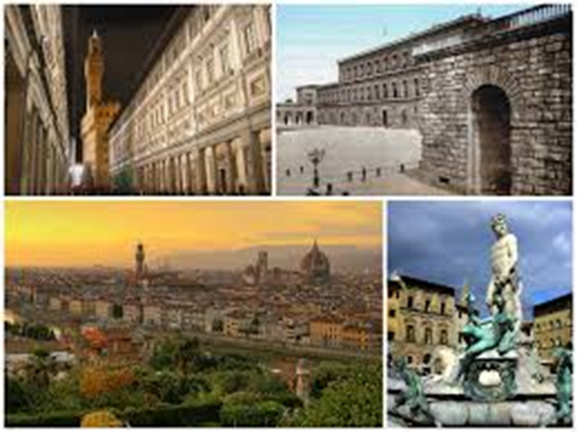
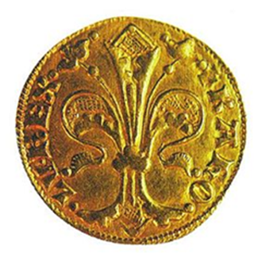
Hungarian HUF
Its origin:
It was named after the city of Florence
Its Latin name: florentinus

Slide 2
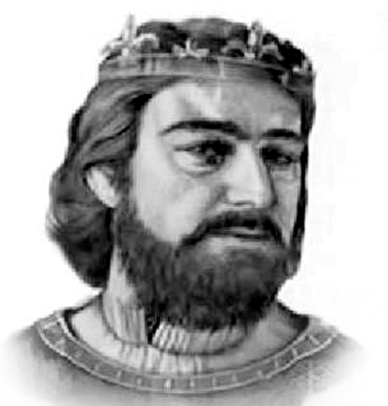
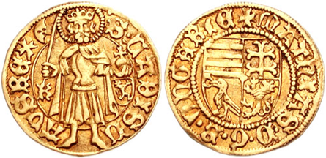
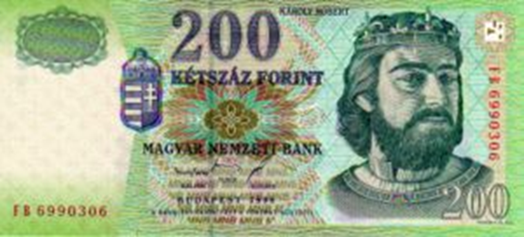
Hungarian Gold coins 1325-1553
Robert Charles
gold coins
John the Baptist
Legend ‚Karolus rex’

Slide 3
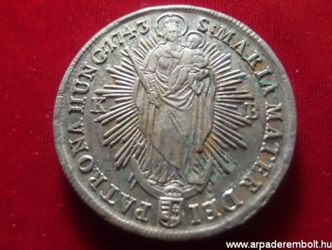
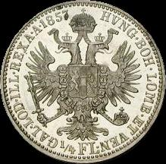
Silver Based forint, 1750-1892
Two main types:
convention forint
Austrian value forint

Slide 4
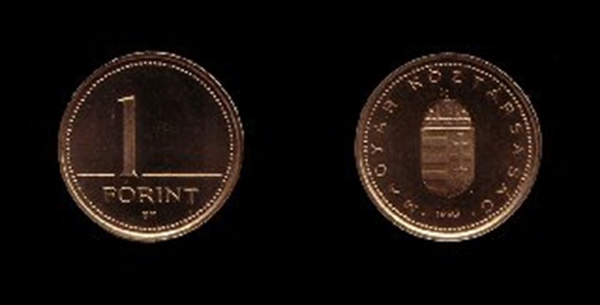
Today's Hungarian Forint

Slide 5
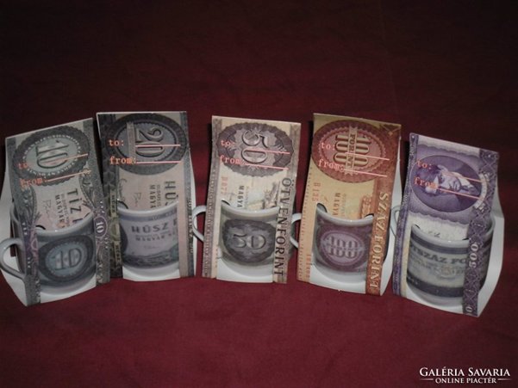
EURO

Slide 6
Thank you for your attention!

