Slide 1
5^{Ο} ΓΕΝΙΚΟ ΛΥΚΕΙΟ ΠΕΤΡΟΥΠΟΛΗΣ
5TH LYCEUM OF PETROUPOLI
PETROUPOLI - ATHENS - GREECE

Slide 2
5th Lyceum of Petroupoli
Our school, 5th Lyceum of Petroupoli is a public school of secondary education, placed in Athens, at the west side of the city.
It has 241 students of age 15-18 and covers the three last grades of their secondary education. It provides general studies of multiple subjects and students can continue their studies at the higher education institutes, if they successfully pass the final examinations of the last grade.

Slide 3
5th Lyceum of Petroupoli
25 Teachers
241 Students
12 classrooms for teaching
1 chemistry lab
1 physics laboratory
1 IT lab
1 place for Physical Education
Offices for Director, deputy director and teachers

Slide 4
5th Lyceum of Petroupoli
Our school participates in three Erasmus+ KA2 programs and in the EPAS (European Parliament Ambassadors School) Participating in European programs, is a great opportunity for their whole school society (students and teachers) to make an opening to the world, to widen their horizons, to communicate, exchange experiences and realize things that both unite and differentiate school community.

Slide 5
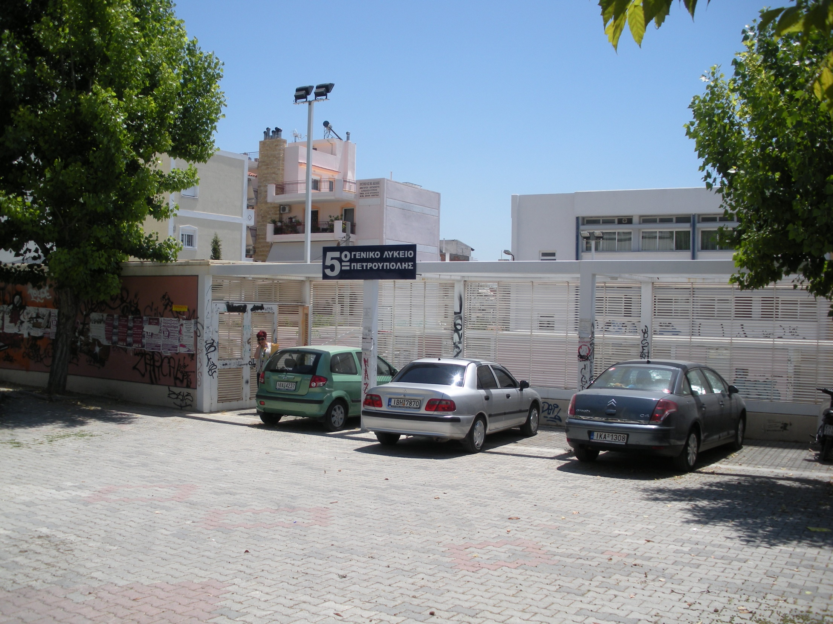

Slide 6
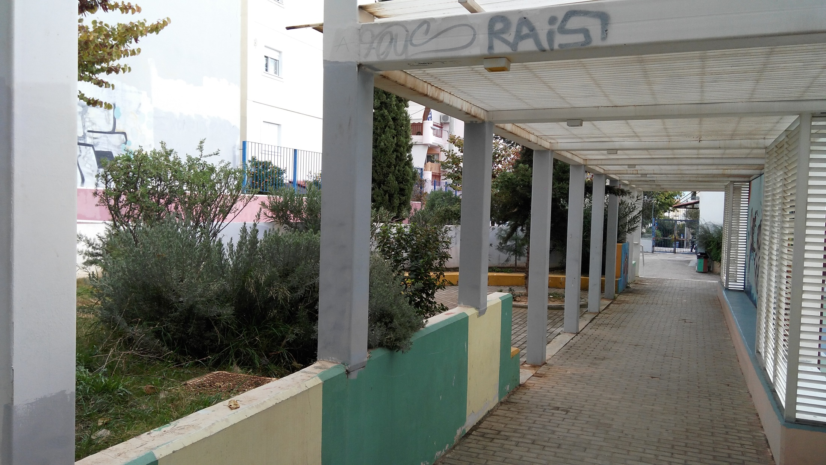

Slide 7
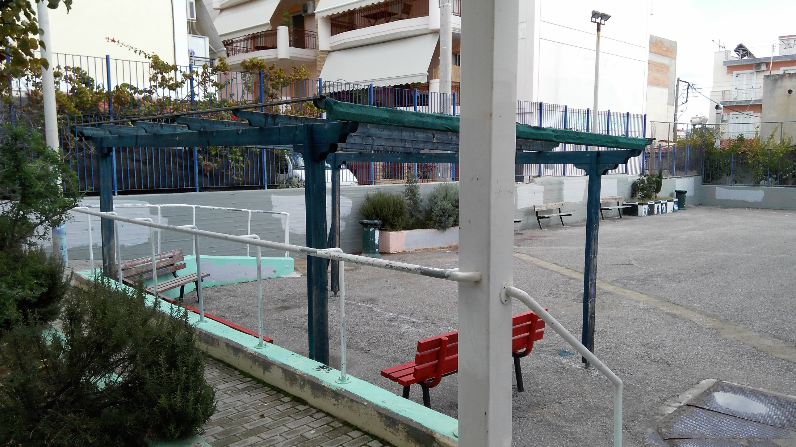

Slide 8
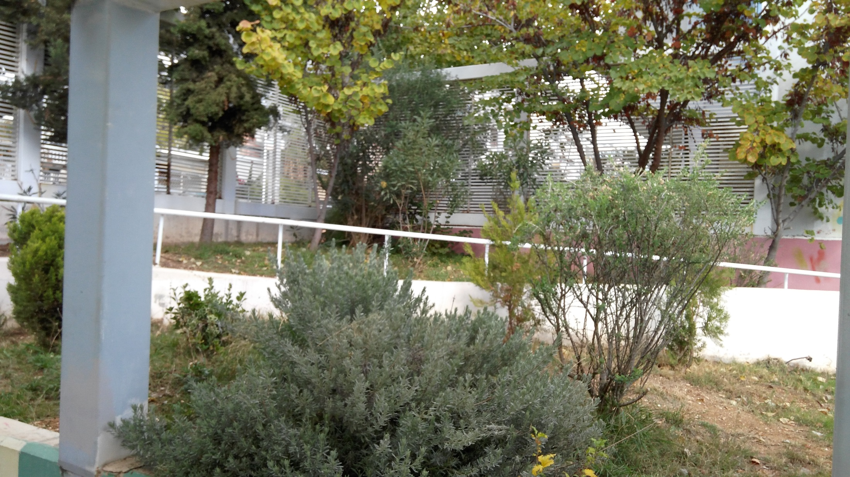

Slide 9
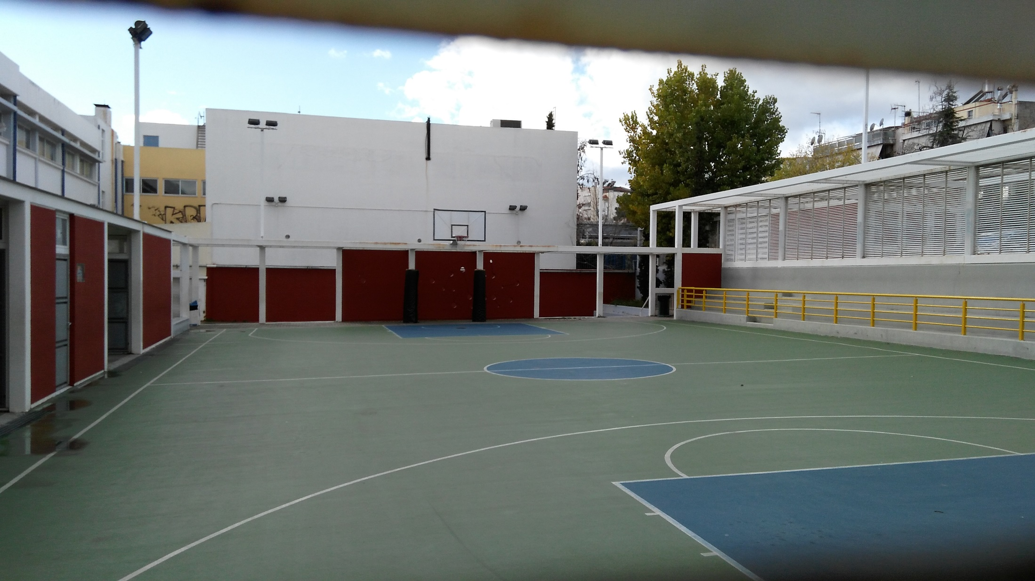

Slide 10
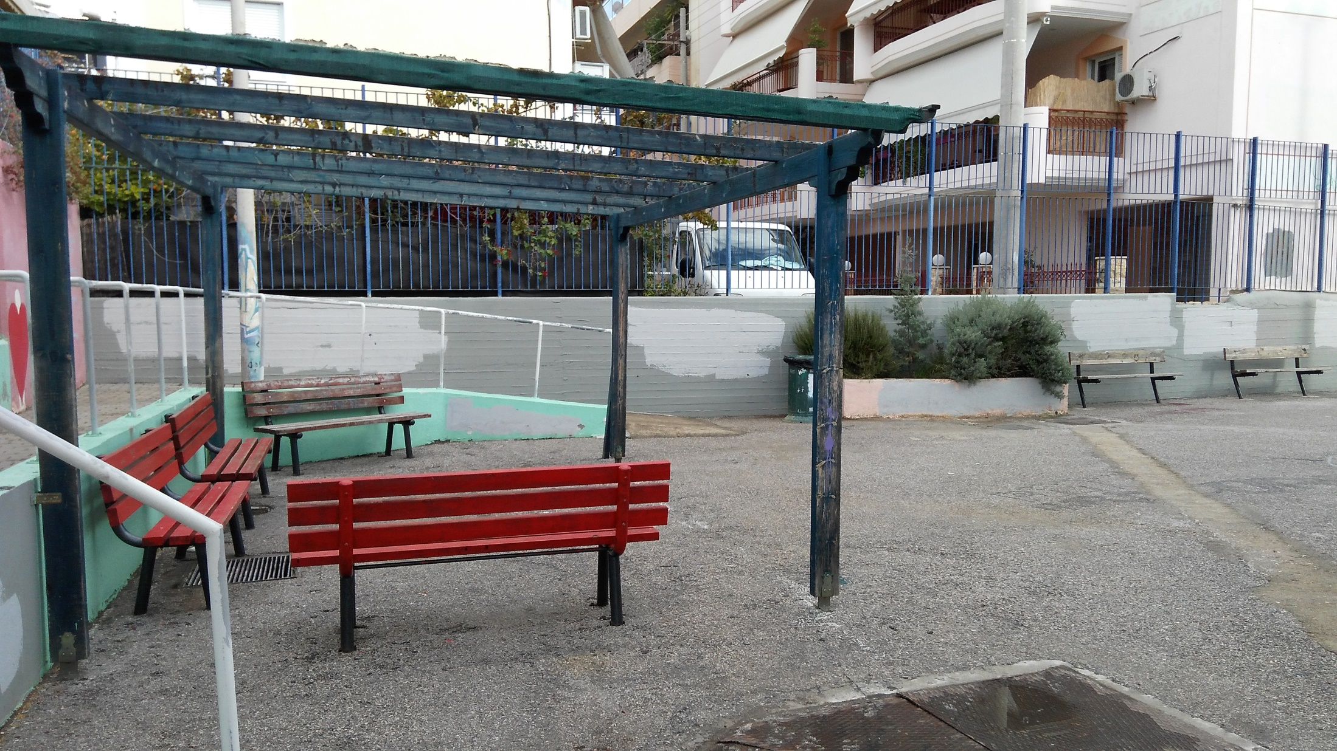

Slide 11
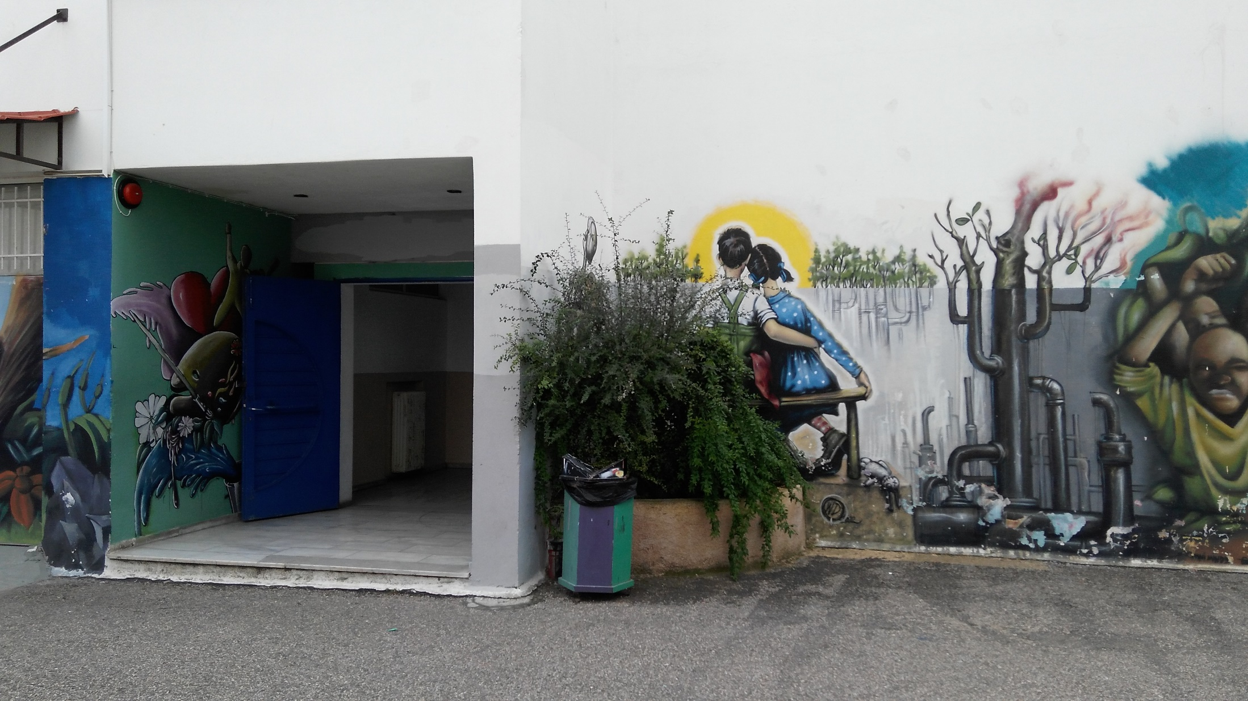

Slide 12
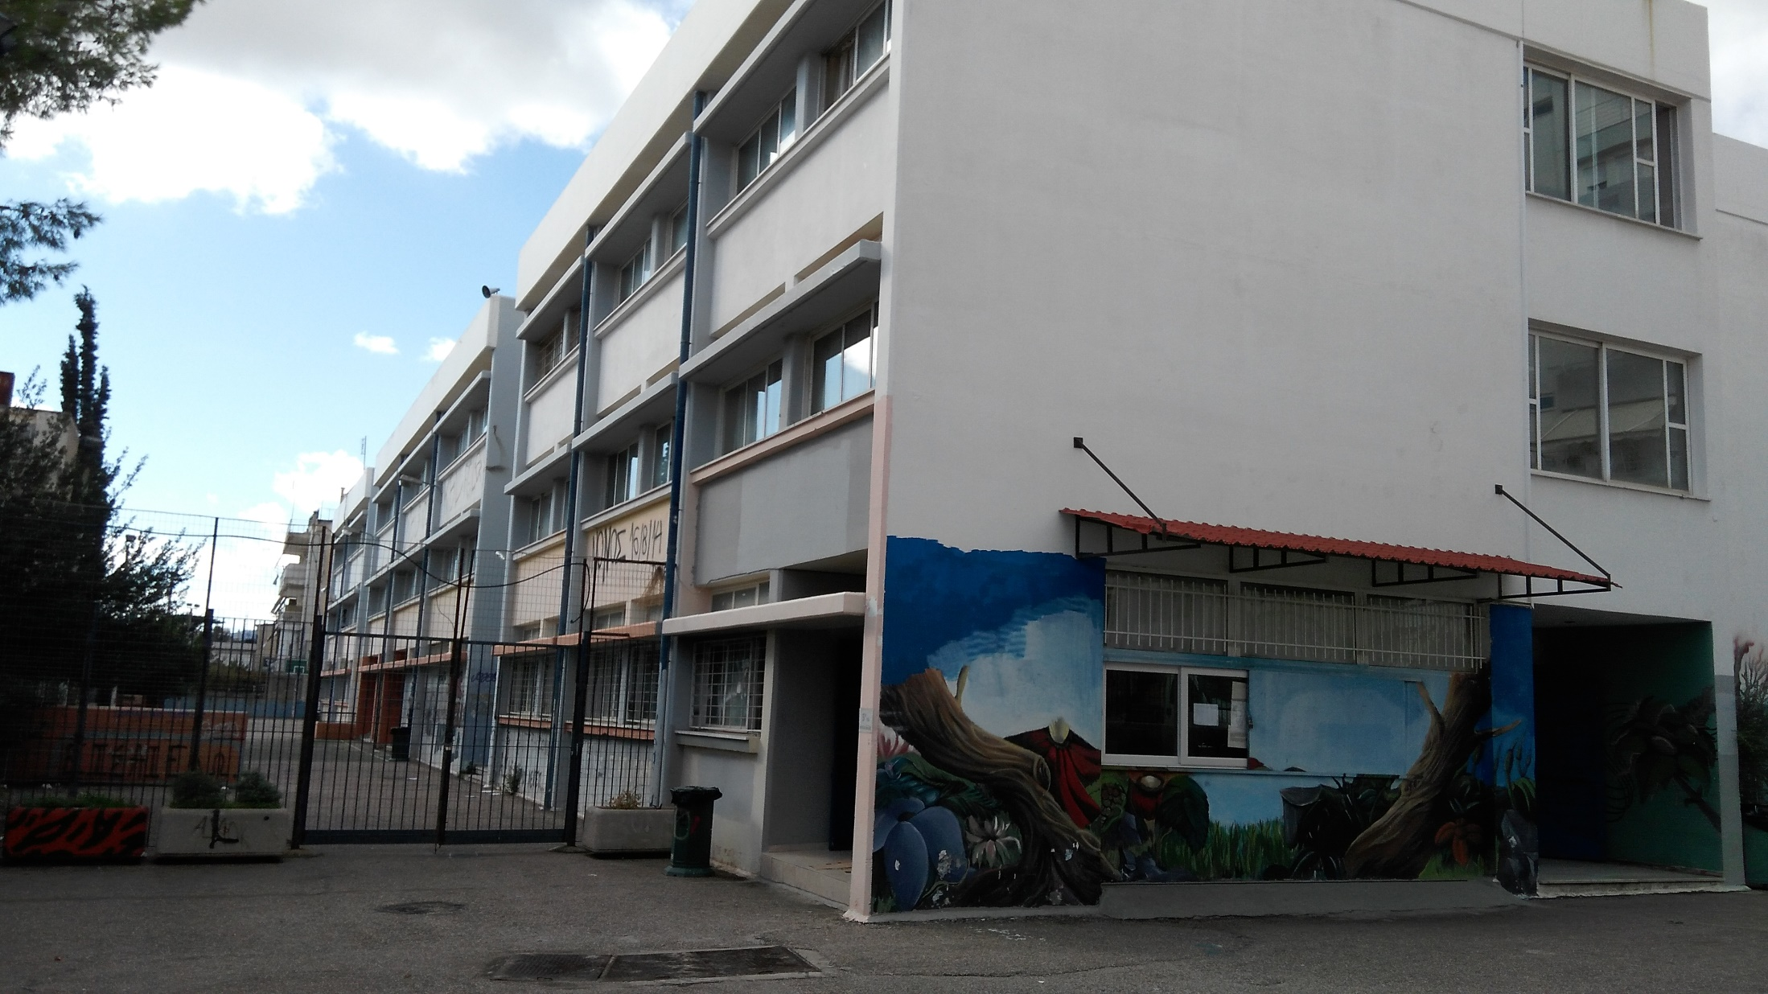

Slide 13
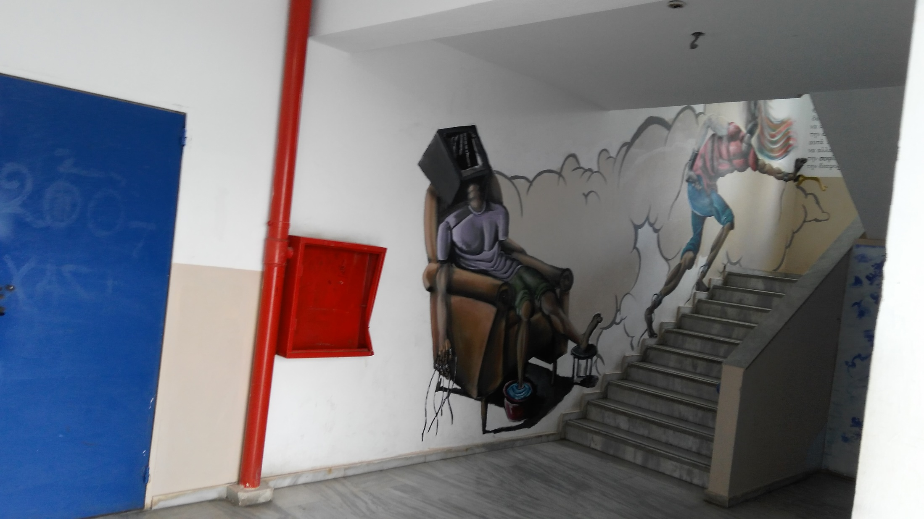

Slide 14
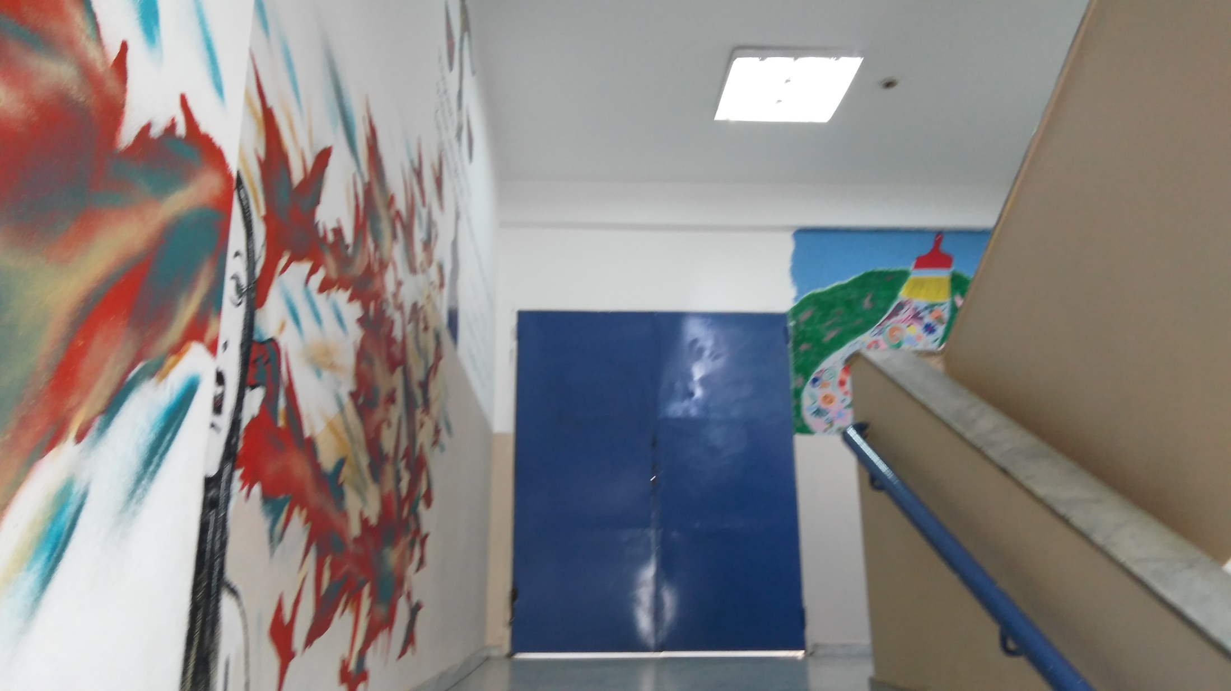

Slide 15
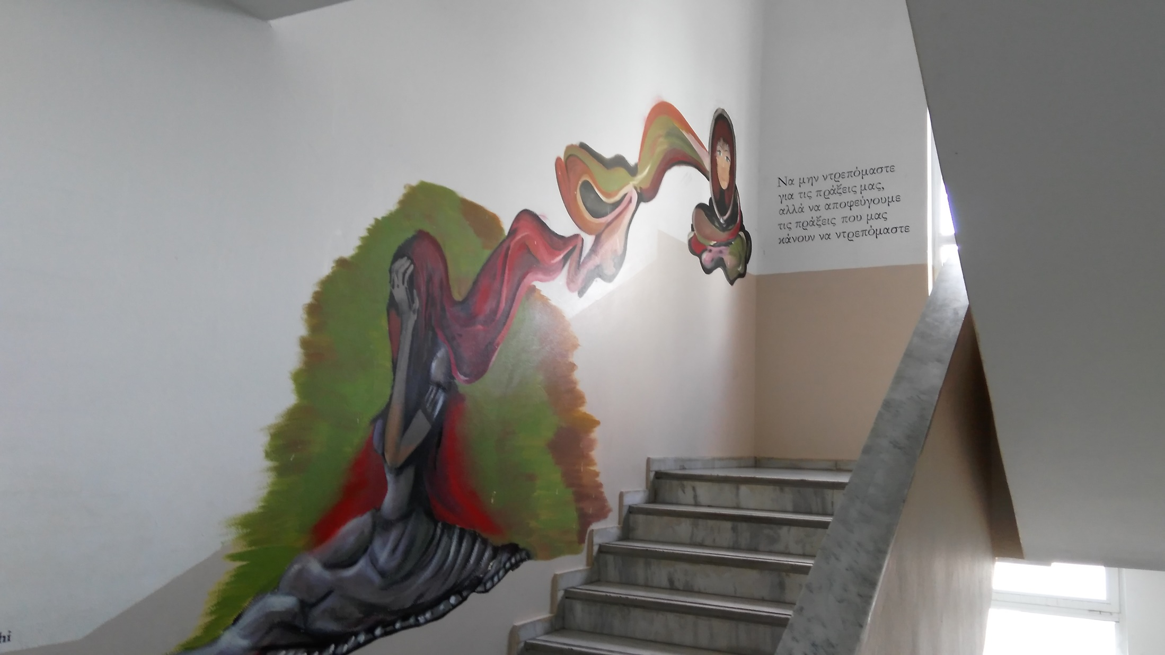

Slide 16
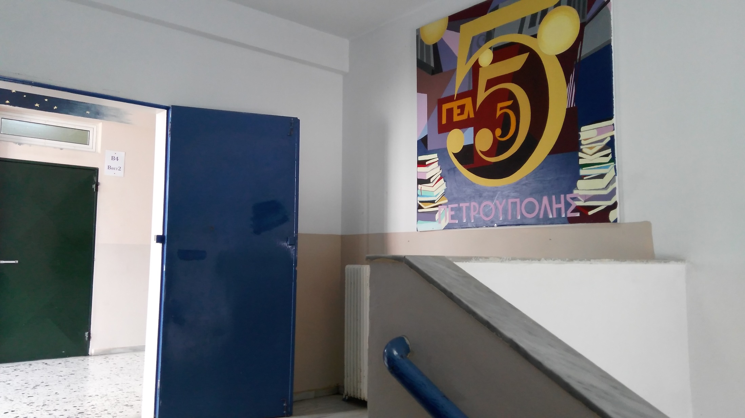

Slide 17
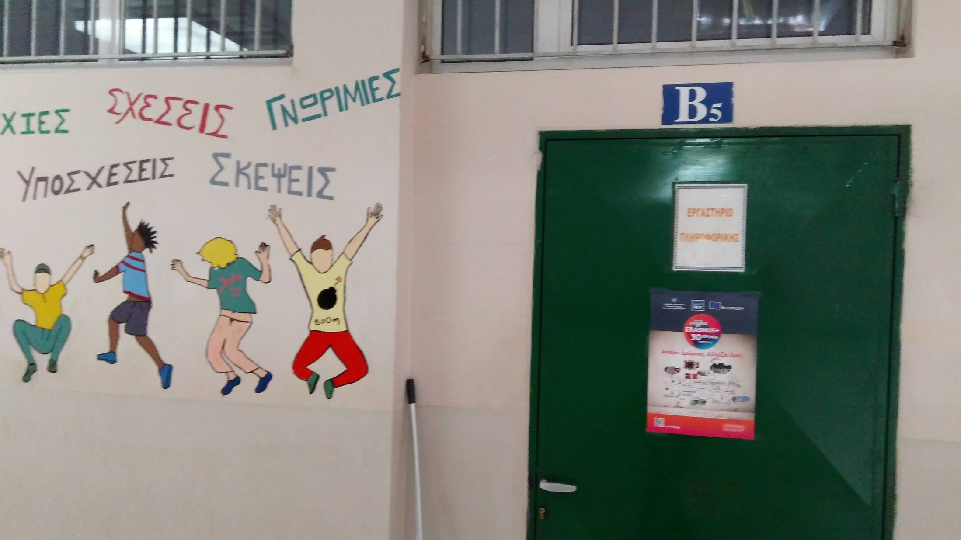

Slide 18
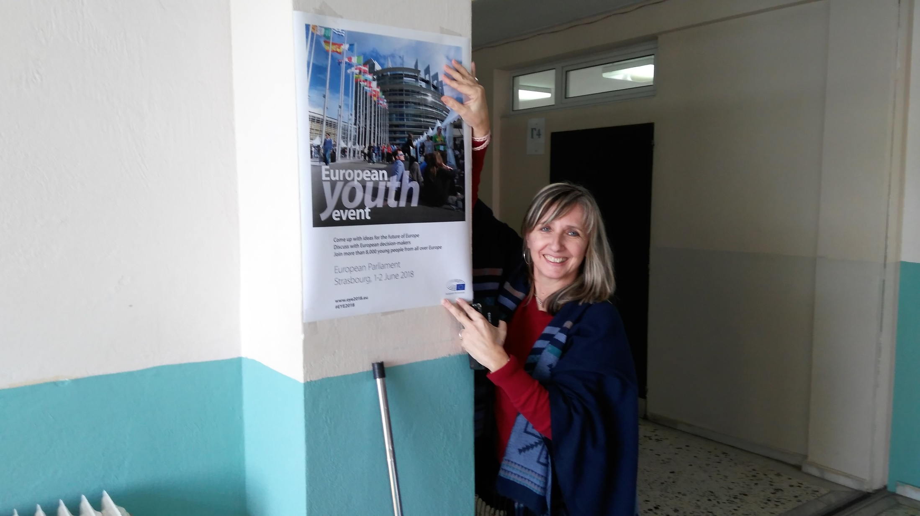

Slide 19
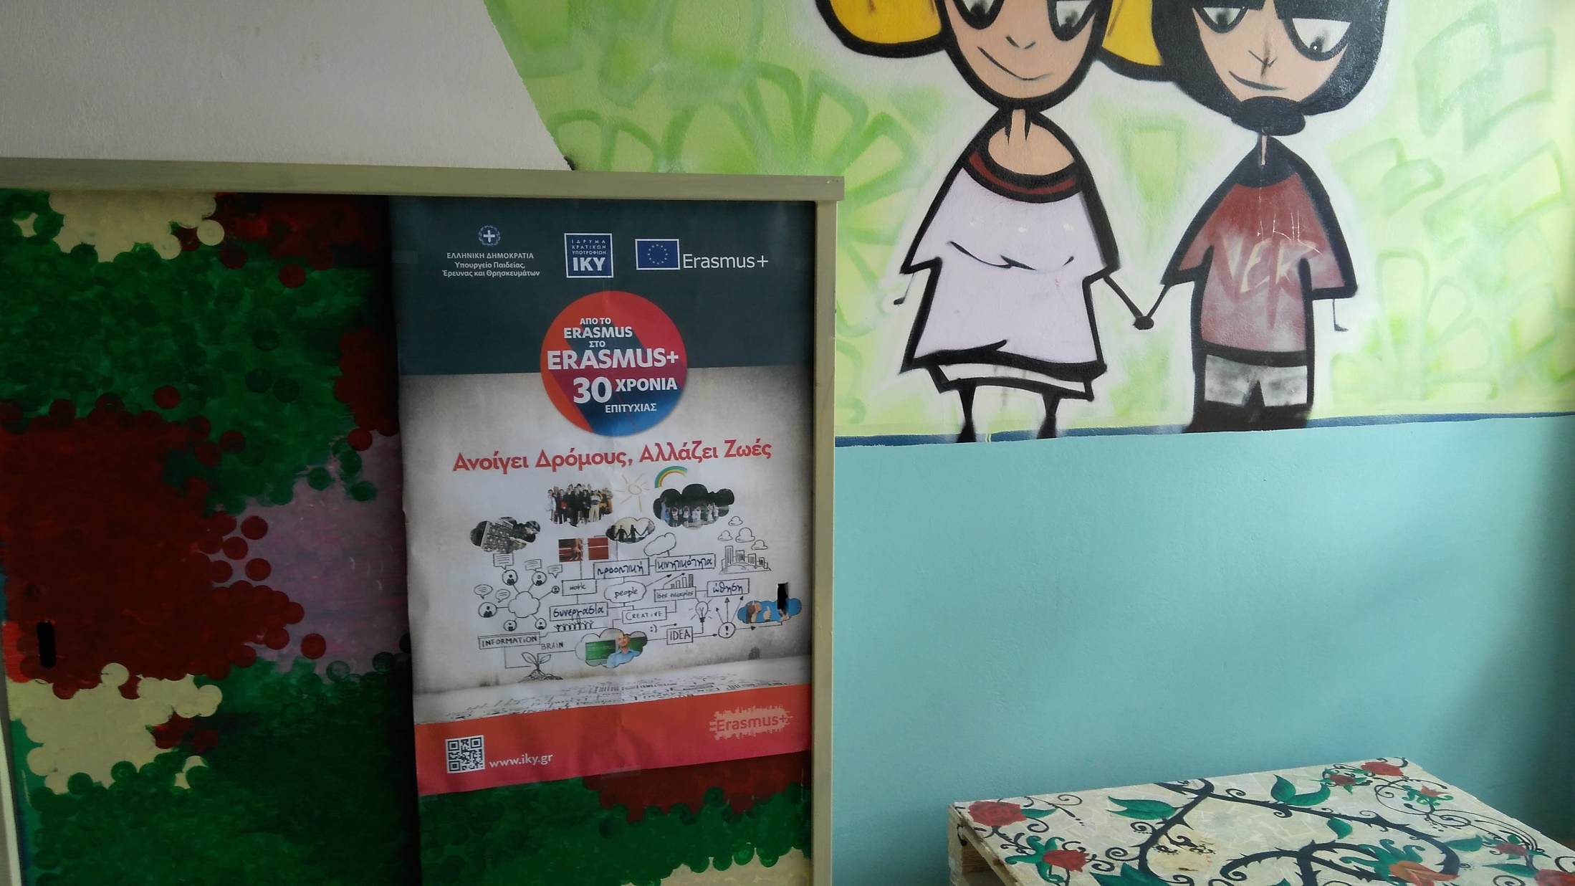

Slide 20
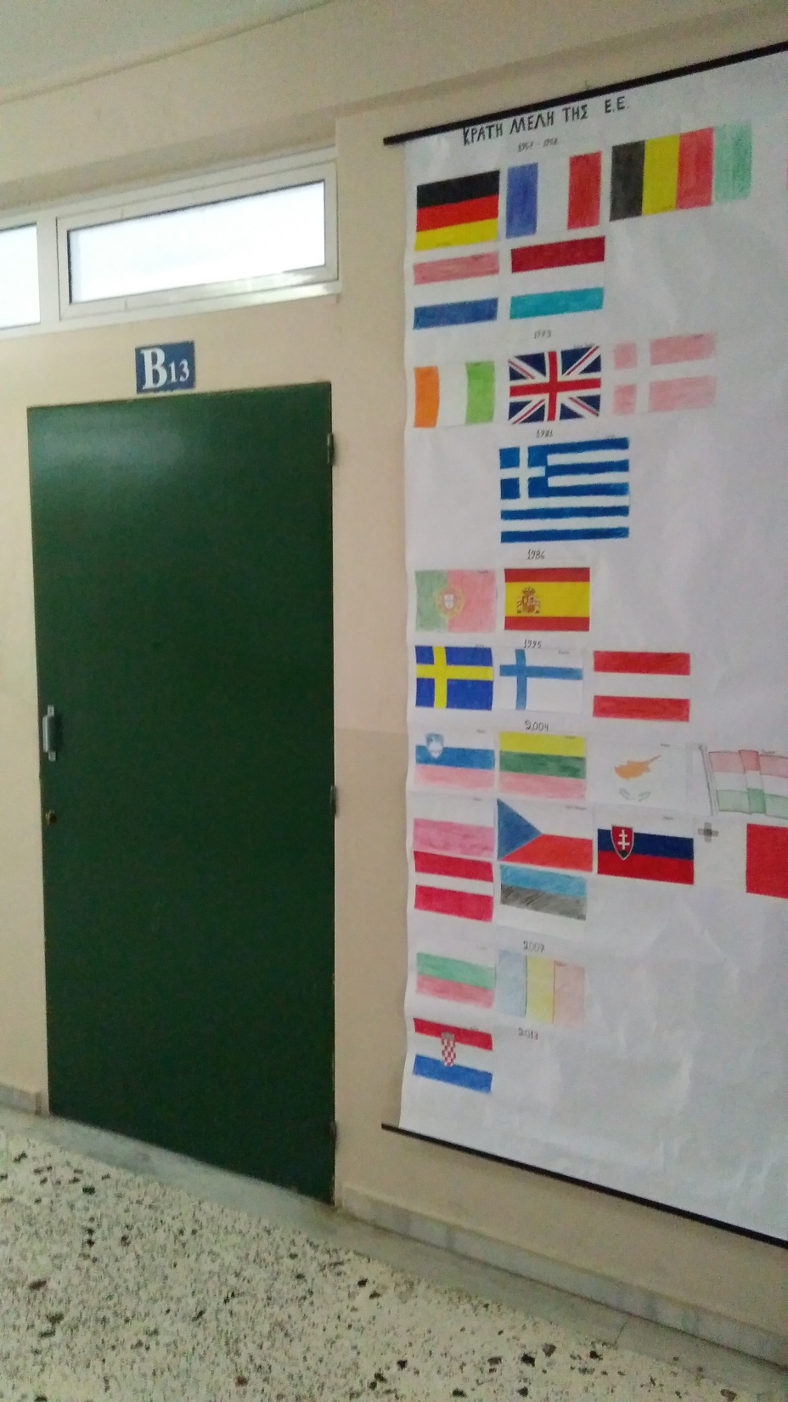

Slide 21
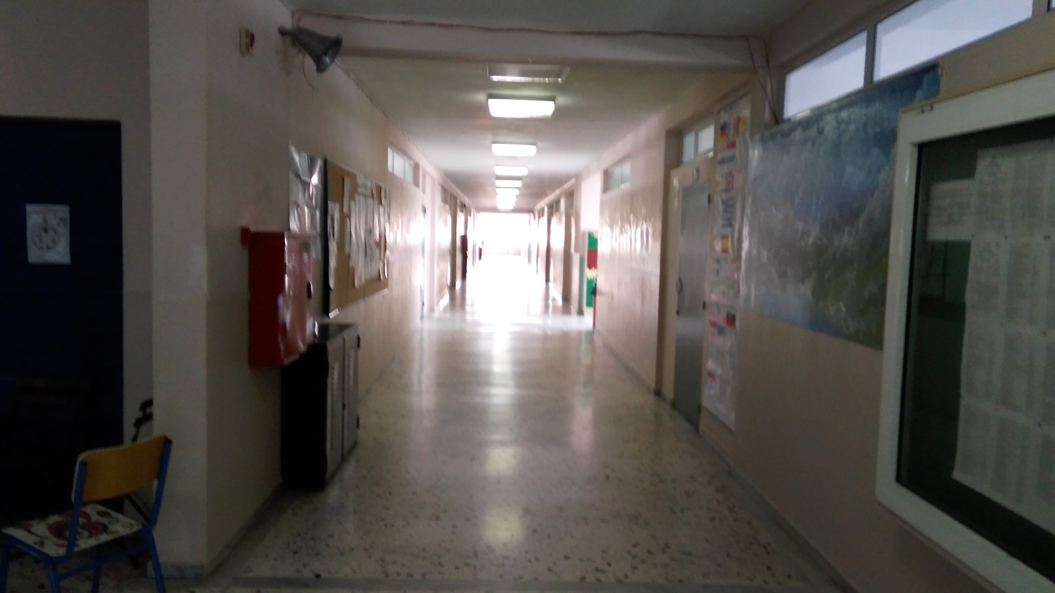

Slide 22
IT lab

Slide 23
The Director of school

Slide 26
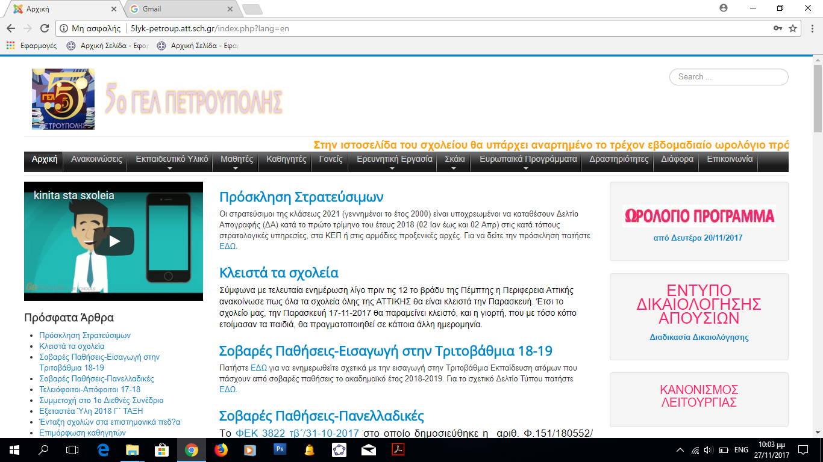
Web page http://5lyk-petroup.att.sch.gr

