Slide 1
European Central Bank
(Tóbi Dorina)

Slide 2
General information
The European Central Bank (ECB) is the central bank of the 19 EU Member States that have adopted the euro.
Established in: 1998
Location: Frankfurt (Germany)
President: Mario Draghi
Members: ECB President and Vice-President and governors of national central banks from all EU countries
Main aim: keeping prices stable supporting economic growth,
job creation

Slide 3
Tasks
The Eurosystem is responsible for:
Defining and implementing monetary policy
Conducting foreign exchange operations
Holding and managing the euro area’s foreign currency reserves
Promoting the smooth operation of payment systems
Authorising issuance of euro banknotes by eurozone countries

Slide 4
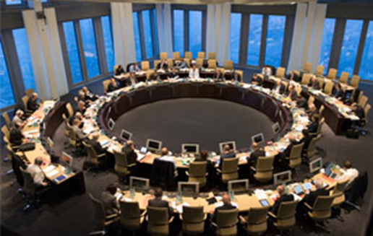
Organisation
The ECB has the 3 following decision-making bodies:
Governing Council: -defines eurozone monetary policy
(main body) -adopts regulations
-allows the euro to be issued
Executive Board: -responsible for implementing monetary policy
General Council: - monetary and exchange rate policy coordination between member states

Slide 5
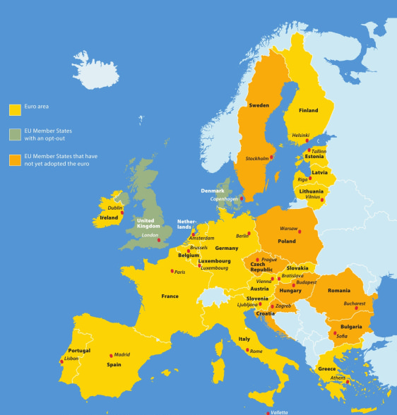
The euro area
A group of countries within the European Union where the euro is the official currency.

Slide 6
As a revision watch this video.
https://www.youtube.com/watch?v=TAlcFwGIQBg&t=7s

