Slide 1
EUROPEAN PARLIAMENT

Slide 2
Overview
ROLE: Directly-elected EU body with legislative, supervisory, and budgetary responsibilities
Members: 751 MEPs (Members of the European Parliament)
President: Antonio Tajani
Established in: 1952 as Common Assembly of the European Coal and Steel Community, 1962 as European Parliament, first direct elections in 1979
Location: Strasbourg (France), Brussels (Belgium), Luxembourg

Slide 3
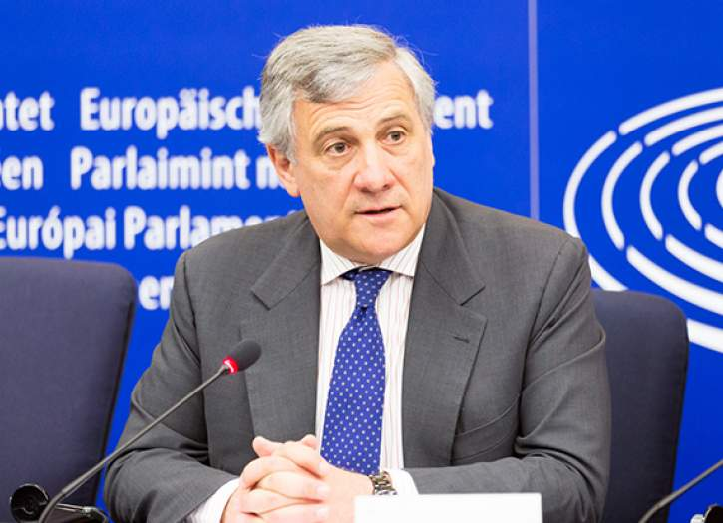
THE PRESIDENT OF THE EUROPEAN PARLIAMENT
The President is elected for a renewable term of two and a half years, i.e. half the lifetime of a Parliament. The President represents the European Parliament vis-à-vis the outside world and in its relations with the other EU institutions.

Slide 4
*The President oversees the work of the Parliament and its constituent bodies as well as the debates in plenary and ensures that Parliament’s Rules of Procedure are adhered to. *At the beginning of meeting, the President sets out Parliament’s point of view. *After the European Union’s budget has been adopted by Parliament, the President signs it, rendering it operational. The EP President and the President of the Council both sign all legislative acts adopted under ordinary legislative procedure.

Slide 5
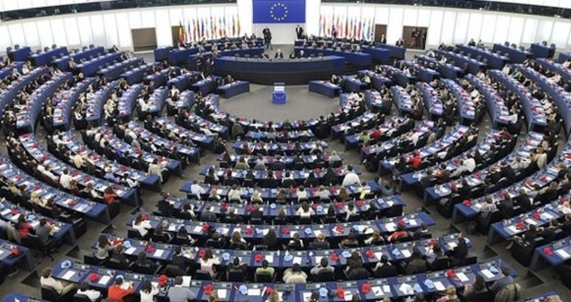
The Members of the European Parliament
The European Parliament is made up of 751 Members elected in the 28 Member States of the enlarged European Union. Since 1979 MEPs have been elected by direct universal suffrage for a five-year period.

Slide 6
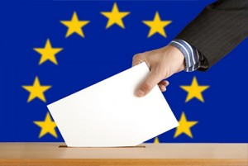
Elections
The European Parliament is the EU's law-making body. It is directly elected by EU voters every 5 years. The last elections were in May 2014. The last European elections were the largest transnational elections ever held at the same time. The next European elections will take place between 23-26 May 2019.

Slide 7
What does the Parliament do?
The Parliament has 3 main roles:
1-)Legislative:
*Passing EU laws, together with the Council of the EU, based on European Commision proposals
*Deciding on international agreements
*Deciding on enlargements
*Reviewing the Commission's work programme and asking it to propose legislation

Slide 8
2-) Supervisory:
*Democratic scrutiny of all EU institutions
*Electing the Commission President and approving the Commision as a body. Possibility of voting a motion of censure, obliging the Commission to resign
*Granting discharge, i.e. approving the way EU budgets have been spent

Slide 9
*Examining citizens' petitions and setting up inquiries
*Discussing monetary policy with the European Central Bank *Questioning Commission and Council
*Election observations

Slide 10
3-)Budgetary:
*Establishing the EU budget, together with the Council
*Approving the EU's long-term budget, the "Multiannual Financial Framework"

Slide 11
How does the Parliament work?
Parliament's work comprises two main stages:
1-)Committees: to prepare legislation. The Parliament numbers 20 committees and two subcommittees, each handling a particular policy area.

Slide 12
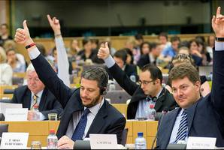
The Committees of the European Parliament
There are 20 parliamentary committees. A committee consists of between 25 and 73 MEPs, and has a chair, a bureau and a secretariat. The political makeup of the committees reflects that of the plenary assembly.

Slide 13
*The parliamentary committees meet once or twice a month in Brussels. Their debates are held in public.
*The committees draw up, amend and adopt legislative proposals and own-initiative reports. They consider Commission and Council proposals and, where necessary, draw up reports to be presented to the plenary assembly.
*

Slide 14
2-)Plenary sessions: to pass legislation. This is when all the MEPs gather in the chamber to give a final vote on the proposed legislation and the proposed amendments. Normally held in Strasbourg for four days a month, but sometimes there are additional sessions in Brussels.

Slide 15
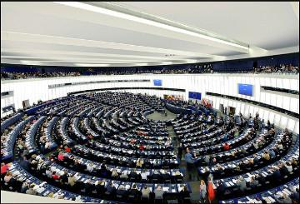
European Parliament plenary session
The Plenary Sessions represent the culmination of the legislative work done in committees and in the political groups. These sessions are where the Parliament formally sits to vote on EU legislation and adopt its position on political issues.

Slide 16
The MEPs (the Members of the European Parliament) meet around once a month in Strasbourg for a four-day part session from Monday to Thursday. In addition to these twelve annual Strasbourg sessions, the Parliament may also meet in additional two-day plenary sessions in Brussels up to six times a year.

