Slide 3
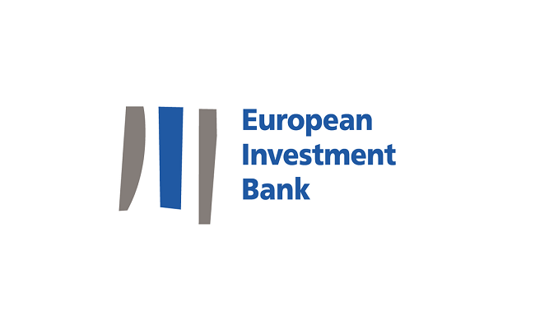

Slide 4
OVERVIEW:
Role: provides funding for projects that help to achieve EU aims, both within and outside the EU
President: Werner Hoyer
Board of Directors: comprises one director per EU country, plus one from the European Commission
Founded in: 1958
Location: Luxembourg

Slide 5
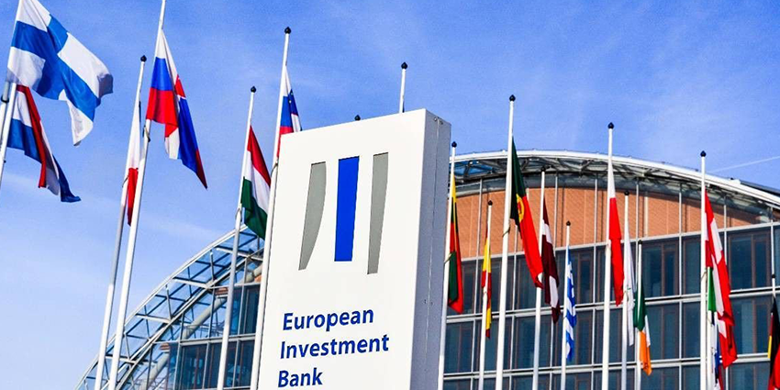

Slide 6
The European Investment Bank (EIB) is jointly owned by the EU countries. It seeks to:
boost Europe's potential in terms of jobs & growth
support action to mitigate climate change
promote EU policies outside the EU.

Slide 7
WHAT THE EIB DOES?
The Bank borrows money on capital markets and lends it on favourable terms to projects that support EU objectives. None of the money comes from the EU budget.

Slide 8
The EIB provides 3 main types of products and services:
Lending – about 90 % of its total financial commitment. The Bank lends to clients of all sizes to support growth and jobs, and this support often helps to attract other investors.
'Blending' - allowing clients to combine EIB financing with additional investment.
Advising and technical assistance - maximising value for money.

Slide 9
Composition
All EU countries are shareholders in the EIB. Decisions are taken by the following bodies:
The Board of Governors, comprising ministers from all EU countries. It defines general lending policy.
The Board of Directors: It approves lending and borrowing operations.
The Managament Committee, the Bank’s executive body
The Audit Committee checks that EIB operations are conducted in a proper manner.
The Bank's departments implement management decisions.

Slide 10
How does the EIB work?
It makes borrowing and lending decisions, based on the merits of each project and the opportunities offered by financial markets.
As an independent body, the Bank takes its own borrowing and lending decisions. It cooperates with other EU institutions, especially the European Commission, the Parliament and the Council of the EU .
European Investment Fund (EIF)
The EIB is the majority shareholder of the European Investment Fund (EIF), which provides funding to small and medium-sized enterprises (SMEs) through venture capital and risk finance instruments.
Established in 1994, the Fund is active in all EU countries, prospective member countries, Liechtenstein and Norway.

Slide 11
European Ombudsman

Slide 12
OVERVIEW:
Role: Investigates complaints against EU institutions, bodies, offices & agencies
Ombudsman: Emily O'Reilly
Established in: 1995
Location: Strasbourg (France)

Slide 13
WHAT DOES THE OMBUDSMAN DO?
The Ombudsman investigates different types of poor administration, for example:
unfair conduct
discrimination
abuse of power
lack of information or refusal to provide it
unnecessary delays
incorrect procedures.

Slide 14
How is the Ombudsman chosen?
The European Parliament elects the Ombudsman for a renewable 5-year term.
How does the Ombudsman work?
The Ombudsman's office launches investigations either in response to complaints or on its own initiative.
The Ombudsman may be able to solve your problem simply by informing the institution concerned. If more is needed, every effort is made to reach an amicable solution that will put matters right. Should this fail, the Ombudsman can make recommendations to the institution. If these are not accepted, the Ombudsman can draw up a special report to the European Parliament, which must then take appropriate action.

Slide 15
