Slide 1
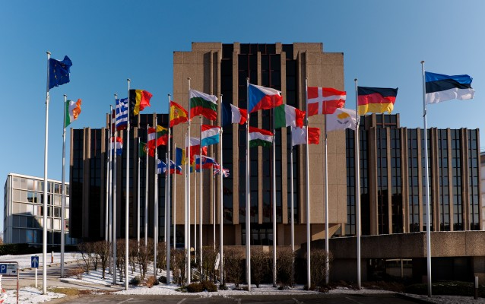
EUROPEAN COURT OF AUDITIORS

Slide 2
OVERVIEW
Role: To check EU funds are collected and used correctly, and help improve EU financial management.
President: Klaus-Heiner Lehne
Members: 1 from each EU country
Established in: 1977
Location: Luxembourg

Slide 3
What does the ECA do?
Audits EU revenue & expenditure, to check EU funds are correctly raised, spent, achieve value for money and accounted for.
Checks any person or organisation handling EU funds – including spot checks in EU institutions (especially the Commission), EU countries and countries receiving EU aid.
Writes up findings and recommendations in audit reports, for the European Commission and national governments.
Reports suspected fraud, corruption or other illegal activity to the European Anti-Fraud Office (OLAF)
Produces an annual report for the European Parliament and Council of the EU, which the Parliament examines before deciding whether to approve the Commission's handling of the EU budget.
Gives its expert opinion to EU policymakers on how EU finances could be better managed and made more accountable to citizens.

Slide 4
Also publishes opinions on preparatory legislation that will impact EU financial management, as well as position papers, reviews and ad hoc publications on EU public finance issues.
To be effective, the Court must be independent of the institutions and bodies it audits. To this end, it is free to decide on:
what it will audit
how to do this
how & when to present its findings
The Court's audit work focuses mainly on the European Commission – the main body responsible for implementing the EU budget. But it also works closely with national authorities, because the Commission manages most EU funds (around 80%) jointly with them.

Slide 5
Composition
Court members are appointed by the Council, after consulting the Parliament, for renewable 6-year terms. They choose one of their number as President for a 3-year term (also renewable).
How does the ECA work?
It carries out 3 types of audit:
Financial audits – checking that accounts accurately present the financial position, results and cash flow for the year.
Compliance audits – checking that financial transactions follow the rules.
Performance audits – checking that the EU funds achieve its goals with the fewest possible resources and in the most economical manner.
The Court is divided into audit groups called 'chambers'. They prepare reports & opinions for the Court members to adopt, thus making them official.

Slide 6
Governence
The ECA operates as a collegiate body of 28 Members, one from each Member State. The Members are appointed by the Council after consultation with the European Parliament for a renewable term of six years. Members elect one of their number as President for a renewable term of three years.
Organisation – chambers and committees
The ECA is organised into five chambers, to which Members and audit staff are assigned. The Members of each chamber elect a Dean for a renewable term of two years.
Each chamber has two areas of responsibility:
to adopt special reports, specific annual reports and opinions; and
to prepare the annual reports on the EU budget and the European Development Funds, for adoption by the Court as a whole.
The full Court of 28 Members meets around twice a month to discuss and adopt documents such as the ECA's main annual publications - the reports on the EU general budget and the European Development Funds.

Slide 7
President
The European Court of Auditors is headed by Klaus-Heiner Lehne, who was elected ECA’s 11th president.
He chairs ECA meetings and ensures that ECA decisions are implemented and that the institution and its activities are soundly managed.
The Members
The Members of the ECA are appointed by the Council, after consultation with the European Parliament, following nomination by their respective Member States. Members are appointed for a renewable term of six years. They are required to perform their duties in complete independence and in the general interest of the European Union.

Slide 8
The Secretary-General
The Secretary-General is the most senior member of ECA staff and is appointed to this role by the Court for a renewable period of six years. He or she is responsible for staff management and administration in the fields of human resources, finance and general services; information, workplace and innovation; and translation and language services.
The ECA's staff
The ECA has around 900 staff in audit, translation and administration. The audit staff have a broad range of professional backgrounds and experience in both the public and private sectors, including accountancy, financial management, internal and external audit, law and economics.

Slide 9
Transparency at the European Court of Auditors
As the guardian of the EU’s finances,they at the European Court of Auditors believe that the functioning of their institution should be transparent. This means disclosing information about their management and activities, and publishing the results of their audit work. In this way, they can help citizens gain a better understanding of how they fulfil their role and promote robust financial governance by holding to account those managing the EU budget.

