Slide 1
european bank for reconstruction and development
Stjepan Latić

Slide 2
EBRD - founding
The European Bank for Reconstruction and Development (EBRD) was established in London in April 1991. to help build a new, post-Cold War era in Central and Eastern Europe.
It has since played a historic role and gained unique expertise in fostering change in the region - and beyond -, investing more than €130 billion in a total of over 5,200 projects.

Slide 3
EBRD - GOAl
The European Bank for Reconstruction and Development (EBRD) helps businesses and economies thrive.
„Everything we do pursues the goal of advancing the transition to open, market economies, whilst fostering sustainable and inclusive growth.”
https://www.youtube.com/watch?v=VDcp_od5GN8

Slide 4
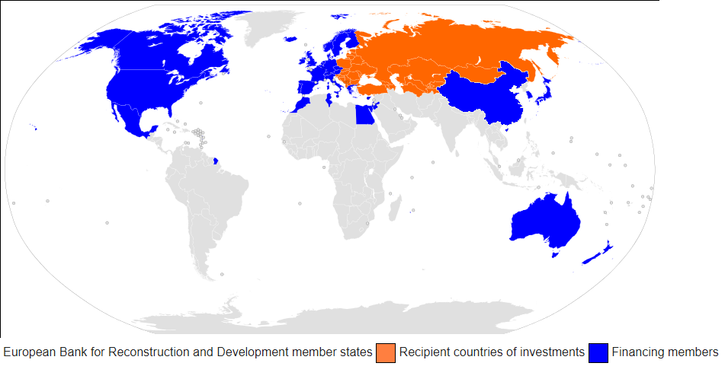
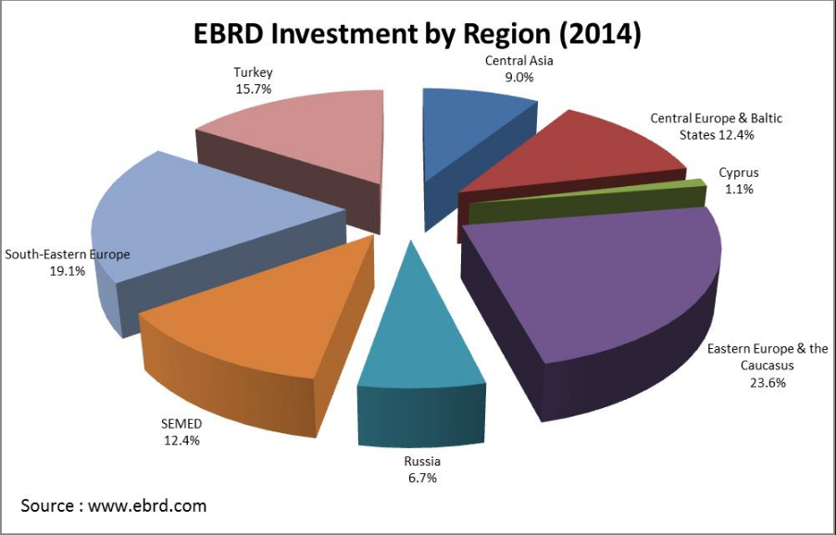
Investment regions
Countries investing

Slide 5
Sectors and topics :

