Slide 1
Customs as an important source of revenue
Created by Dorottya Dancsok

Slide 2
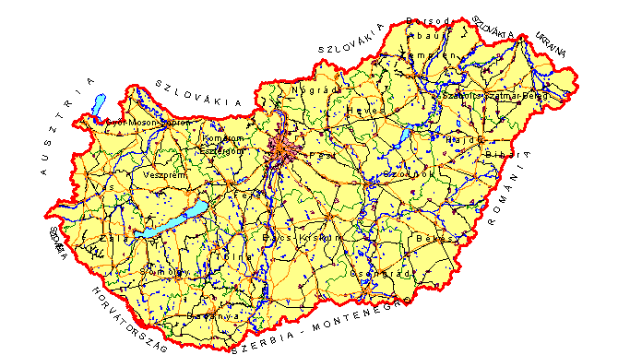
Duty
Tax
Border crossing
Goods
STOP

Slide 3
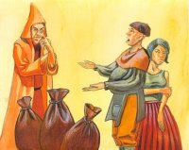
Origin:
Anciant Greece
Ports, bridges, city gates

Slide 4
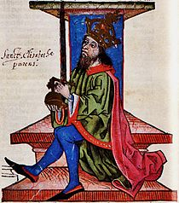
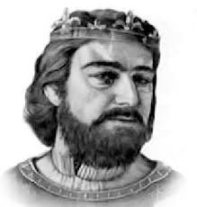
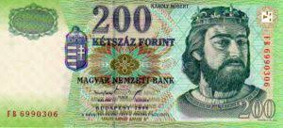
Hungarian origin:
II. Andras and his daughter
Thirtieth part duty
Robert Charles

Slide 5
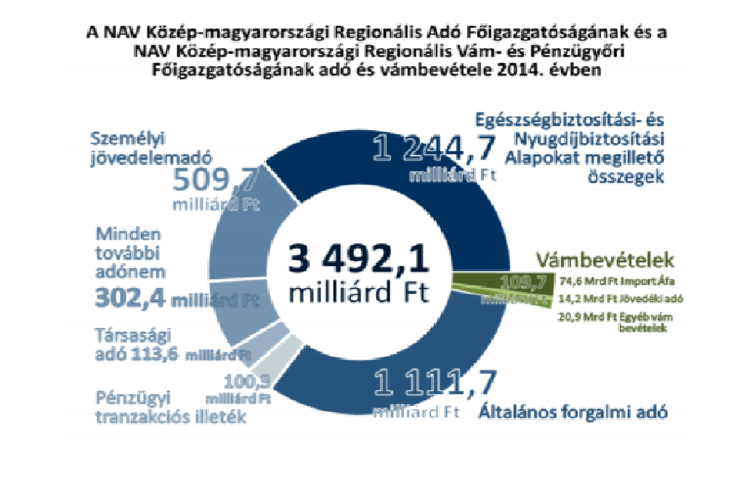
Types of Customs:
Protective duty
Fiscal duty
Important revenue

Slide 6
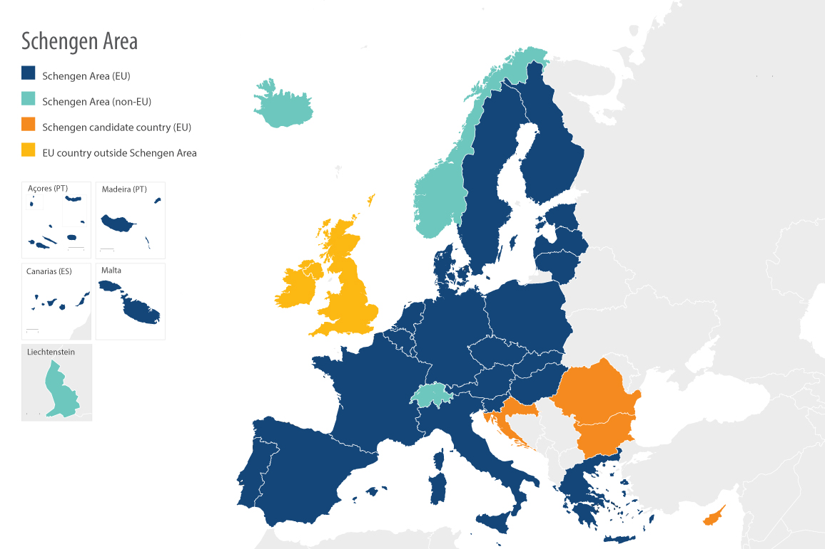
In Eu
Schengen
Boundaries

Slide 7
Thank you for your attention

