Slide 1
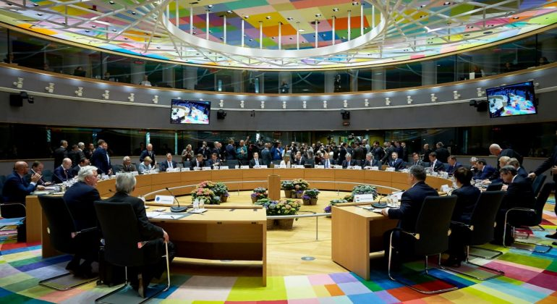
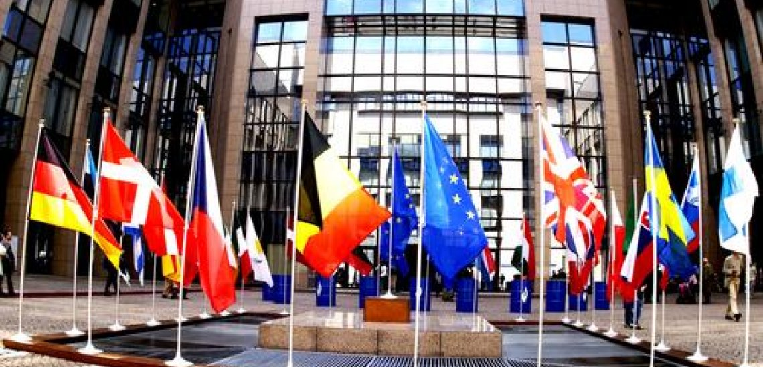
Council of the European Union

Slide 2
Role: Voice of EU member governments, adopting EU laws and coordinating EU policies
Members: Government ministers from each EU country, according to the policy area to be discussed
President: Each EU country holds the presidency on a 6-month rotating basis
Established in: 1958 (as Council of the European Economic Community)
Location: Brussels (Belgium)

Slide 3
In the Council, government ministers from each EU country meet to discuss, amend and adopt laws, and coordinate policies. The ministers have the authority to commit their governments to the actions agreed on in the meetings.
Together with the Europan Parlament,body of the EU.
Not to be confused with:
Europan Council - quarterly summits, where EU leaders meet to set the broad direction of EU policy making
Council of Europe - not an EU body at all.

Slide 4
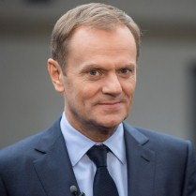
President
Donald Tusk

Slide 5
What does the Council do?
Negotiates and adopts EU laws, together with the Europan Parlament,, based on proposals from the Europan Commission
Coordinates EU countries' policies
Develops the EU's foreign & security policy, based on Europan Council guidelines
Concludes agreements between the EU and other countries or international organisations
Adopts the annual EU Budget - jointly with the European Parliament.

Slide 6
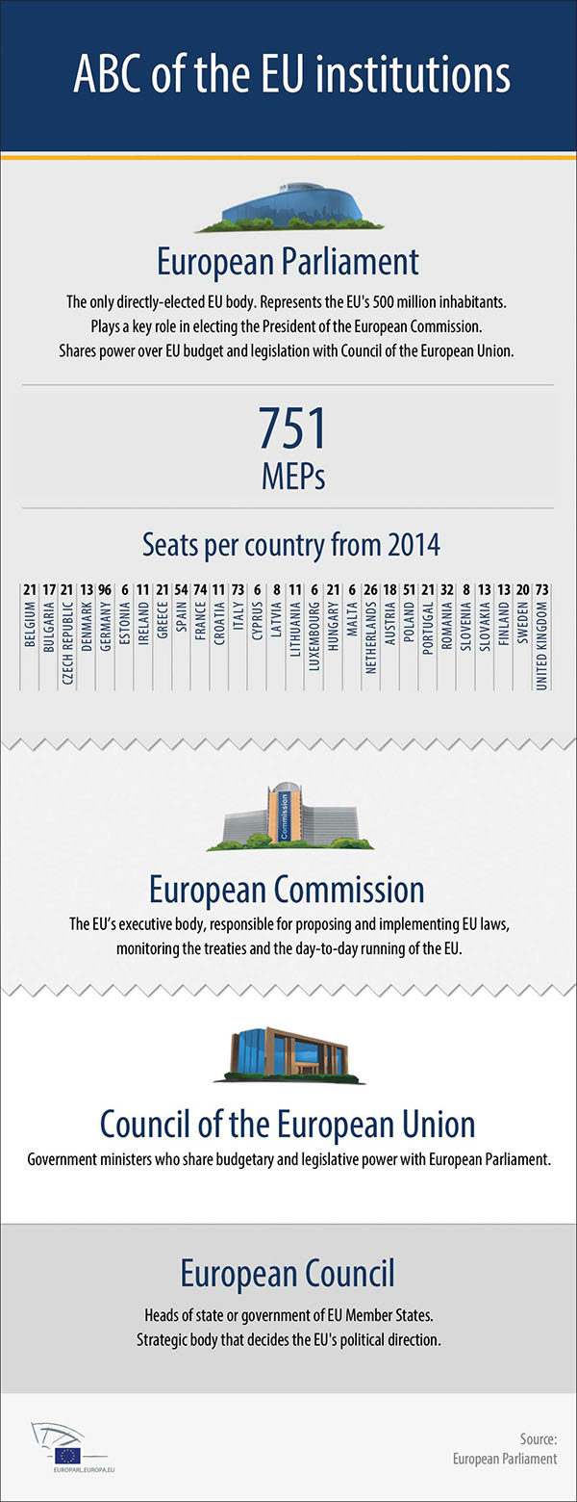
What does the Parliament do and what are the responsibilities of the Commission? What do we mean with the European Council and how is it different from the Council of the European Union?

Slide 7
Composition
There are no fixed members of the EU Council. Instead, the Council meets in 10 different configurations, each corresponding to the policy area being discussed. Depending on the configuration, each country sends their minister responsible for that policy area.
For example, when the Council meeting on economic and financial affairs (the "Ecofin Council") is held, it is attended by each country's finance minister.

Slide 8
Who chairs the meetings?
The Foreign Affairs Council has a permanent chairperson - the EU High Representative for Foreign Affairs and Security Policy. All other Council meetings are chaired by the relevant minister of the country holding the rotating EU presidency.
For example, any Environment Council meeting in the period when Estonia holds the presidency will be chaired by the Estonian environment minister.
Overall consistency is ensured by the General Affairs Council - which is supported by the Permanent Representatives Committee. This is composed of EU countries' Permanent Representatives to the EU, who are, in effect, national ambassadors to the EU.

Slide 9
Eurozone countries
Eurozone countries coordinate their economic policy through the Eurogroup, which consists of their economy and finance ministers. It meets the day before Economic & Financial Affairs Council meetings. Agreements reached in Eurogroup gatherings are formally decided upon in the Council the next day, with only ministers of Eurozone countries voting on those issues.

Slide 10
How does the Council work?
All discussions & votes take place in public.
To be passed, decisions usually require a qualified majority :
55% of countries (with 28 current members, this means 16 countries)
representing at least 65 % of total EU population.
To block a decision, at least 4 countries are needed (representing at least 35% of total EU population)
Exception - sensitive topics like foreign policy and taxation require a unanimous vote (all countries in favour).
Simple majority is required for procedural & administrative issues

Slide 11
The European Council
The European Council defines the EU's overall political direction and priorities. It is not one of the EU's legislating institutions, so does not negotiate or adopt EU laws. Instead it sets the EU's policy agenda, traditionally by adopting 'conclusions' during European Council meetings which identify issues of concern and actions to take.
More recently, the European Council adopted a 'strategic agenda' of priority areas for longer-term EU action and focus.

Slide 12
Members of the European Council
The members of the European Council are the heads of state or government of the 28 EU member states, the European Council President and the President of the European Commission. The High Representative of the Union for Foreign Affairs and Security Policy also takes part in European Council meetings when foreign affairs issues are discussed.
Decision-Making Process
The European Council mostly takes its decisions by consensus. However, in certain specific cases outlined in the EU treaties, it decides by unanimity or by qualified majority.
If a vote is taken, neither the European Council President nor the Commission President take part.

Slide 13
What does the Council of the EU do?
1. Negotiates and adopts EU laws
2. Coordinates member states' policies
3. Develops the EU's common foreign and security policy
4. Concludes international agreements
5. Adopts the EU budget

