Slide 1
Banknotes, coins, security features and symbols

Slide 2
Current payment instruments in Hungary

Slide 3
Coins

Slide 4
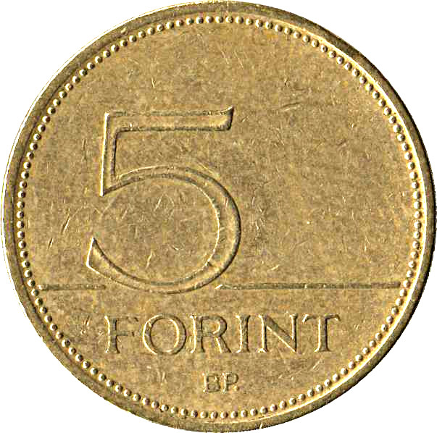
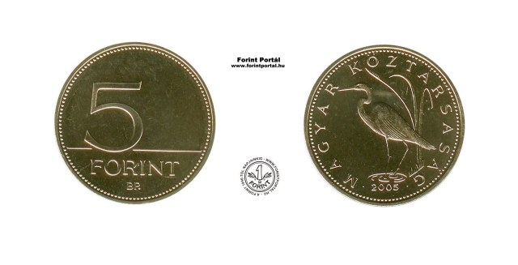
Coins
5 Forint
0.11 Kuna
0.09 Lira
0.01 Euro

Slide 5
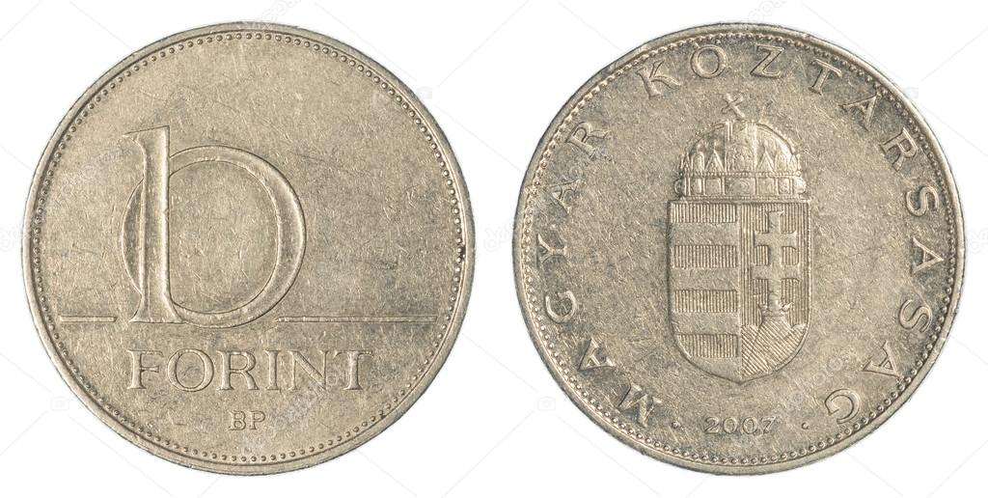
Coins
10 Forint
0.22 Kuna
0.18 Lira
0.03 Euro

Slide 6
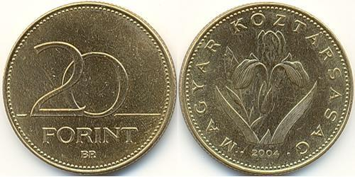
Coins
20 Forint
0.44 Kuna
0.36 Lira
0.06 Euro

Slide 7
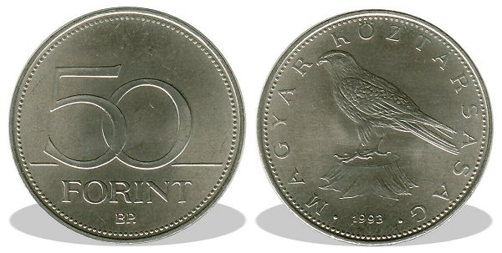
Coins
50 Forint
1.1 Kuna
0.9 Lira
0.15 Euro

Slide 8
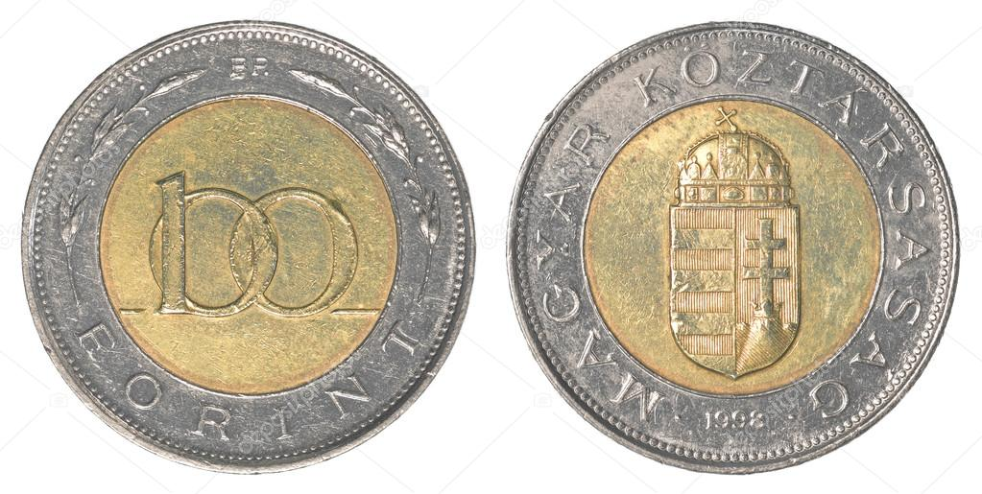
Coins
100 Forint
2.2 Kuna
1.8 Lira
0.3 Euro

Slide 9
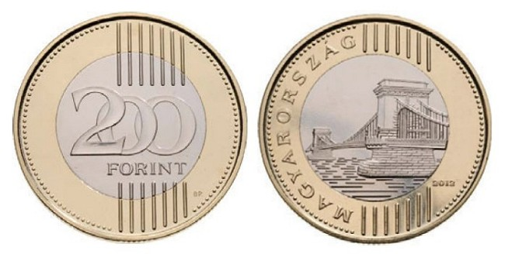
Coins
200 Forint
4.5 Kuna
3.6 Lira
0.6 Euro

Slide 10
Notes

Slide 11
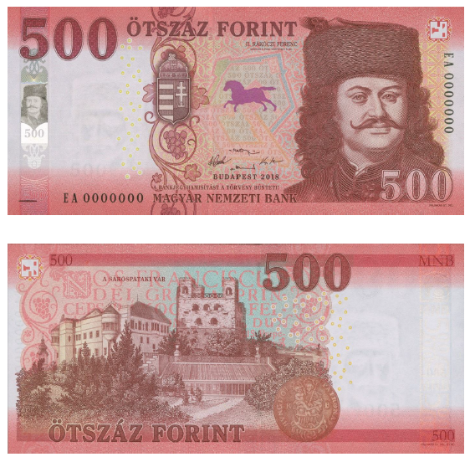
Notes
500 Forint
11 Kuna
9 Lira
1.5 Euro

Slide 12
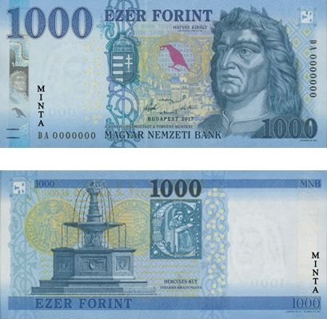
Notes
1,000 Forint
23 Kuna
18 Lira
3 Euro
minta = sample

Slide 13
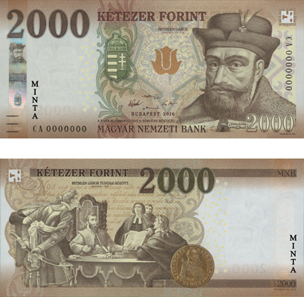
Notes
2,000 Forint
45 Kuna
36 Lira
6 Euro
minta = sample

Slide 14
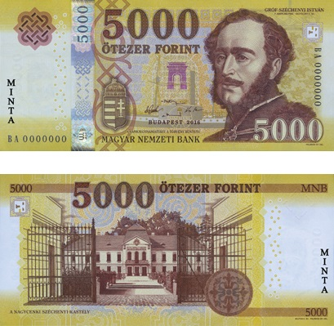
Notes
5,000 Forint
114 Kuna
91 Lira
15 Euro
minta = sample

Slide 15
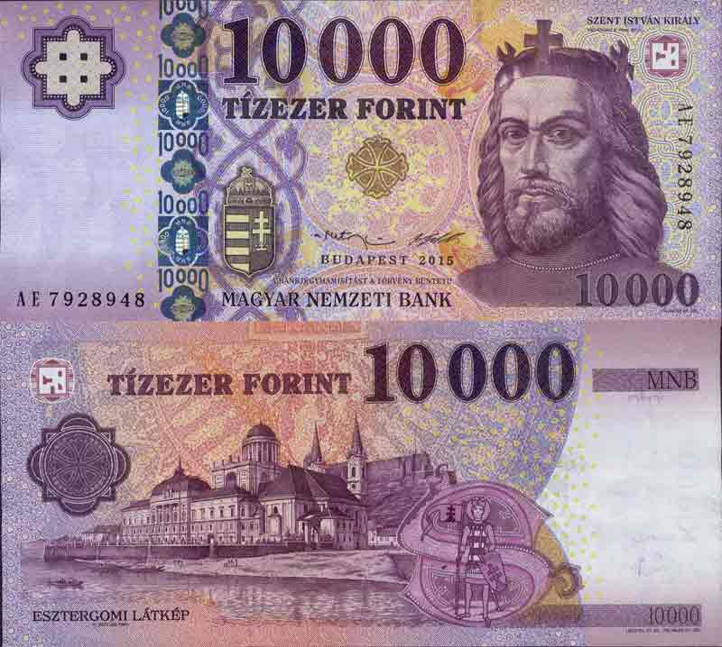
Notes
10,000 Forint
228 Kuna
181 Lira
31 Euro

Slide 16
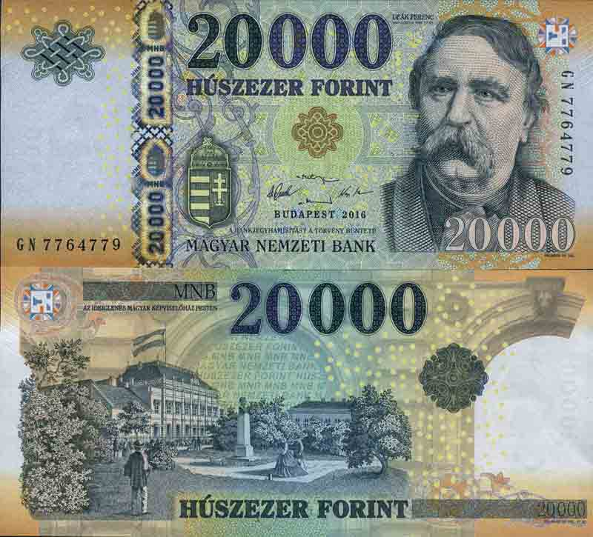
Notes
20,000 Forint
455 Kuna
363 Lira
61.5 Euro

Slide 17
Security elements on banknotes

Slide 18
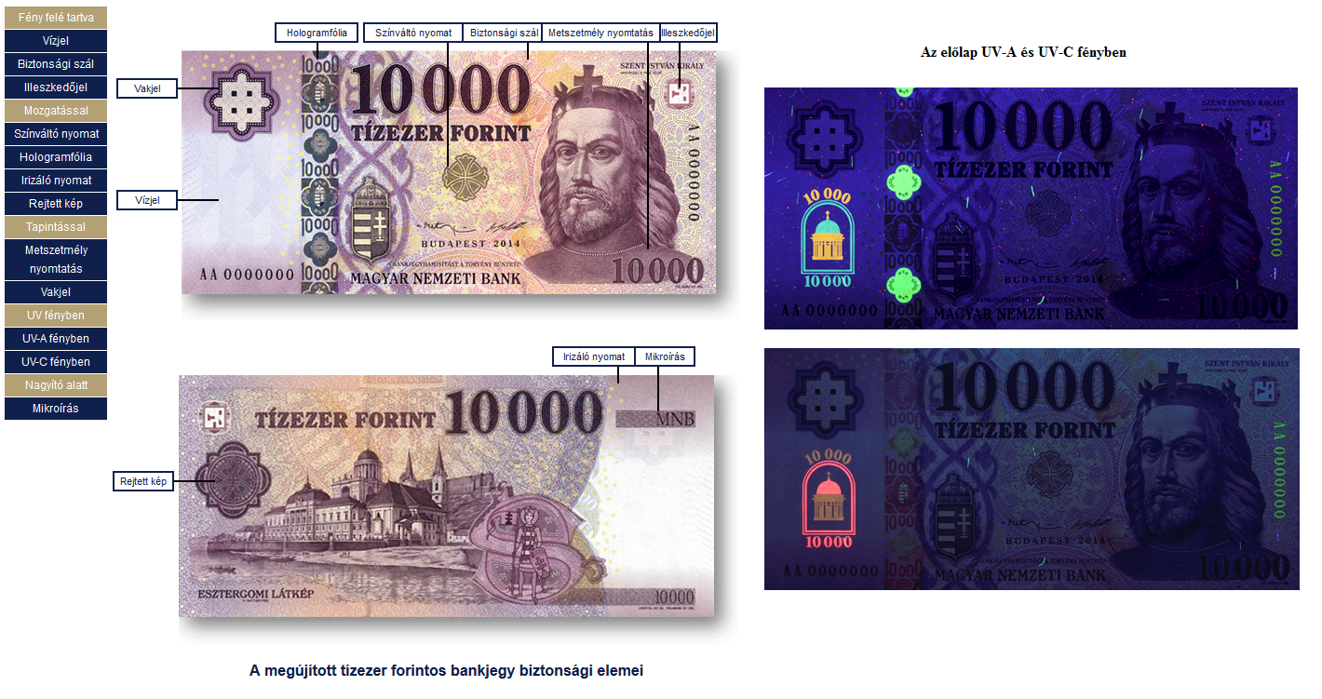
Hologram foil
Color-changing print
Security thread
Engraving printing
Fitting symbol
Front panel in UV-A and UV-C light
Blind signal
Watermark
Iridescent print
Microprinting
Hidden picture
Renewed ten thousand forint banknote

Slide 19
Thank you for you attention!

