Slide 1
Guess the banknote!

Slide 2
1.

Slide 3
2.

Slide 4
3.

Slide 5
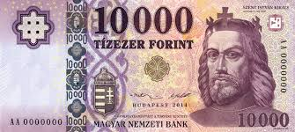
4.

Slide 6
5.

